Slide 1
Chinese Classical Architecture

Slide 2
一
二
三
四
五
Chinese
Classical
Garden
Palace
Pagoda
Bridge
Temple
Content

Slide 3
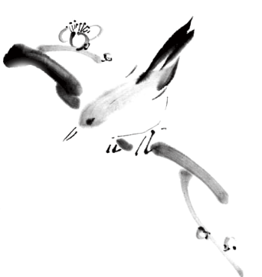
一

Slide 4
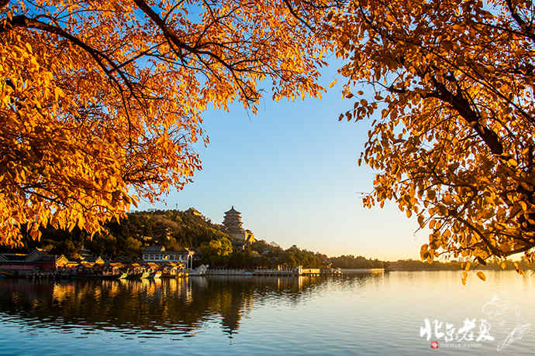
Chinese Classical Gardens
一
Brief Introduction
二
Classification
三
Models for royal and private gardens
四
The Comparison

Slide 5
一
Brief Introduction
The Chinese garden, also known as a Chinese classical garden, recreates natural landscapes in miniature. The style has evolved for more than three thousand years. The classical Chinese garden is enclosed by a wall and has one or more ponds, a rock garden, trees and flowers, and an assortment of halls and pavilions within the garden, connected by winding paths and zig-zag galleries. Chinese garden, and its associated garden culture are expressions of Chinese landscape architecture aesthetics(美学),which is an important part of Chinese culture. We should preserve them and learn the ways of keeping a harmonious relationship between human and nature.

Slide 6
the Classification
Chinese Classical Gardens
二
Imperial Gardens （皇家园林））
Private Gardens （私家园林）
Landscape Gardens （风景名胜园林）
Temple Gardens（寺庙园林）

Slide 7
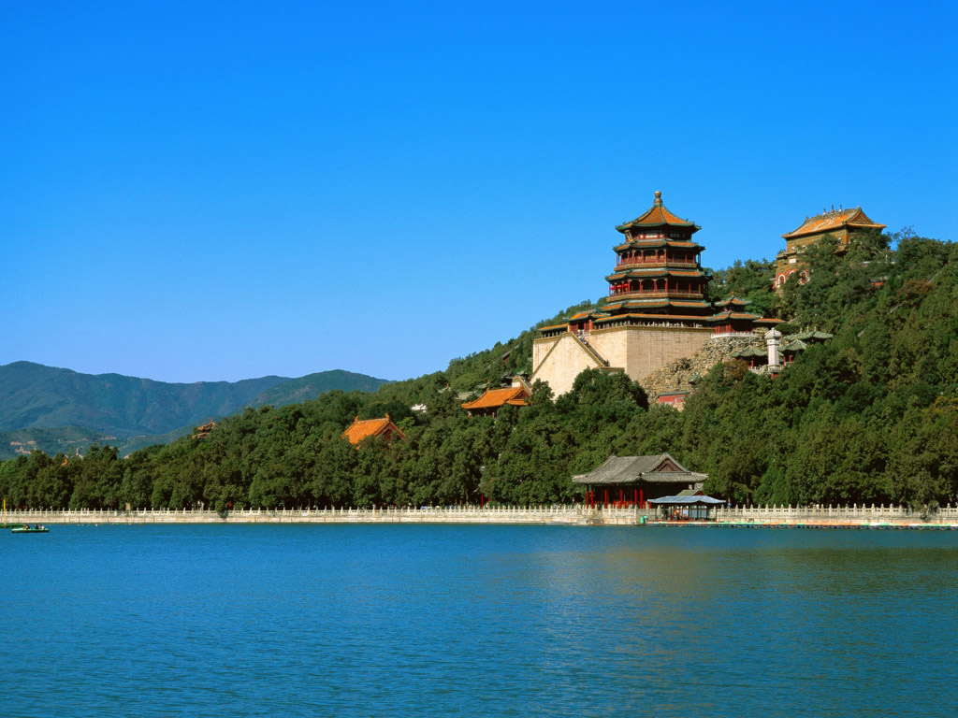
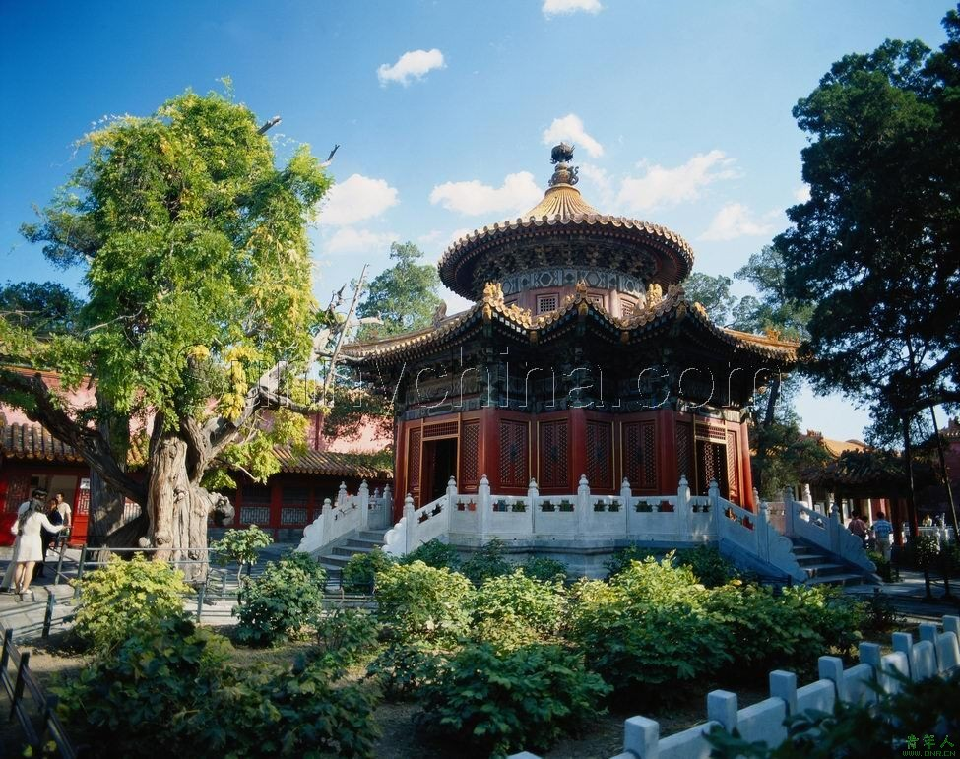
◆ Imperial Gardens
Owned by ancient Chinese emperors.
Beihai Park ; the Summer Palace ;
the Mountain Resort in Chengde

Slide 8
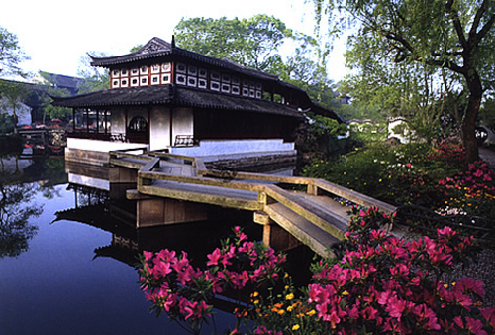
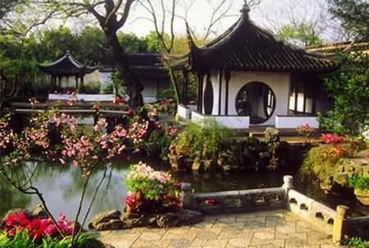
◆ Private Gardens
Owned mainly by the painters, the poets, and other scholars.

Slide 9
◆ Private Gardens
Famous Private Gardens in Suzhou:
Humble Administrator‘s Garden
Lingering Garden
Master of the Nets Garden (网师园)
Lion Grove Garden (狮子林)
Famous Private Gardens in Yangzhou:
Geyuan Garden(个园)
Heyuan Garden (何园)

Slide 10
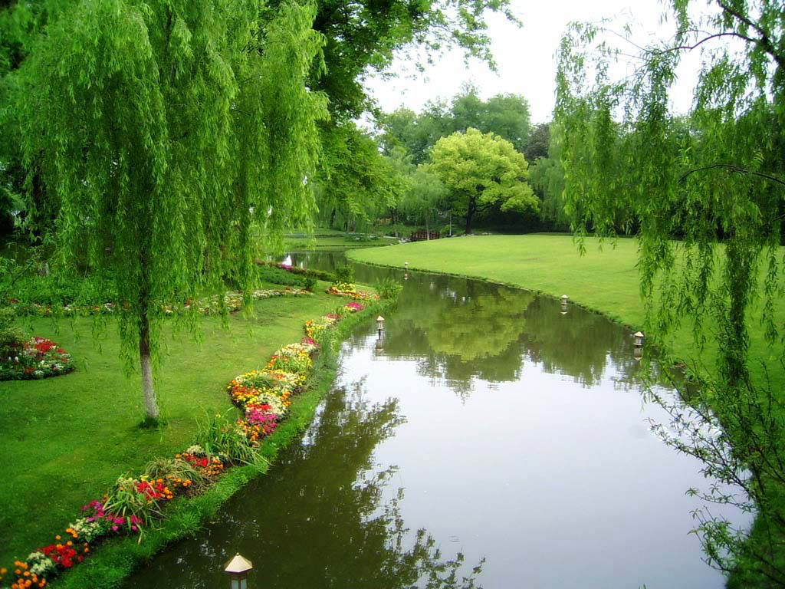
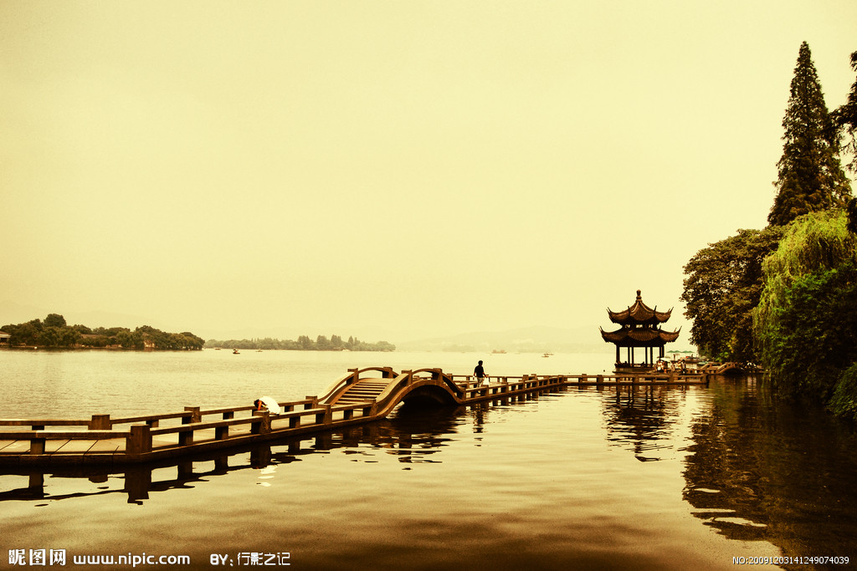
◆ Landscape Gardens
Places for public recreation.
West Lake ; Daming Lake

Slide 11
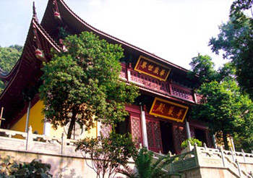
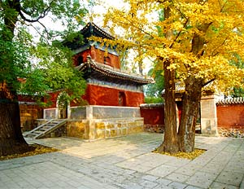
◆ Temple Gardens

Slide 12
the Classification
Chinese Classical Gardens
Due to political, economic, culture and geographic differencs, royal gardens and private gardens differ greatly from each other in size, structure and color.
After the learning, please make the conclusion about the differences between them.

Slide 13
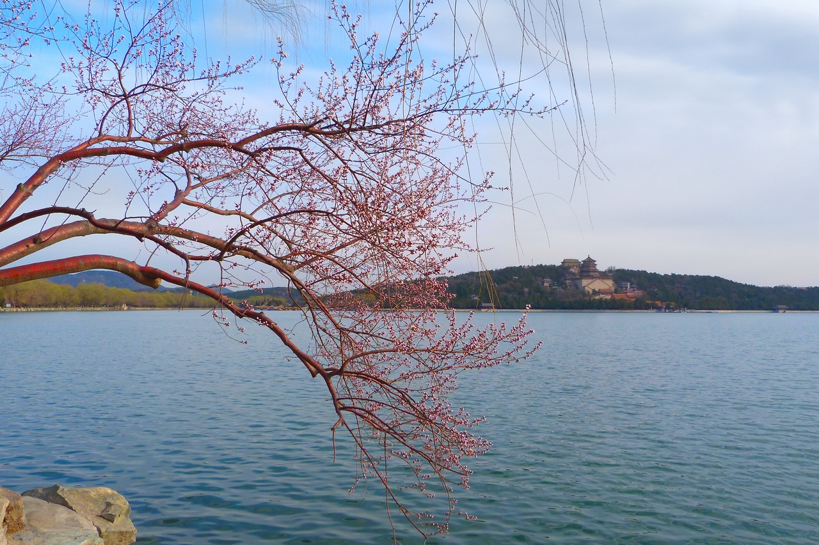
Chinese Classical Gardens
三
Model for royal and private gardens
1. The model of Royal garden : Summer Palace in Spring

Slide 14
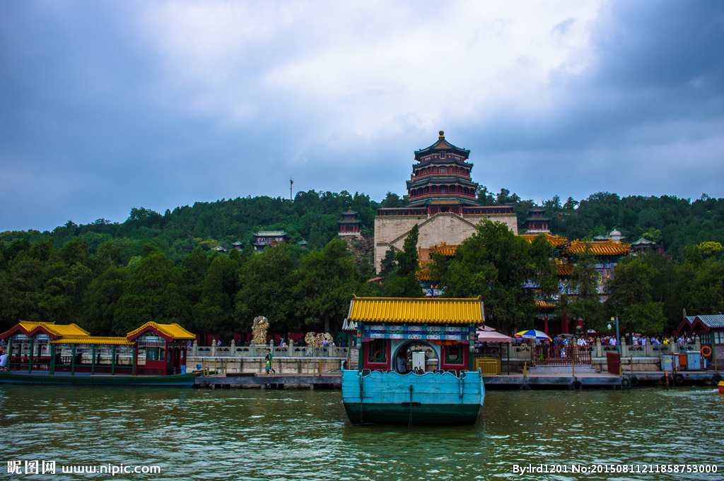
Chinese Classical Gardens
Model for royal and private gardens
1. The model of Royal garden: Summer Palace in summer

Slide 15
Chinese Classical Gardens
Model for royal and private gardens
1. The model of Royal garden : Summer Palace in autumn

Slide 16
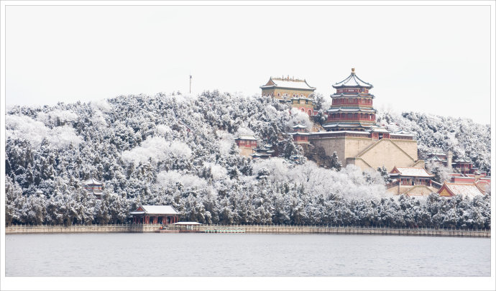
Chinese Classical Gardens
Model for royal and private gardens
1. The model of Royal garden : Summer Palace in winter

Slide 17
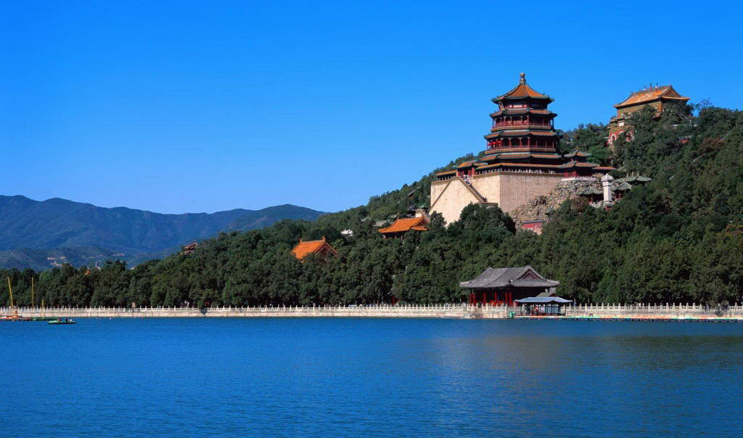
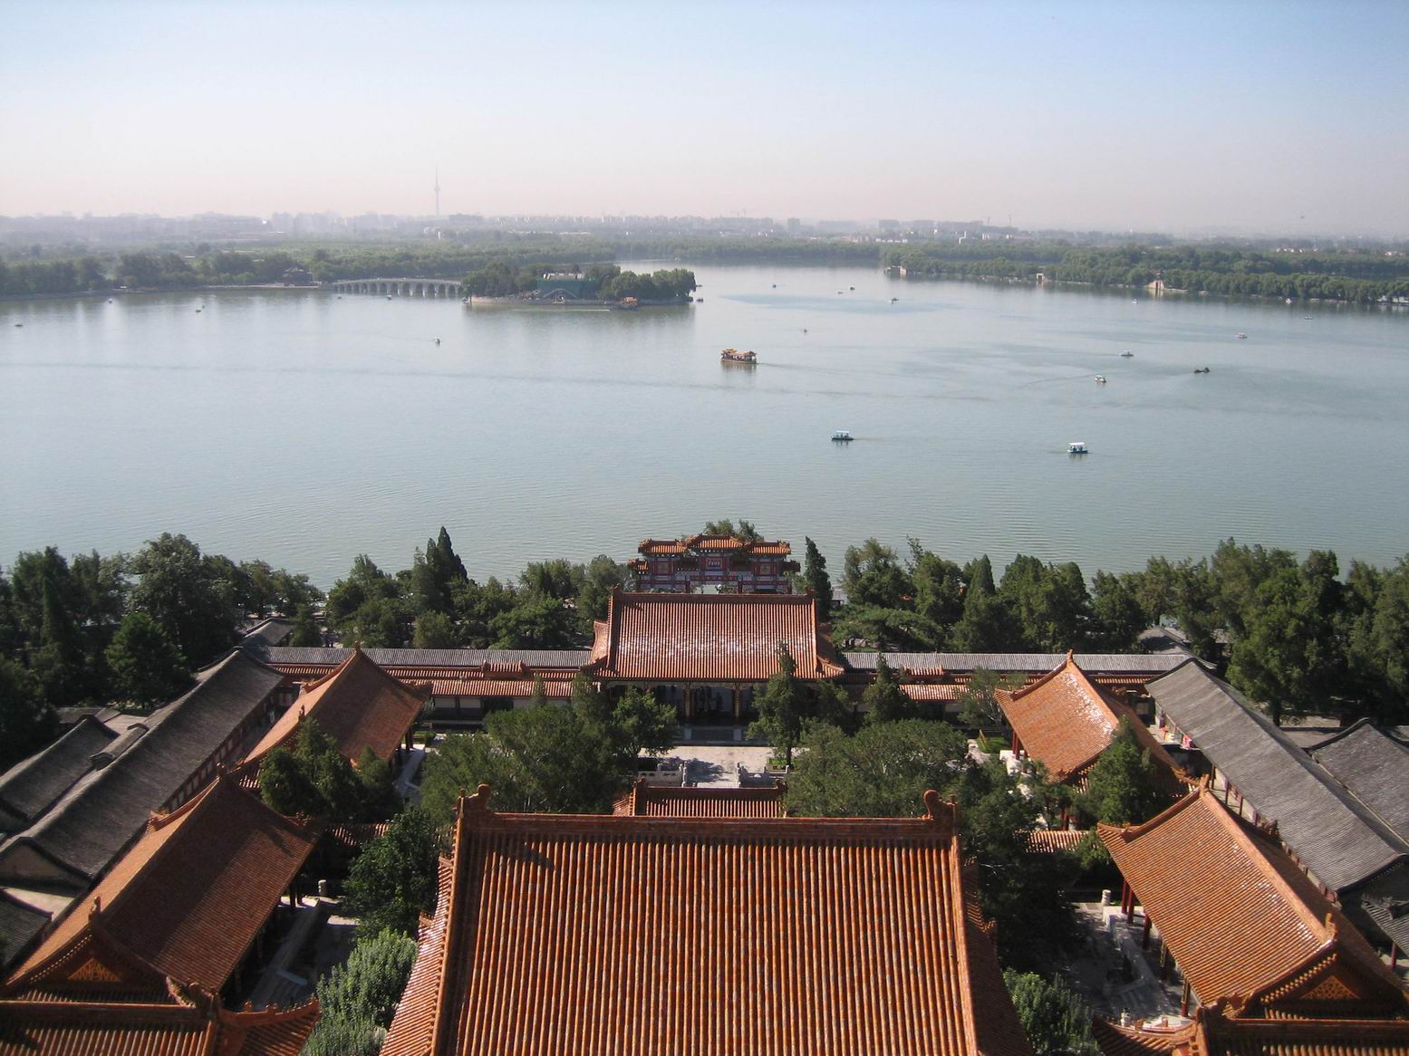
Model for royal and private gardens
Chinese Classical Gardens
1. The model of Royal garden : Summer Palace

Slide 18
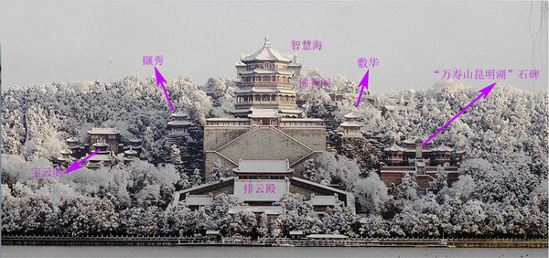
Model for royal and private gardens
Chinese Classical Gardens
2.Structure of the Summer Palace:
(1) The center of Summer Palace is the Longevity Hill.
The Tower of Buddhist Incense
The Tablet of Kunming Lake
The Belvedere of
Treasured Clouds
The Hall of Dispelling Clouds

Slide 19
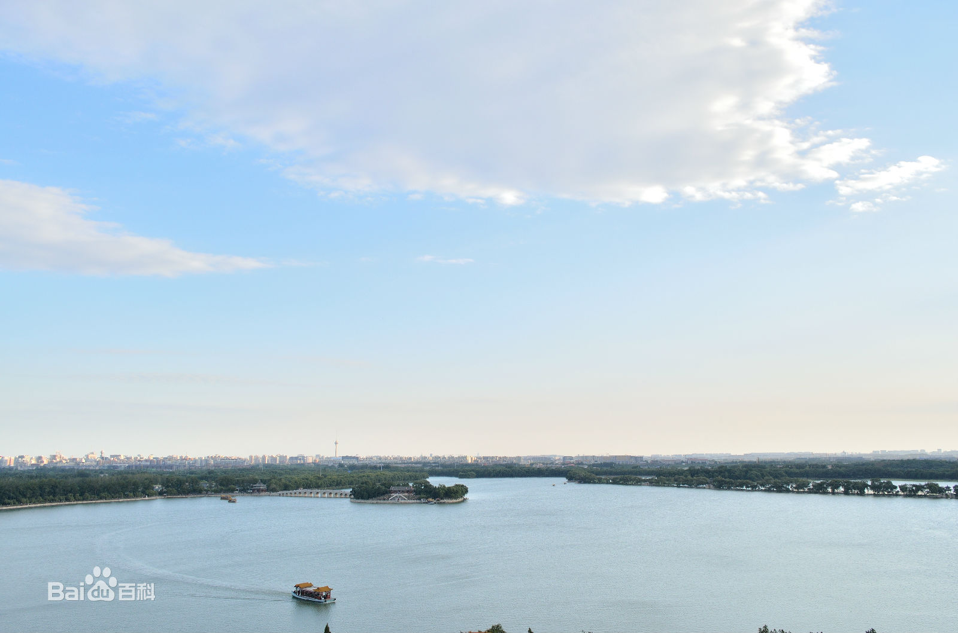
Model for royal and private gardens
Chinese Classical Gardens
2.Structure of the Summer Palace:
(2) The southern part is mainly composed of the Kunming Lake with open water.

Slide 20
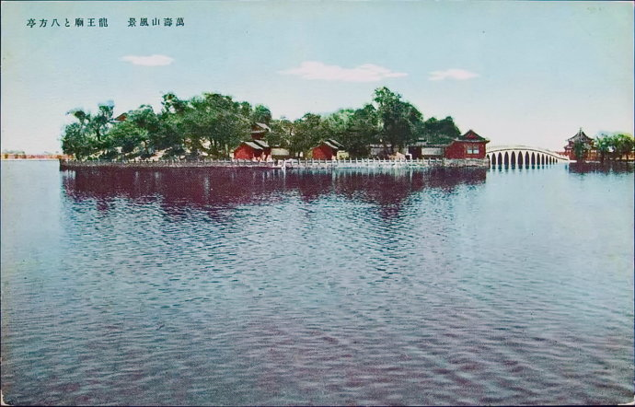
Model for royal and private gardens
Chinese Classical Gardens
2.Structure of the Summer Palace:
(3) The Dragon King Island is the scenery opposite of _____________, and it is also the garden within the garden.
Longevity Hill

Slide 21
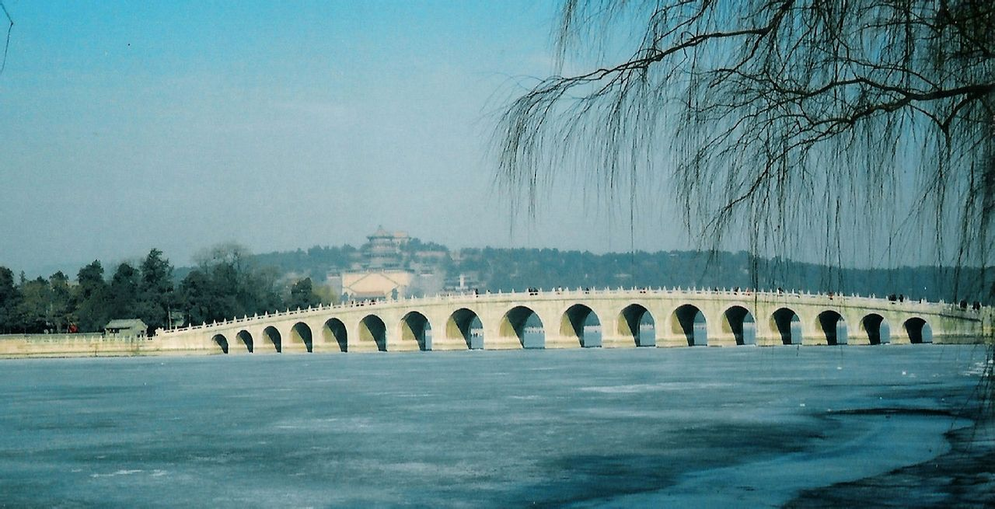
Model for royal and private gardens
Chinese Classical Gardens
2.Structure of the Summer Palace:
(4) The seventeen-Arch Bridge links the island to the East Bank.

Slide 22
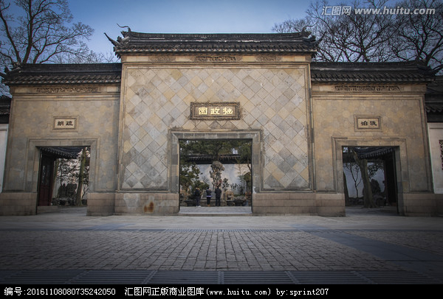
Model for royal and private gardens
Chinese Classical Gardens
3.The model of Private garden: Humble Administrator’s Garden

Slide 23
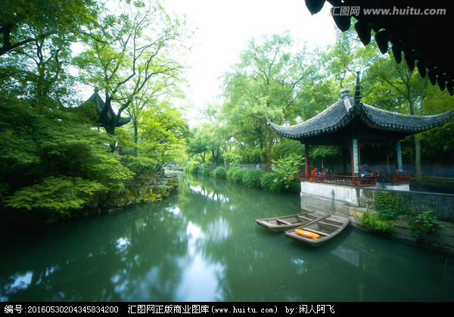
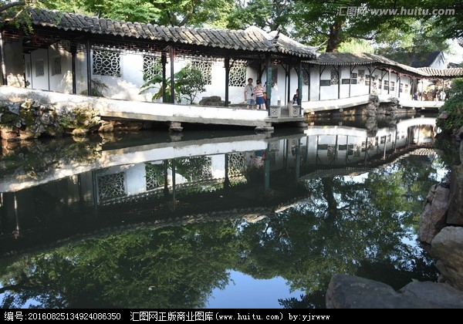
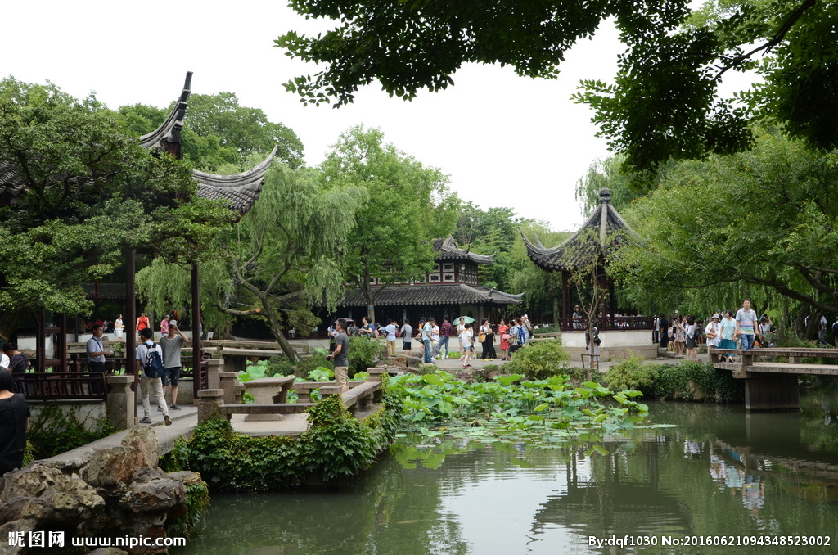
Model for royal and private gardens
Chinese Classical Gardens
4. Structure of Humble Administrator’s Garden:
(1) It is well-known for the waterscape.

Slide 24
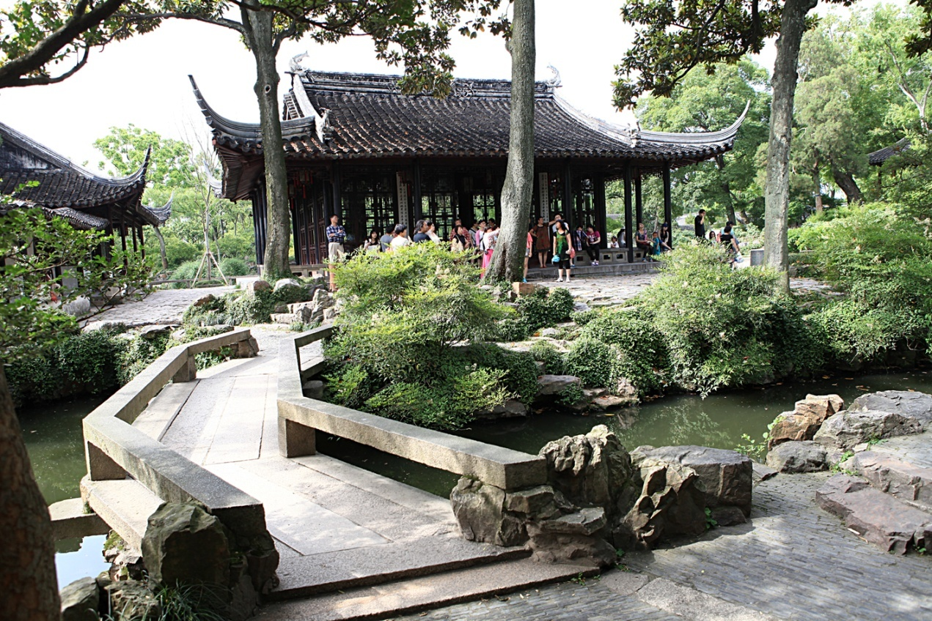
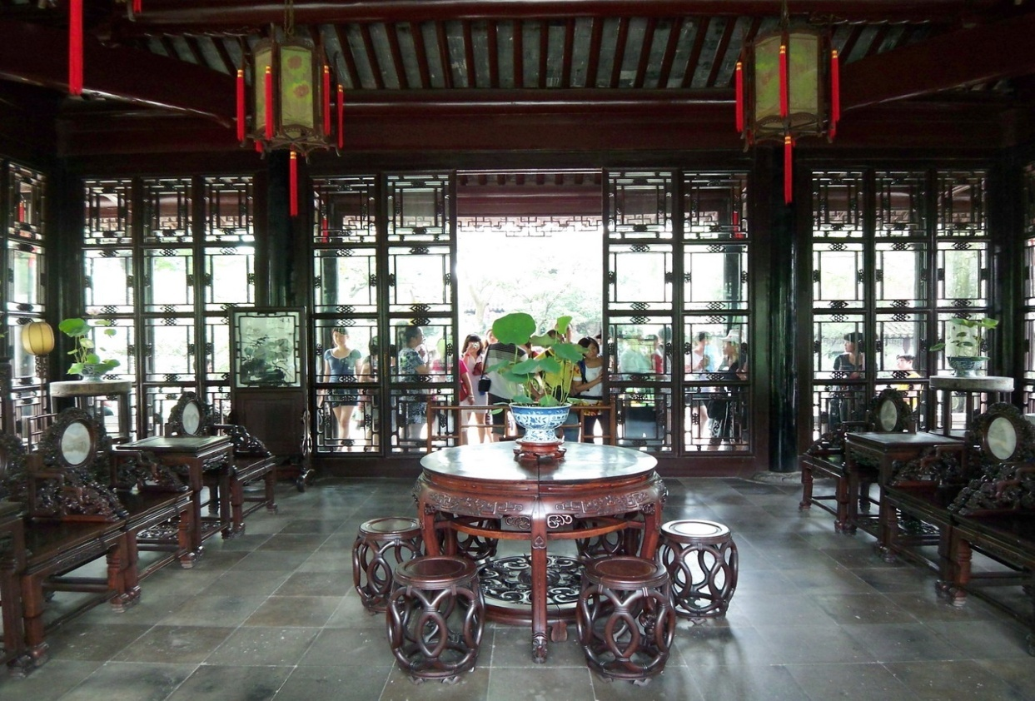
Model for royal and private gardens
Chinese Classical Gardens
4. Structure of Humble Administrator’s Garden:
(2) The main attraction is the Yuanxiang Hall.

Slide 25
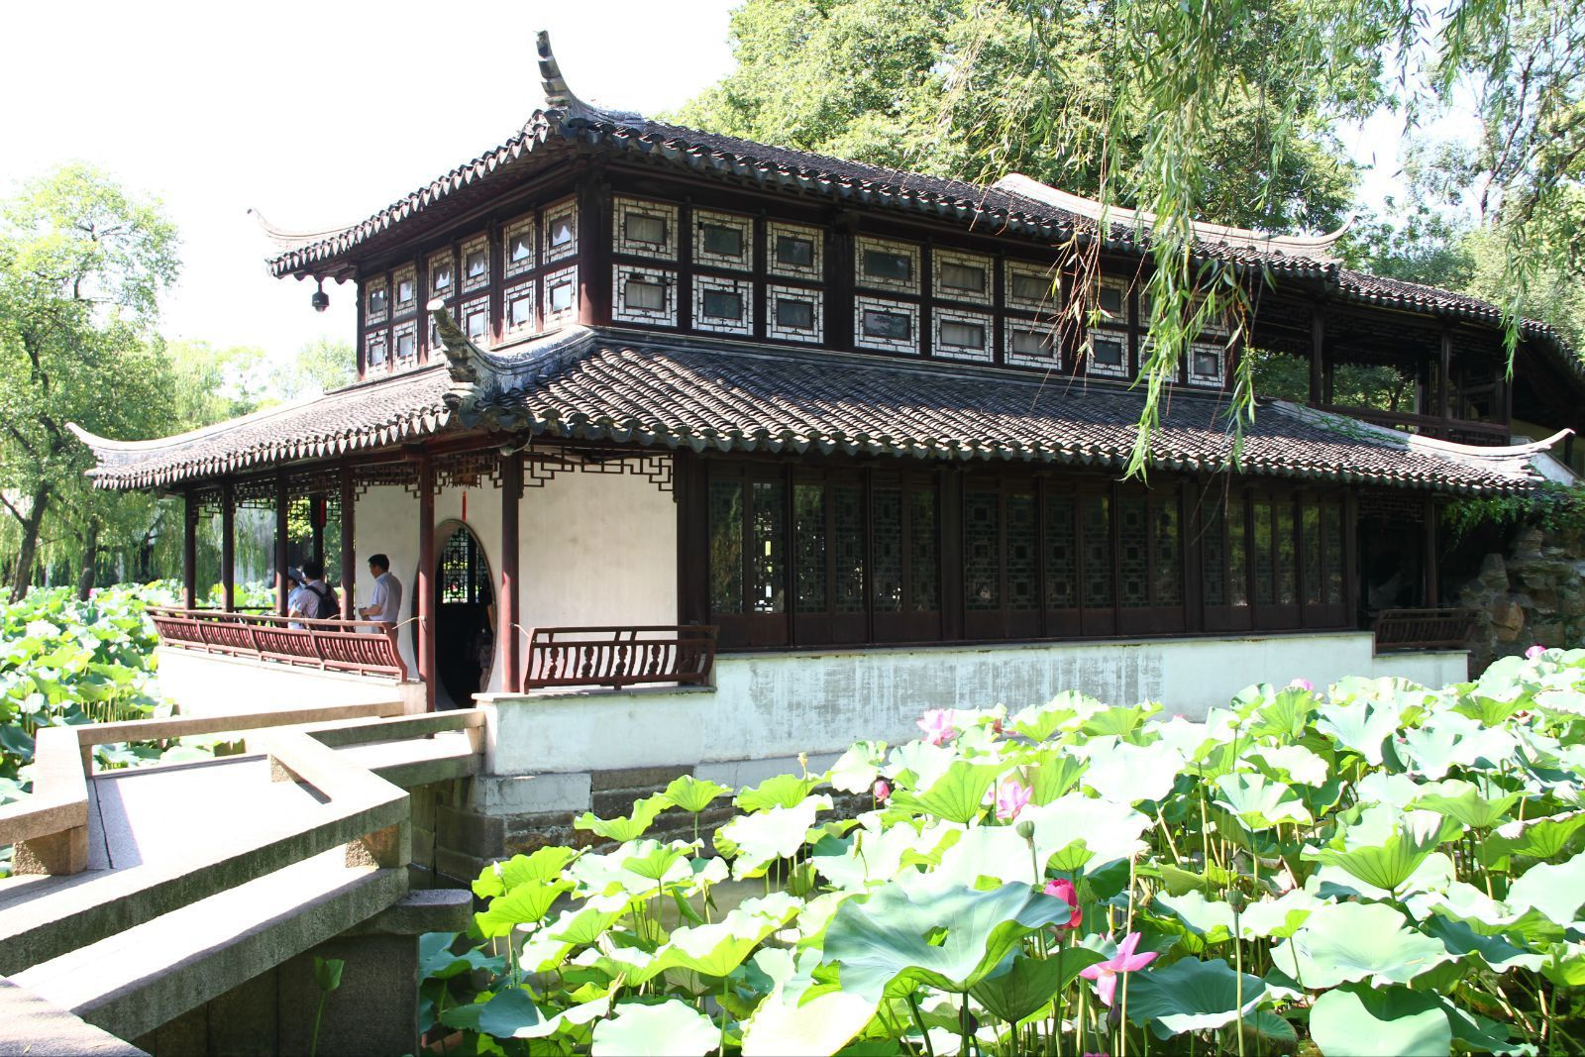
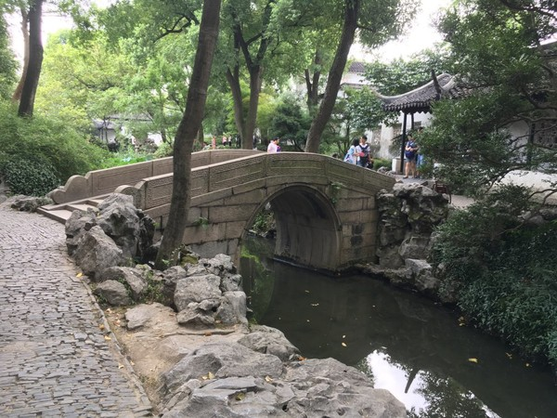
Model for royal and private gardens
Chinese Classical Gardens
4. Structure of Humble Administrator’s Garden:
(3) The scenic spots are linked with each other by zigzag verandas and small bridges.

Slide 26
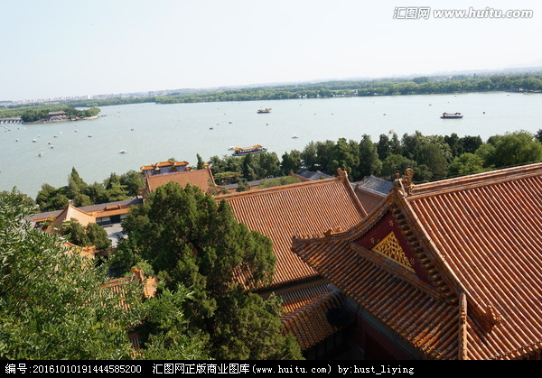
Model for royal and private gardens
Question: Are they royal or private garden?
Chinese Classical Gardens
Royal
Private

Slide 27
Model for royal and private gardens
Question: Are they royal or private garden?
Chinese Classical Gardens
Royal
Private

Slide 28
Model for royal and private gardens
Chinese Classical Gardens
5. Please answer the questions：
(1) What are essential elements in Chinese classical gardens?
Waterscape; Hall as the main attraction; Bridges as the link; Artificial
mountains and rock gardens; Flowers and trees.
Chinese gardens harmoniously combine water, plants and buildings.
(2) What are the differencs between royal and private gardens?
Royal garden is famous for magnificance, neat formation and gorgeousness
while the private garden being loved for their exquisteness, free design and elegance.

Slide 29
◆ Private Gardens
Chinese Classical Gardens
Famous Private Gardens in Suzhou:
Humble Administrator‘s Garden
Lingering Garden
Master of the Nets Garden (网师园)
Lion Grove Garden (狮子林)
Famous Private Gardens in Yangzhou:
Geyuan Garden(个园)
Heyuan Garden (何园)

Slide 30
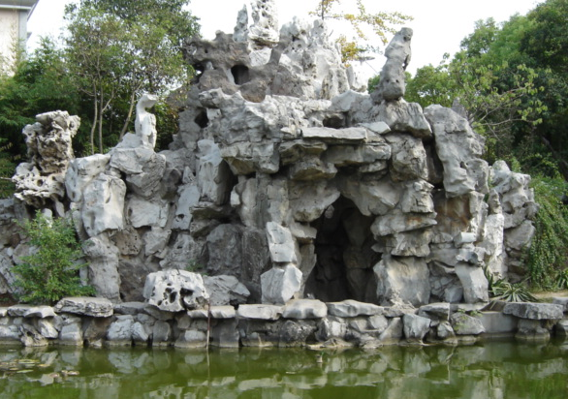
the Elements & Design
Chinese Classical Gardens
■ the rock
The artificial mountain (假山) or rock garden is an integral(必需的) element of Chinese classical gardens.
pile up the rock hills
single standing rocks
make the bonsai(盆景)

Slide 31
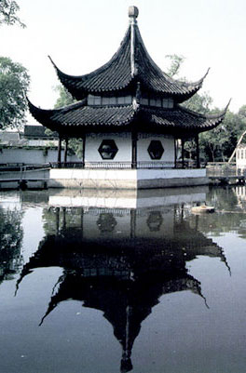
the Elements & Design
Chinese Classical Gardens
■ the water
Water is used in the Chinese private gardens：
for its physical beauty
for its important symbols

Slide 32
the Elements & Design
Chinese Classical Gardens
■ the flowers and trees
They represent nature in its most vivid form, and contrast with the straight lines of the architecture and immobility(静止) of the rocks.
"Three Friends of Winter" (歲寒三友).
Pine
bamboo
Chinese plum (梅)
— persistence(坚韧不拔), humble, dignity

Slide 33
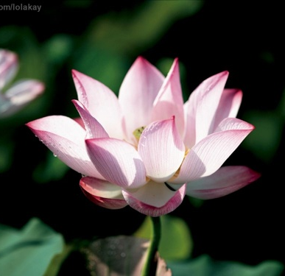
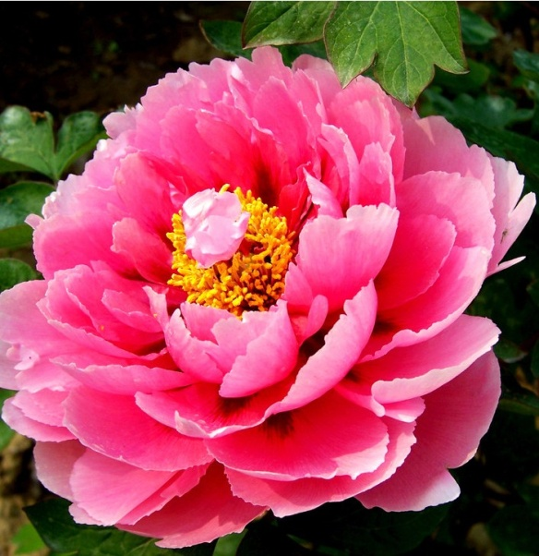
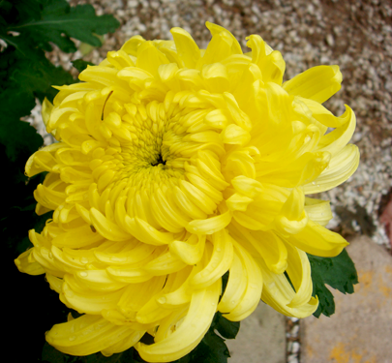
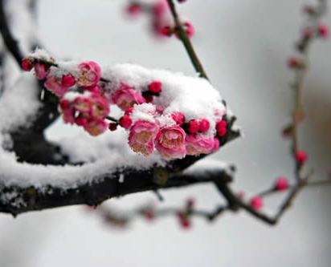
the Elements & Design
lotus (莲花)
purity
peony(牡丹)
wealth
chrysanthemum
splendor
plum blossoms
strength of will
willow（柳树）
peach ……

Slide 34
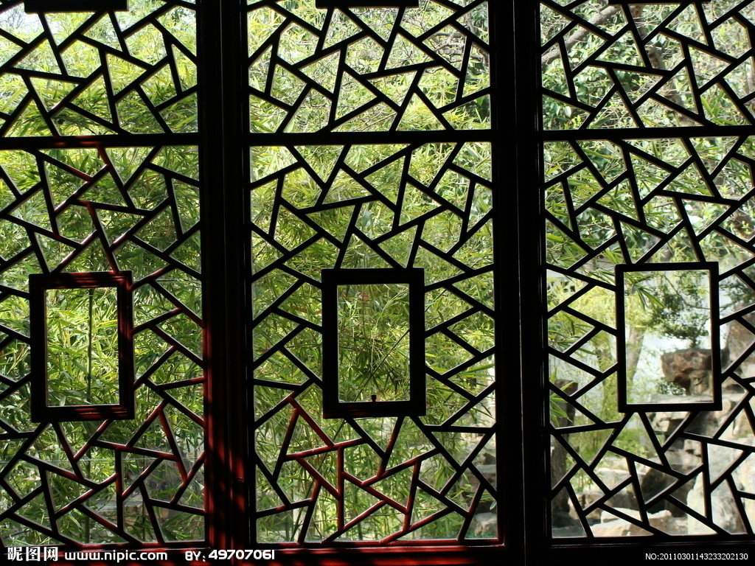
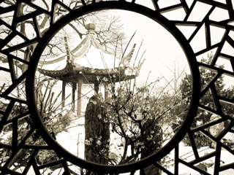
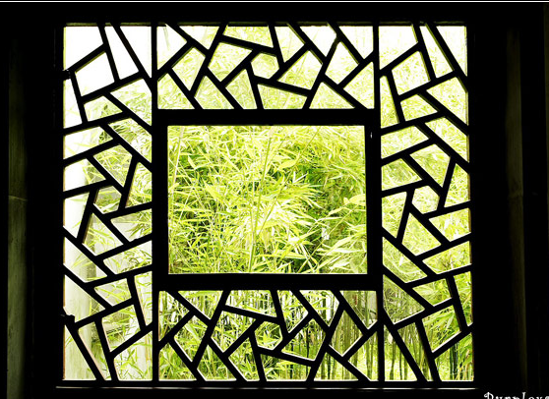
Chinese Classical Gardens
the Elements & Design
■ Architecture
Window

Slide 35
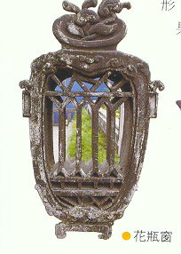
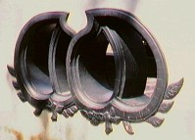
Chinese Classical Gardens
Window

Slide 36
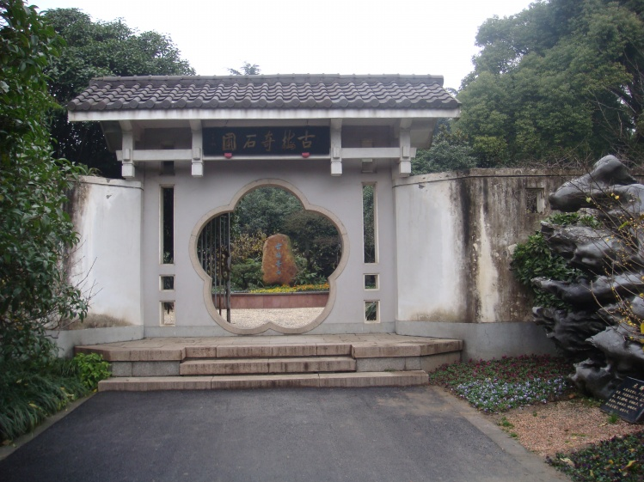
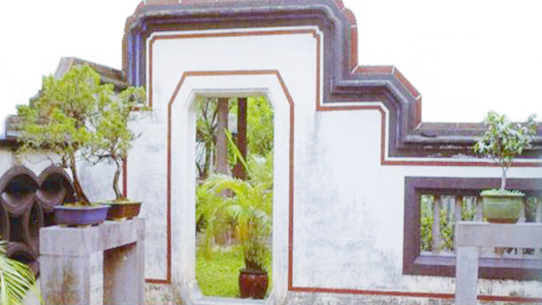
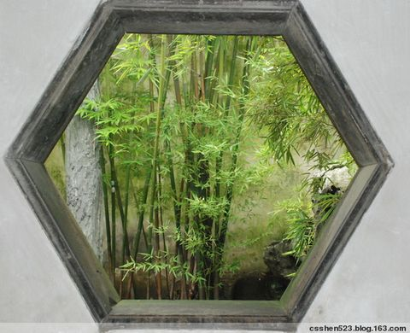
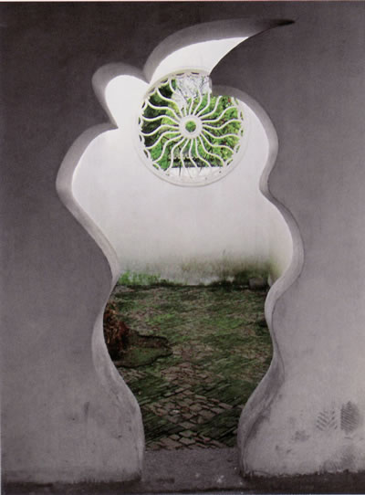
Door

Slide 37
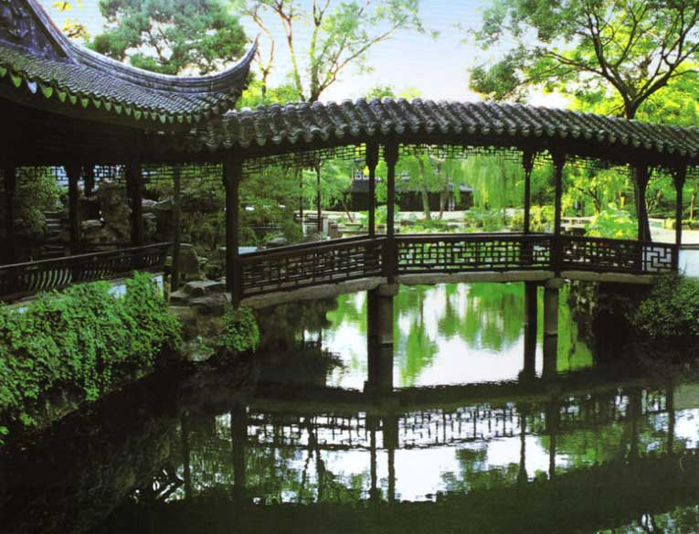
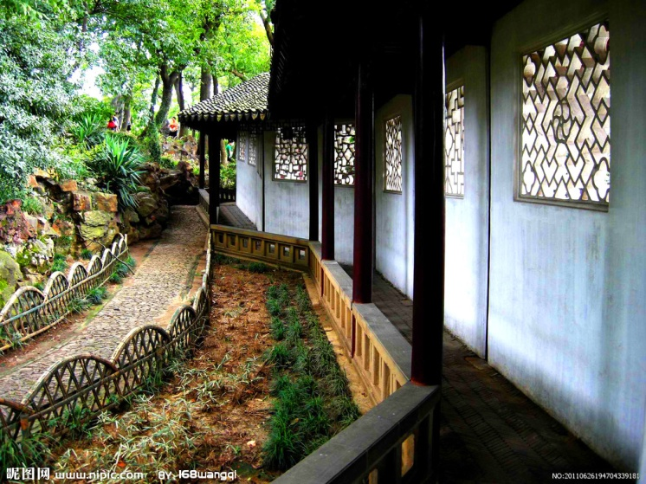
Gallery(廊)

Slide 38
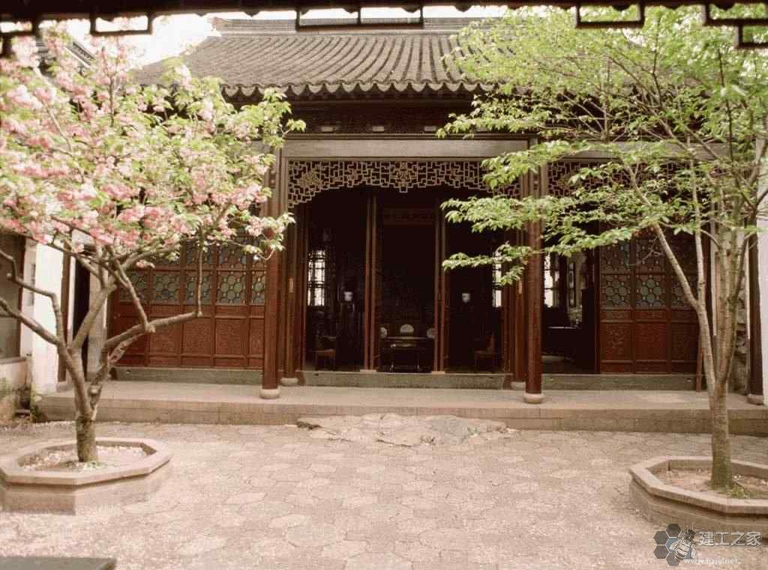
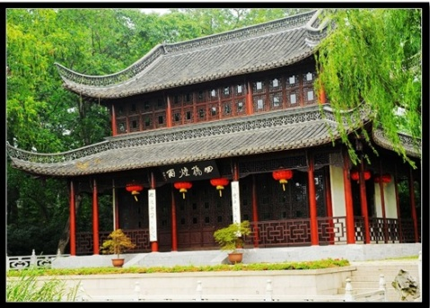
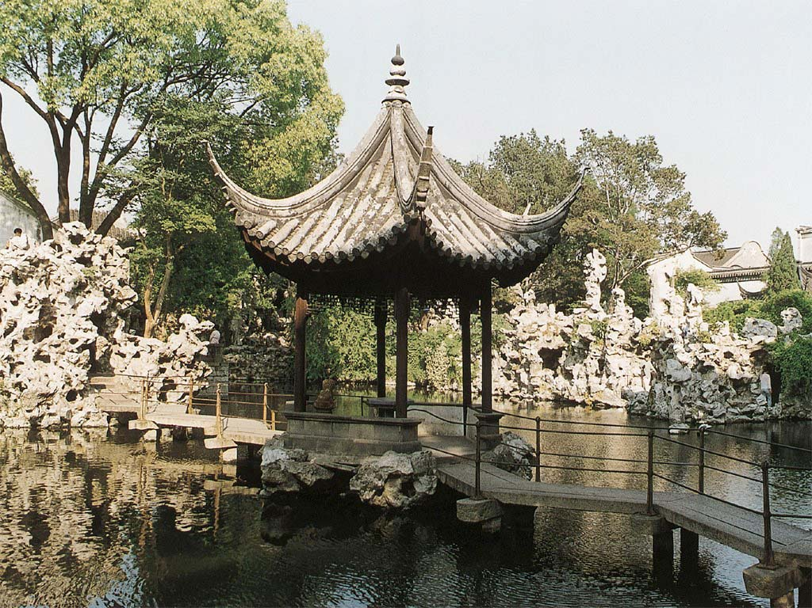
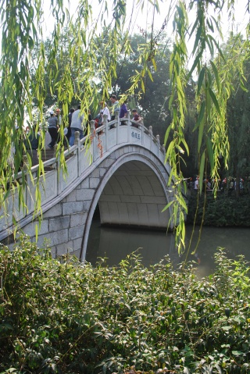
Chinese Classical Gardens
Hall(厅)
Floor(楼)
Pavilion(亭)
Bridge

Slide 39
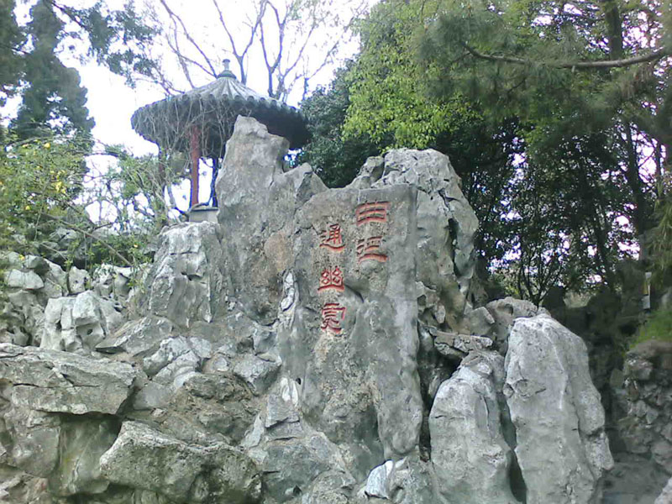
the Elements & Design
Chinese Classical Gardens
■ obstructive scenery (抑景或障景)
It uses some artistic methods to block the scene at the entrance of a garden

Slide 40
Chinese Classical Gardens
the Elements & Design
■ adding view (添景)
When a scenic spot is a little bit far from the viewer,
kinds of flowers, trees, or other plants will be planted in the middle or near to the observers as a kind of transition.

Slide 41
the Elements & Design
Chinese Classical Gardens
■ vista line(夹景)
It’s a distant view between rows of trees or buildings which is seen through a line.

Slide 42
the Elements & Design
Chinese Classical Gardens
■ Enframed scenery (框景)
The doors, the windows, the holes will often enframe the views afar into a very beautiful picture.

Slide 43
the Elements & Design
Chinese Classical Gardens
■ leaking through scenery(漏景)
People will have a view from the hollow windows

Slide 44
Chinese Classical Gardens
the Elements & Design
■ borrowed scenery (借景)
This could mean using scenes outside the garden, such as a view of distant mountains or the trees in the neighboring garden, to create the illusion that the garden was much bigger than it was.
Inside a Chinese garden, one scenic section always partially borrows the scenery of another section, not only to inspire the viewer’s curiosity for further discovery but also to enlarge the confined areas as well.

Slide 45
四
the Comparison
Chinese Classical Gardens
Western gardens

Slide 46
the Comparison
Chinese Classical Gardens
Chinese gardens
Western gardens
The Western model is an ordered garden laid out in carefully planned geometric and symmetrical lines.
without axial symmetry or other geometries

Slide 47
the Comparison
Chinese Classical Gardens
Chinese gardens
Western gardens
Lawns and hedges need to be kept neatly clipped for maximum effect. The plants are carefully arranged, shaped and continually maintained.
recreate natural landscapes in miniature

Slide 48
Chinese Classical Gardens
the Comparison
Chinese gardens
Western gardens
natural beauty
artificial beauty
Taoism had a strong influence on the classical garden.
The world follows nature
“Even though everything is the work of man, it must appear to have been created by heaven...”
—— Ji Cheng(计成), Yuanye(园治) (1633)
tidiness(整齐)
precision(精确)
“虽由人作，宛自天开”

Slide 49
二

Slide 50
Palace
一
Brief introduction
二
General characteristics of palace
三
Model for Chinese Palace: Forbidden City

Slide 51
Brief introduction
A palace is a grand residence, especially a royal residence or the home of a head of state or some other high-ranking dignitary.
The palace is the highest,most luxurious and valuable architectural type in ancient China.

Slide 52
Chinese Palace
1. General characteristics of palace:
Chinese palace is designed in regular
square grids and arranged in formal
layout, consisted of main buildings
and numbers of pavilions enclosed
within walls. Unlike massive single
structured European palace or castle,
Chinese palace is a multitude of complexes
contains several large and smaller structures
with parks and courtyards.

Slide 53
Epang Palace 阿房宫
It was a palace complex of Qin Shihuang, the first emperor of China. Construction of the palace began in 212 BC and was never completed.

Slide 54
Daming Palace 大明宫
It was the imperial palace complex of the Tang Dynasty, located in its capital Chang'an. It served as the royal residence of the Tang emperors for more than 220 years.The end of the Tang Dynasty, the entire palace was destroyed in the war.

Slide 55
The finest example of Chinese palace is the Forbidden City, the imperial palace of Chinese empire from the Ming Dynasty to the end of the Qing Dynasty. It is largest palace complex in the world and located in the middle of Beijing, China. The palace complex exemplifies traditional Chinese palatial architecture.

Slide 56
Chinese Palace
2. Model for Chinese Palace：Forbidden City 紫禁城

Slide 57
Chinese Palace
3. The design concept of the Forbidden City:
(1) Axial Symmetry
(2) Holding Court in the front and sleeping in the rear

Slide 58
Chinese Palace
4. The layout of the Forbidden City:

Slide 59
Chinese Palace
4. The Meridian Gate of the Forbidden City:

Slide 60
Chinese Palace
Since nine is the largest odd number under ten, it was regarded as the extremely lucky number. For this reason, the number “nine” or its multiples（倍数）is often employed in palace structures and designs.

Slide 61
Chinese Palace
5. The Hall of Supreme Harmony:

Slide 62
Chinese Palace
6. Some distinctive features in the Hall of Supreme Harmony
(1) Caisson ceiling in the Hall of Supreme Harmony

Slide 63
Chinese Palace
6. Some distinctive features in the Hall of Supreme Harmony
(2) Sundial in front of the Hall of Supreme Harmony

Slide 64
Chinese Palace
6. Some distinctive features in the Hall of Supreme Harmony
(3)The bronze incense burner in front of the Hall of Supreme Harmony

Slide 65
Chinese Palace
6. Some distinctive features in the Hall of Supreme Harmony
(4) The ceremonial pier in front of the Hall of Supreme Harmony

Slide 66
Chinese Palace
6. Some distinctive features in the Hall of Supreme Harmony
(5) The rank mountain in front of the Hall of Supreme Harmony

Slide 67
Chinese Palace
6. Some distinctive features in the Hall of Supreme Harmony
(6)The head of Chi, a hornless dragon in front of the Hall of Supreme Harmony

Slide 68
Chinese Palace
6. Some distinctive features in the Hall of Supreme Harmony
(7) The gilt copper in front of the Hall of Supreme Harmony

Slide 69
Chinese Palace
6. Some distinctive features in the Hall of Supreme Harmony
(8) Zhengwen on the Hall of Supreme Harmony

Slide 70
Chinese Palace
6. Some distinctive features in the Hall of Supreme Harmony
(9) Beasts squatting on the ridges

Slide 71
Chinese Palace
City wall: 12-meter high and 3400-meter long wall
Battlement:1.34 meters high,
0.37 meters thick

Slide 72
Chinese Palace
7. A city within city:
What are the City wall and moat?
(1) The city wall refers to the ramparts.
(2) The moat refers to the river embracing
and defending the city.

Slide 73
Chinese Palace
Review: What are these?

Slide 74
三

Slide 75
A Brief Introduction of Chinese Ancient Bridges

Slide 76
Bridge
一
Structure Form of Ancient Bridges
二
Decoration of Chinese Ancient Bridges

Slide 77
Structure Form of Ancient Bridges
timber beam-columns bridge－In Spring and Autumn Period (770-476 B.C.)
timber beam-piers bridge－In Tang Dynasty
stone beam-columns bridge－Qin Dynasty
stone beam-piers bridge－Qin Dynasty
timber cantilever girder bridge－Western Jin Dynasty (265-316)
trestle bridge－Qin Dynasty
stone arch bridge－Jin Dynasty
timber arch bridge－Northern Song Dynasty
cable bridge－(300-200 B.C)

Slide 78
Structure Form of Ancient Bridges
timber beam-columns bridge & timber beam-piers bridge

Slide 79
Lugou Bridge
The Lugou Bridge also known as the Marco Polo Bridge in English, is a famous stone bridge located 15 km southwest of the Beijing city center across the Yongding River—a main tributary of Hai River.

Slide 80
Lugou Bridge
Construction of the original bridge on this site commenced in 1189 and was completed in 1192 and was later reconstructed in 1698. The Lugou Bridge is 266.5 m in length and 9.3m in width, supported on 10 piers and 11 segmental arches.

Slide 81
Structure Form of Ancient Bridges
timber cantilever girder bridge

Slide 82
Structure Form of Ancient Bridges
stone arch bridge

Slide 83
Zhaozhou Bridge (In Hebei Province)
The Zhaozhou Bridge is the world's oldest open-spandrel stone segmental arch bridge. Credited to the design of a craftsman named Li Chun, the bridge was constructed in the years 595-605 during the Sui Dynasty (581–618). Located in the southern part of Hebei Province, it is the oldest standing bridge in China.

Slide 84
Zhaozhou Bridge (In Hebei Province)
The Zhaozhou Bridge is 50.82 meters long and 9.6 meters wide; the span of its large stone arch in the middle measures 37.37 meters -- the world's largest arch at the time.

Slide 85
Zhaozhou Bridge (In Hebei Province)
It has only one main arch and this arch has a span of more than 37 meters.
The bridge has two small side arches on either of the main arch, they serve two important functions: First, they reduce the total weight of the bridge and save the structural materials. Second, in time of flood, they cooperate with the main one allowing water to pass through, thus weaken the flood's impact on the body of the bridge itself.

Slide 86
Structure Form of Ancient Bridges
cable bridge

Slide 87
Luding Iron Cable Bridge(In Sichuan province)
Three hundred years ago, in order to solve the traffic problems, the emperor at the time, who was named KangXi, decided to constuct the first bridge on the dadu river. After a year of construction, the bridge is completed in 1706 A.D. and was named LuDing Bridge by the emperor.

Slide 88
铁索泸定桥（四川）
《桥梁概论》 同济大学桥梁工程系 孙利民

Slide 89
Decoration of Chinese Ancient Bridges
ornamental pillars(华表)
memorial archways(牌坊)
pavilion(亭、榭)
veranda(廊、阁)
tower(幢塔)
railing (木栏、石栏)
sculpture (雕塑)

Slide 90
Decoration of Chinese Ancient Bridges
ornamental pillars on Lugou Bridge
stone memorial archways on
Gaoyang Bridge in Anhui Province

Slide 91
Decoration of Chinese Ancient Bridges
stone pavilion on Suzhou Baodai Bridge
pavilion at Chengde Imperial Summer Resort

Slide 92
Decoration of Chinese Ancient Bridges
Corridor bridge in Shexian
Pavilion on Shuanglong Bridge
in Yunnan province

Slide 93
Decoration of Chinese Ancient Bridges
stone pagoda on Luoyang Bridge
wood railings of corridor bridge in Zhuozheng Garden

Slide 94
Decoration of Chinese Ancient Bridges
stone railings of Yongtong Bridge in Zhaoxian
stone lion on Lugou Bridge

Slide 95
四

Slide 96
Tower
一
Brief introduction
二
General characteristics of tower
三
Materials of tower
四
Buddhism in Towers

Slide 97
Pagoda
Brief introduction
Pagodas have been used by mankind since prehistoric times. The Chinese used pagodas as integrated elements of the Great Wall of China in 210 BC during the Qin Dynasty. Pagodas were also an important element of castles.

Slide 98
General characteristics of pagoda
The advantage of tower throughout history:
1. Provide defensive positions.
2. Obtain a better view of the surrounding areas, including battlefields.

Slide 99
General characteristics of pagoda
河北定州
开元寺料敌塔
The usage of tower:
In history, simple towers like lighthouses, bell towers, clock towers, signal towers and minarets were used to communicate information over greater distance.
浙江杭州
六和塔
（ 其导航灯塔作用）

Slide 100
Materials of pagoda: According to the materials it can be divided into mood pagoda, bricks pagoda, stone pagoda and metal pagoda, etc.
铁塔
石塔
木塔
砖塔
湖南当阳玉泉寺铁塔
福建泉州
开元寺石塔
应县木塔
陕西西安大雁塔

Slide 101
Han Dynasty

Slide 102
Northern and Southern Dynasty

Slide 103
Tang Dynasty

Slide 104
雷峰塔 Leifeng tower
Leifeng tower is on the north of Jingci temple and on south of Westlake. In NanSong Dynasty, “Lei Feng Xi Zhao” was selected as the ten views of Westlake.

Slide 105
雷峰塔 Leifeng tower
Because Leifeng tower was not repaired for long years and superstition man believed that the bricks of the tower could keep the evil out, so the thieves become more and more. Day after day, in September 1924, the remaining of the tower collapsed. At that time, almost all the residents in Hangzhou city came out to take a look at the collapsing view.

Slide 106
On 26th in December, 2000 the celebration of foundation laying of rebuilding of Leifeng tower was held on the ruins of the tower on Xizhao mountain.

Slide 107
After rebuilding, the new Leifeng tower is a five floor tower with the flying ledges on eight sides . The new is made of steel on the former basis, the total height of the tower is 71.96 meters.

Slide 108
When the visitors come into the tower, they can see the ruins of Leifeng tower through a glass protecting cover.

Slide 109
The Leifeng is rebuilt, the wonderful scenery is back. The new Leifeng tower makes the dream of ten views of Westlake of resident in Hangzhou.

Slide 110
五

Slide 111
Chinese Temple
A Chinese temple is a place of worship of the Chinese folk religion/Shenism, where people revere ethnic Chinese gods and ancestors. They can be classified as:
miào (庙) or diàn (殿), simply meaning "temple" and mostly enshrining nature gods or national gods; or
cí (祠), cítáng (祠堂), zōngcí (宗祠) or zǔmiào (祖庙), referring to ancestral temples, mostly enshrining the ancestral gods of a family or clan.

Slide 112
The first temple—White Horse Temple
White Horse Temple is the introduction of Buddhism to China by the Crown to create the first temple, known as the "first temple".

Slide 113
Royal Temple——Famen Temple
Famen Temple is known as the" royal temple", because of the placement of Sakyamuni Buddha and become national phalanx relic to Buddhist holy sites

Slide 114
The most famous one——Shao Lin Temple
Dharma is known as the ancestor of Chinese Zen Buddhism, the temple has been called the birthplace of Zen.

Slide 115
Thank You !

