Slide 1
College of International Education
Jinzhou Medical University
汉 字 书 写 1
汉 字 书 写
Annie

Slide 2
Assessment
The full marks of this course is 100 points, and the proportion of each task is :
Ⅰ.Attitude and discipline assessment (20%)
Ⅱ.Homework assessment (20%)
Ⅲ.Final examination (60%)

Slide 3
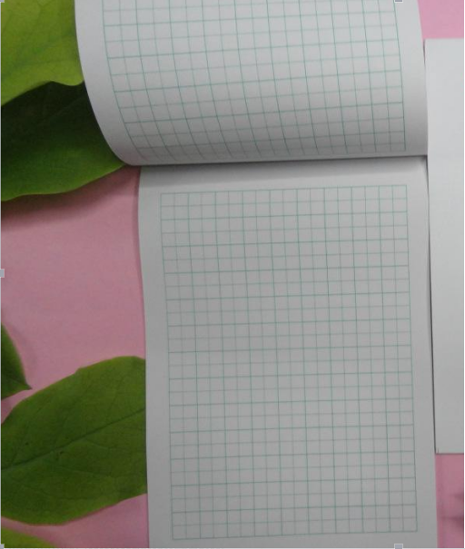
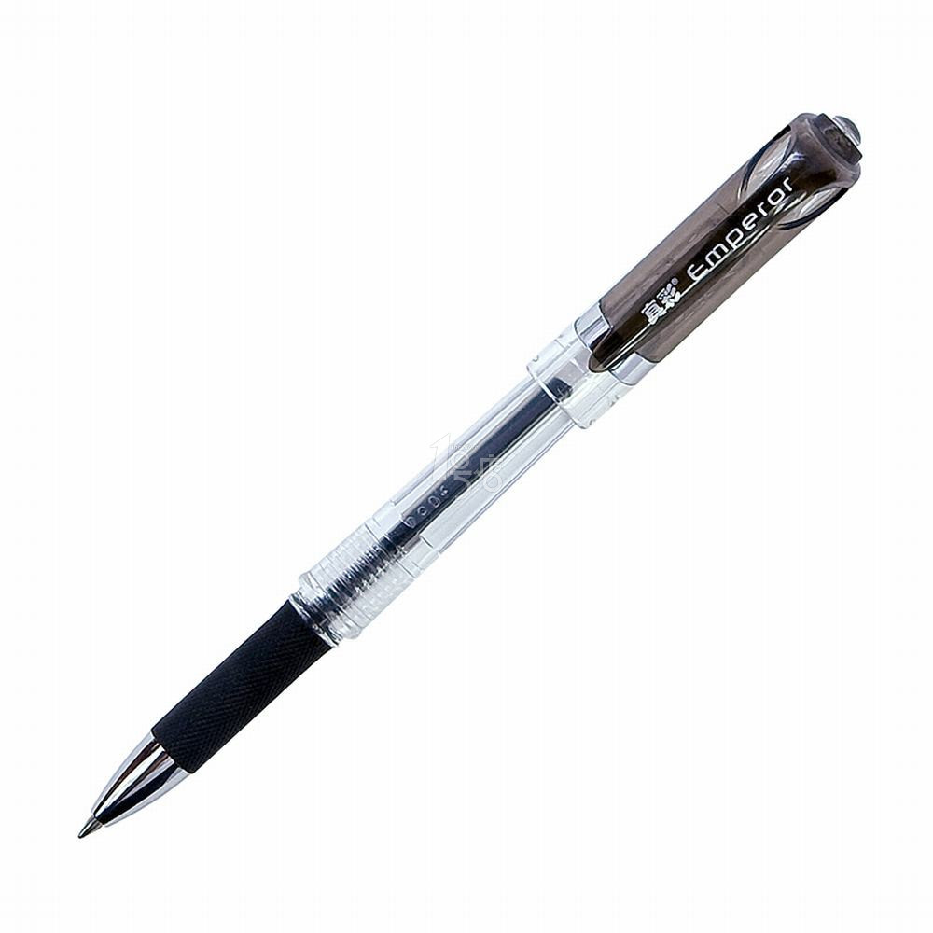
本 běn
笔 bǐ

Slide 4
了 解 汉 字
汉字的笔画
汉字的书写

Slide 5
Chinese Characters
91251 characters
1000 commonly used characters can cover 92% written materials.
2000 can cover 98% written materials.
3000 can cover 99% written materials.

Slide 6
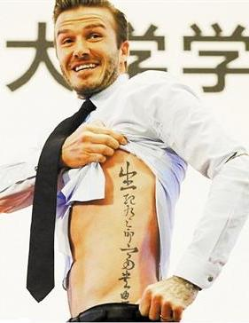
It's the longest living character in the world.
Chinese Character is world famous.

Slide 7
Chinese Characters

Slide 8
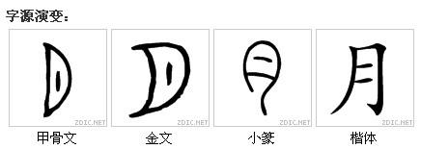
Chinese Characters

Slide 9
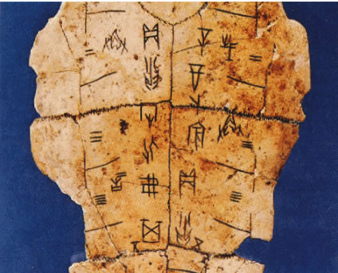
The Chinese character is a kind of the most ancient characters in the world.

Slide 10
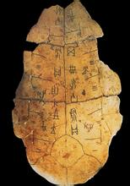
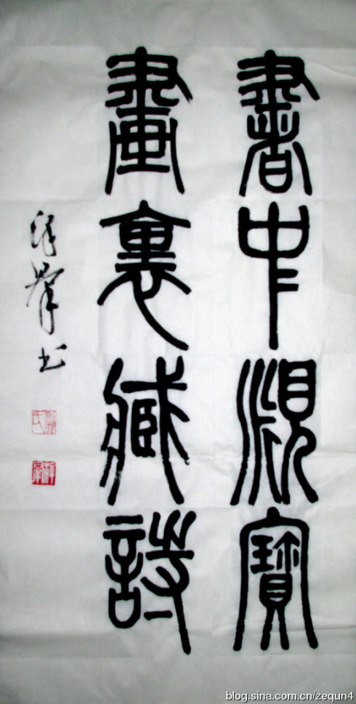
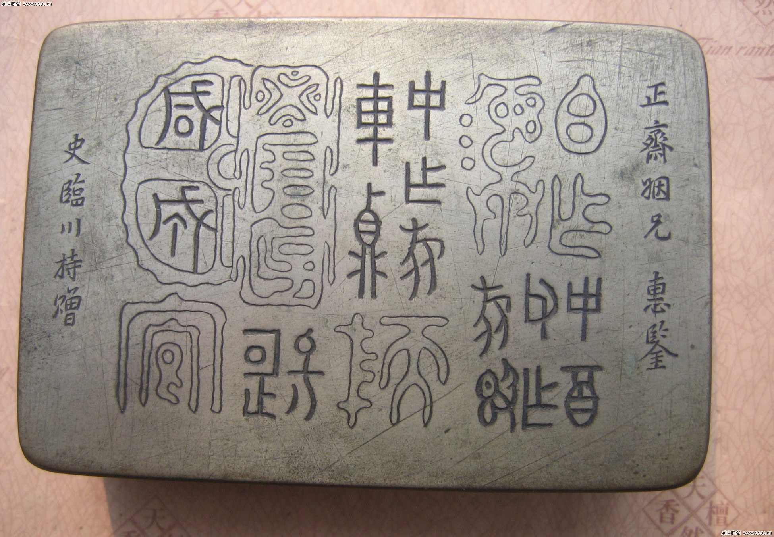
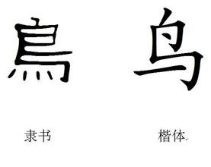
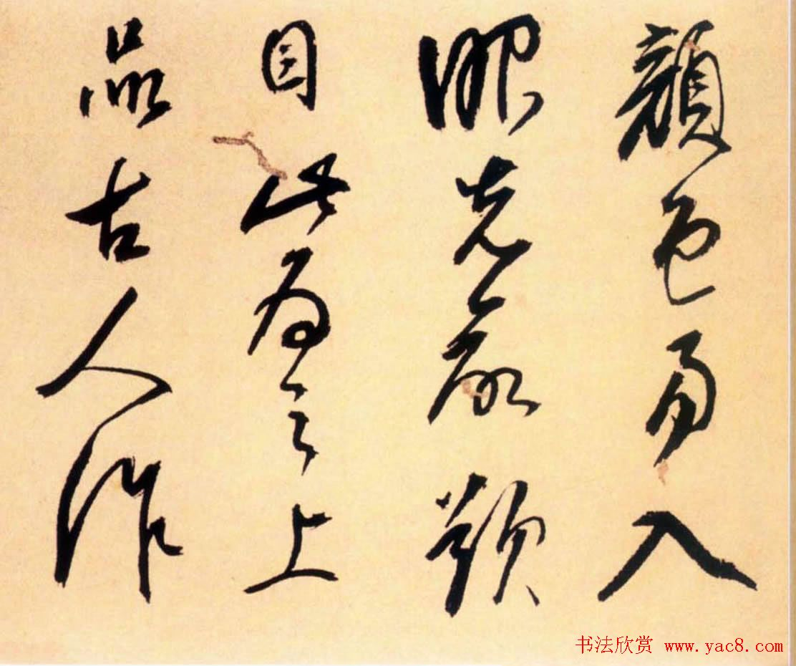
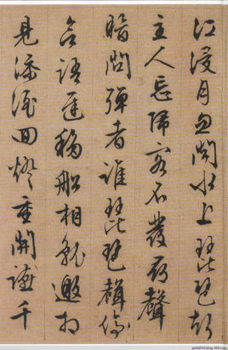
The evolution of Chinese Characters
Oracle Bone Script
Seal Script
Inscriptions on Bronze
Official Script and Rugular Script
Cursive Script
Running Script

Slide 11
The Strokes and Writing of the New Characters

Slide 12
The Strokes of Chinese Characters
汉字的字形是方的，所以又称“方块字”。汉字是由不同的笔画组成的，笔画是组成方块字字形的各种形状的点和线，它是汉字形体的最小单位。
Chinese characters are written in a shape of square,therefore they are known as square-shaped characters.Each character consists of various strokes formed by different dots or lines as the basic components.

Slide 13
The Strokes of Chinese Characters
组成汉字的基本笔画有六种，即横（一）、竖（丨）、撇（丿）、捺（乀）、点（丶）、提（㇀），其他笔画都是由这六种笔画变化而来的，我们把它们叫做派生笔画。
There are six basic stroles of Chinese characters.They are the horizontal stroke,the vertical stroke,the left-falling stroke,the right-falling stroke,the dot and the rising stroke.Other types of strokes are derived from the strokes mentional above,and thus konwn as the derived strokes.

Slide 14
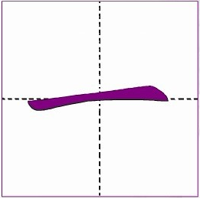
_
1.横 héng Horizontal stroke
The horizontal stroke should only go from left to right.
It would be wrong if it is done other.

Slide 15
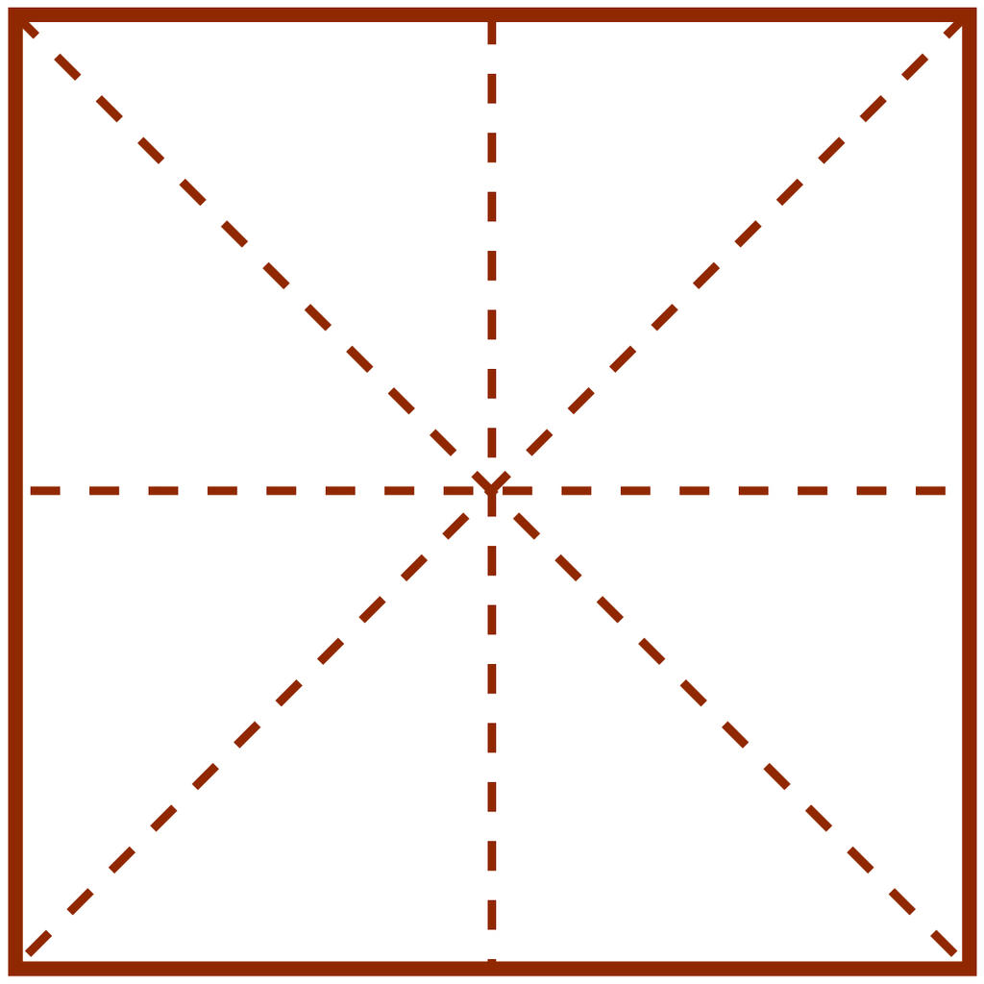
1.横 héng
一
二
三
yī èr sān

Slide 16
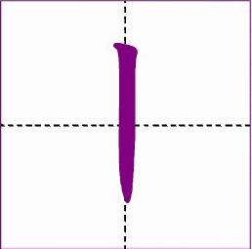
2.竖 shù Vertical stroke
The vertical stroke can only be written from top to bottom,never from bottom to top.

Slide 17
2.竖 shù
十
工
上
shí gōng shàng

Slide 18
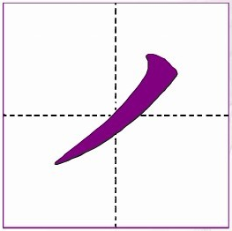
3.撇 piě Left-falling stroke
A left-falling stroke is written from the top right to the bottom left.

Slide 19
3.撇 piě
qiān thousand
wǔ noon
千
午

Slide 20
3.撇 piě
nián year
zuò to do
年
作

Slide 21
4.捺 nà Right-falling stroke
A right-falling stroke is written from the top left to the bottom right with increasing force.

Slide 22
4.捺 nà
bā eight
rén person
八
人

Slide 23
4.捺 nà
gè a measure word
tiān day,the sky
个
天

Slide 24
5.点 diǎn Dot
The dot of a character begins from the top and slants to the right side with a reinforced pause.

Slide 25
5.点 diǎn
xià downward direction
liù six
下
六

Slide 26
5.点 diǎn
shǎo short of
bù not
少
不

Slide 27
5.提 tí Rising stroke
A rising stroke forcibly begins from the lower left to the upward right.

Slide 28
6.提 tí
hàn Han,Chinese
汉

Slide 29
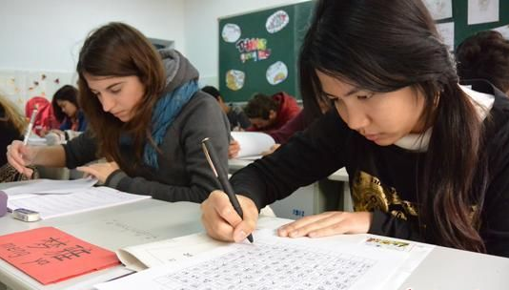
学 写 汉 字

Slide 30
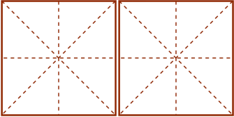
练习 Practice
上
午
下
午
shàng wǔ xià wǔ
morning afternoon

Slide 31
练习 Practice
明
年
去 年
míng nián qù nián
next year last year

Slide 32
练习 Practice
工 作
作 业
gōng zuò zuò yè
work,to work exercise,homework

Slide 33
练习 Practice
上 课
下 课
shàng kè xià kè
work,to work exercise,homework

Slide 34
作业 zuòyè Homework
写汉字

Slide 35
谢谢，再见！

