Slide 1
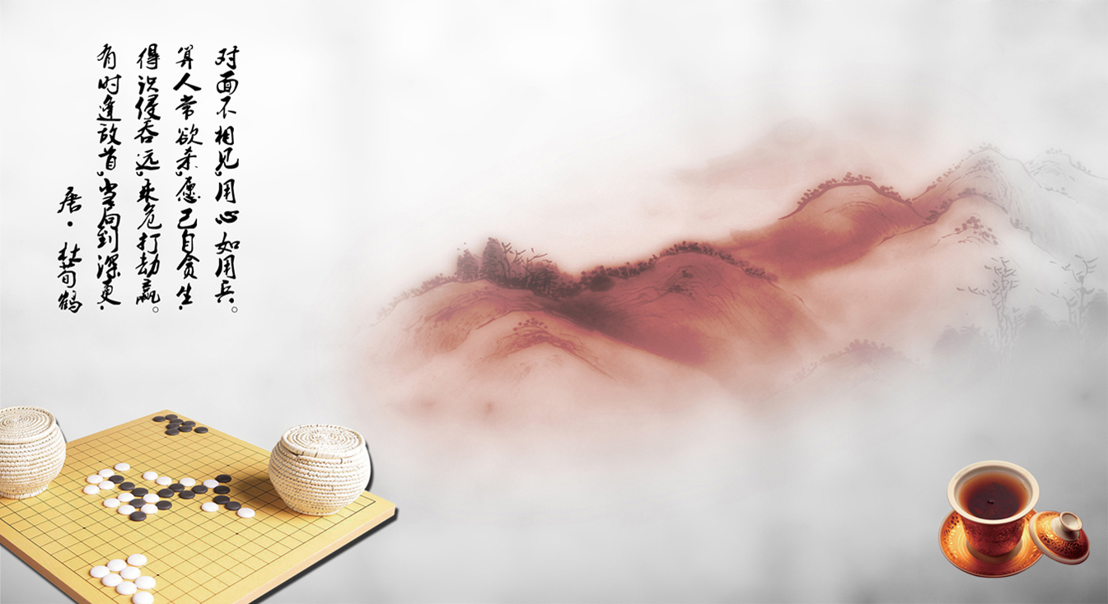
Traditional Culture in Daily Life

Slide 2
琴qín 棋qí 书shū 画huà

Slide 3
Chinese Chess

Slide 4
The Origin of Chinese Chess
Chess,which is also called Chinese chess.In China it has a long history,
belonging to a kind of 2 people adversarial game.Owing to the simple appliance and strong interest,it becomes one of very extensive chess activities.But about the origin of chess ,there is still no final conclusion now.

Slide 5
Chessboard
Chinese chess is played on a board with 9 vertical lines and 10 horizontal lines.In the
middle of the board,there is a blank area which is called“the Chu river and Han boundary”,which breaks the vertical lines and seperates the board into two sides.

Slide 6
Chessboard
The king's palace.It indicates where the king's domain is .There are 9 intesections altogether within these squares,which are called “nine palaces”.

Slide 7
Chessboard
A game of chess is placed between these two sides,the red side and the black side.The red pieces are placed on the red side and the black pieces are placed on the blacked side.

Slide 8
The Chu River and Han Boundary
The four-year war between Xiang Yu and Liu Bang had a great impact on later generations.It even finds an echo in Chinese chess.On the chessboard,the bank area between the positions of the opponents is called the Chu River and Han Boundary,which reminds people who play chess that they are engaging in a kind of war between Chu and Han.

Slide 9
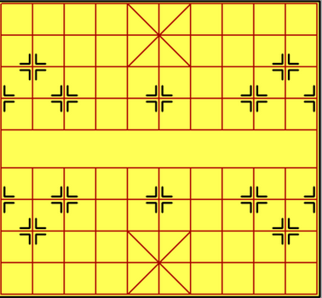
Nine-palaces
In Chinese chess,“nine-palaces”is actually nine intersections which is also the domain of king and guard.On the board the special indentification highlights the king's supreme status and importance.

Slide 10
Rules
1.Chinese chess is a based game,with Red starting gameplay.
2.The objective is to checkmate your opponent trapping while Checking your opponent’s Generals.The game is won by checkmating or stalemating the opponent King.
3.Perpetual check is forbidden.U cannot check your opponent more than three times in a row with the same piece and same board positions.

Slide 11
Pieces
A chess set has 32 pieces altogether.Each side has one king,two rooks,two knights,two cannons,two bishops,two guards and five pawns.The pieces King,Guard,Bishop,and Pawn on the red side are identical in moving and capture ability to the pieces King,Guard,Bishop,and Pawn on the black side.

Slide 12
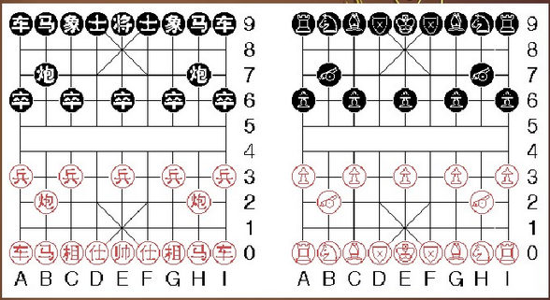
From left to right on the bottom and top rows,you see:a Rook,a Knight,a minister,a knight, and a Rook.On the third rows,u see the Cannons,and on the fourth row you see the Pawns.Pieces at the bottom half are red.

Slide 13
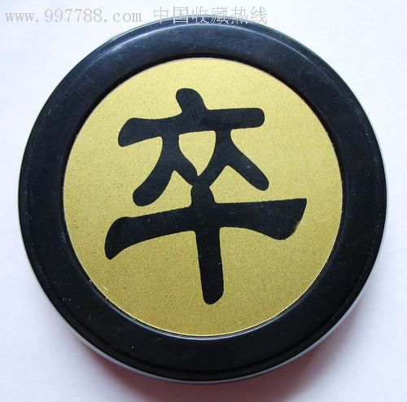
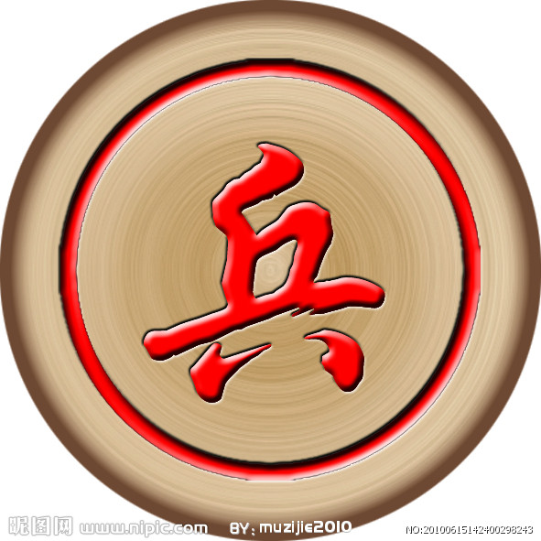
Pawns
“卒”(zú)and“兵”(bīng)
Pawns are the weakest piece in the game of Chinese chess,They can only move forward and attacking,starting pawn moves one point straight forward.

Slide 14
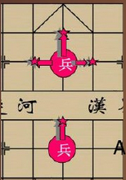
Pawns
A pawn crossing the river promotes,keeping its previous move and gaining a new move—a one-point step to either horizontal.Pawns do not advocate on the last rank,where they can move only left or right.

Slide 15
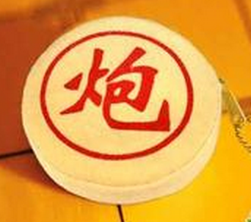
Cannons
“炮”(pào)
The cannon moves differently when it moves to capture than when it moves passively.
1.The cannon moves passively as an rook.
2.The cannon moves to capture as an rook which is required to hop over a single screen.

Slide 16
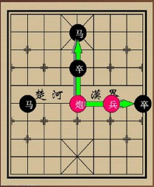
In other words,Cannon capture by skip a second piece in order to capture a third piece.Cannons only capture when skip and only hop when capturing.They may never hop over more than one piece in a given move.

Slide 17
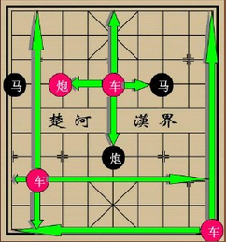
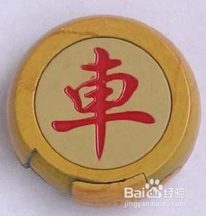
Rook
“車”(jū):
Rook are the first most powerful piece in the game of Chinese chess.They can move either horizontally or vertically.

Slide 18
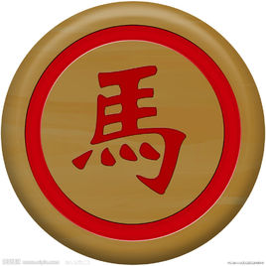
Kncights
“马”(mǎ)
Knights’ movement is very unique,similar to that of a “L”shape.Moving one square laterally,then one square diagonally.The knight moves one point orthogonally followed by one point outward diagonally.It may not leap over occupied points.

Slide 19
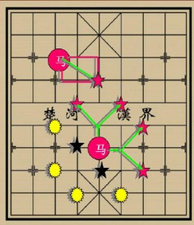

Slide 20
Ministers
“相”and“象”(xiàng)
The ministers can only stay on their designed side,so a Minsters on a red square can never go on a black square.
The ministers move exactly two points diagonally.It may not leap over occupied points.Also,Ministers are confined to their home side of the river.

Slide 22
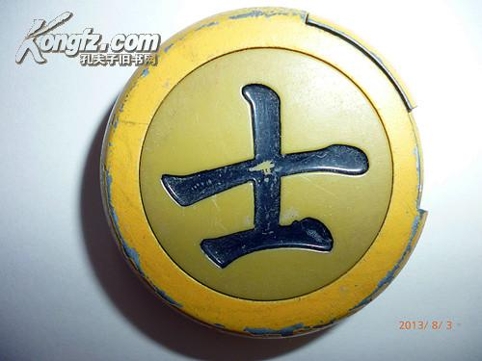
Guards
“士”and“仕”(shì)
The guards’ movement is limited to own palace.Moving any direction diagonally in own palace.moving one step each time.

Slide 24
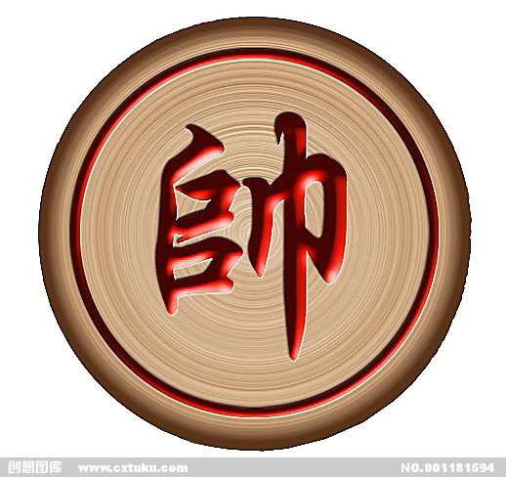
Generals
“将”(jiāng):
It is the king or prince of the black side.
“帅”(shuài):
It is the king or prince of the red side.

Slide 25
Generals
“The generals’ movement is limited to own palace.They can move either horizontally or vertically,but cannot move diagonally.

Slide 27
Tip:
1.The general is a chess piece that you want to protect.If your general is exposed to attack,your general is in “Check”.
2.The two generals cannot face each other on an open file.If either general sits exposed on an open file,the other general may not move to occupy that file.

Slide 28
Chinese Go

Slide 29
The different names of go
Zain(坐隐) Hand-talk(手读) Square-Round(方圆) Black-and-White(黑白)
Go has many names,but it is called the Go by westerners.They only think is a game of go,apparently they do not recognize the profound meaning.

Slide 30
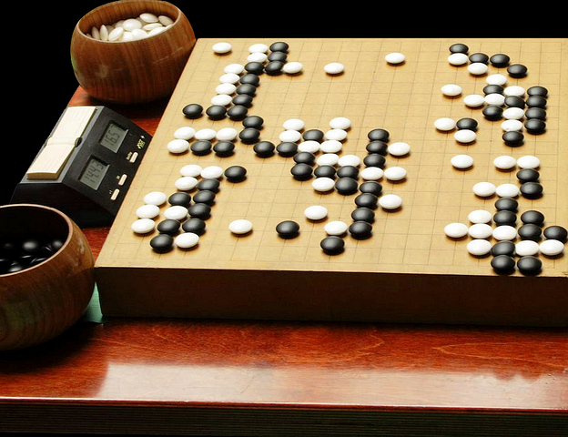
Appliance
It includes a cheeboard,181 black pieces and 180 white pieces.

Slide 31
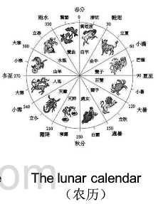
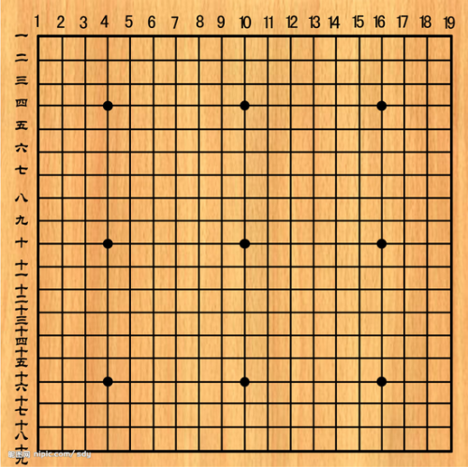
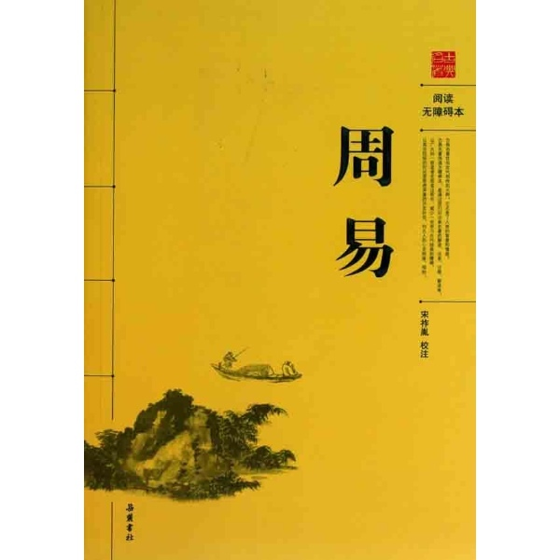
Chessboard
Go has been used to divine firstly,so it has closely relationship with the book of changes.There are nineteen horizontal lines and nineteen vet\rtical lines on the board,and they make up 361 points.They are said the luna calendar of 361 days.

Slide 32
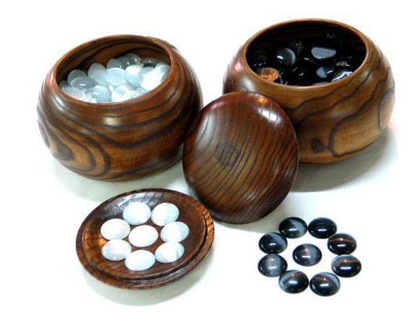
Piece
The pieces are divided into black and white.It is the important theory for yin and yang.That is the basis of Chinese culture.

Slide 33
The Chinese World View
hemispherical dome(天圆地方)
The shape of the board and pieces represents the thought of the Chinese world view.

Slide 34
Rules
Both sides use different color,and black go first.Everyone must use one piece each time.
Piece must put on the cross point.
Do not move the pieces on the board.

Slide 35
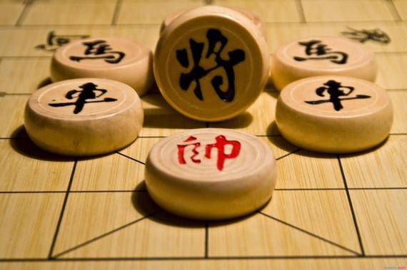
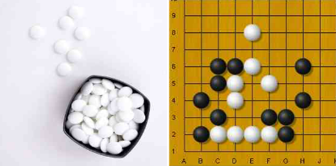
Equality
Every piece is equality.When put on board,it will produce different results.This is noy only the idea of the equality,but also the thinking of the whole and part.

Slide 36
Outcome
The way to get victory is get more points than opponent.But it does not require the number.It reflects the idea of harmony and the Golden Mean.

Slide 37
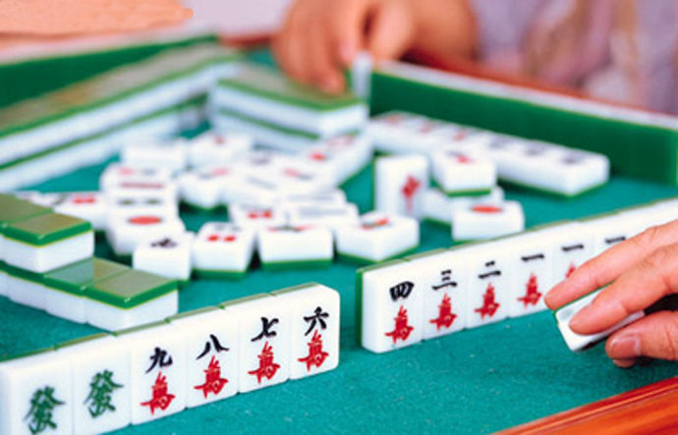

Slide 38
麻将

Slide 39
Introduction
Mahjong is a game for four players that originated in China. A Korean variation allows for three players as well as some variations in Japan and Malaysia. It is known as three player mahjong. By far, the most common form of mahjong is that played by four players.

Slide 40
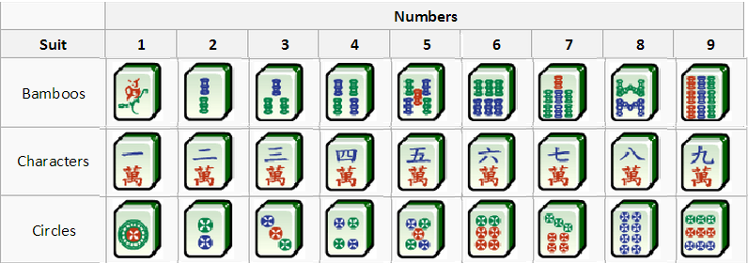
Tiles
Total 136 tiles
（3*9*4+4*4+3*4）
The suit of 3 patterns
Number 1-9 in each pattern
4 tiles of each number

Slide 41
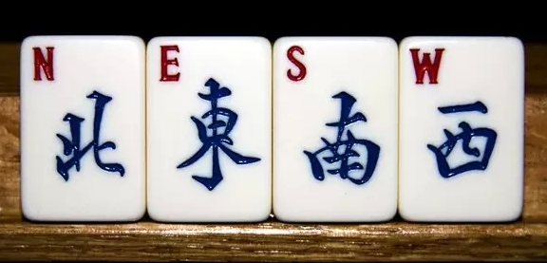
Tiles
The suit of 4 winds, 4 of each wind
běifēng dōngfēng nánfēng xīfēng

Slide 42
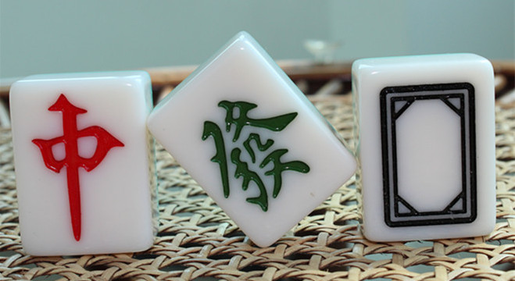
Tiles
The suit of zhong fa bai, 4 of each wind
hóngzhōng fācái báibǎn

Slide 43
How to play
Getting ready: 4 players with 34 unknow titles before each side.
Each player takes 13 tiles by turn
Keep taking in new tiles and discarding useless tiles one by one in turn
Organize the right settlement to win
(4*3 tile suits+1 pair=14 tiles)

Slide 44
How to play
All tiles are placed face down and shuffled. Each player then stacks a row of tiles two tiles high in front of him, 17 stacks for each player.
A player wins the round by creating a standard mahjong hand, which consists of a certain number of melds (namely, four for 13-tile variations and five for 16-tile variations) and a pair. If a player needs only one more tile to complete his winning hand and another player discards the tile he needs, he may claim it immediately, regardless of who discarded it or what part of his hand it completes.

Slide 45
How to play
Examples of winning hands (split into melds and pair for clarity):
(1)11、123、123、123、123
(2)11、123、123、123、111
(3)11、123、123、111、111
(4)11、123、111、111、111
(5)11、111、111、 111、111

Slide 47
Thank you

