Slide 1
College of International Education
Jinzhou Medical University
汉 字 书 写 5
汉 字 书 写
李舒慧 Annie

Slide 2
复习
Review
Pictographic Scripts
象形字
The writing of new characters
汉字的书写

Slide 3
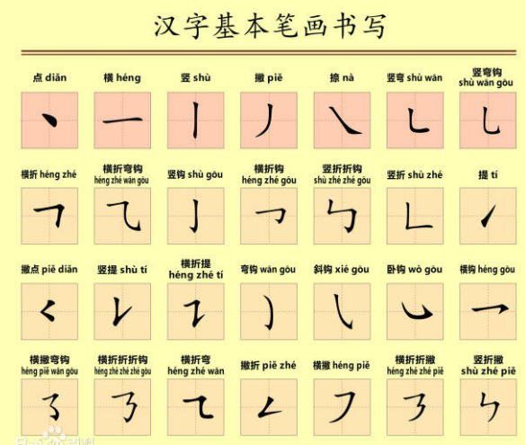
_
复习笔画

Slide 4
_
门
今
北
哥
年
女

Slide 5
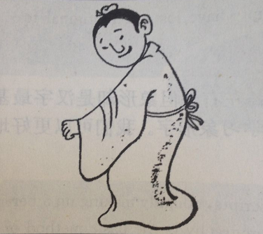
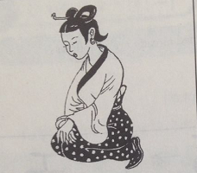
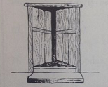
月
水
人
门
女

Slide 6
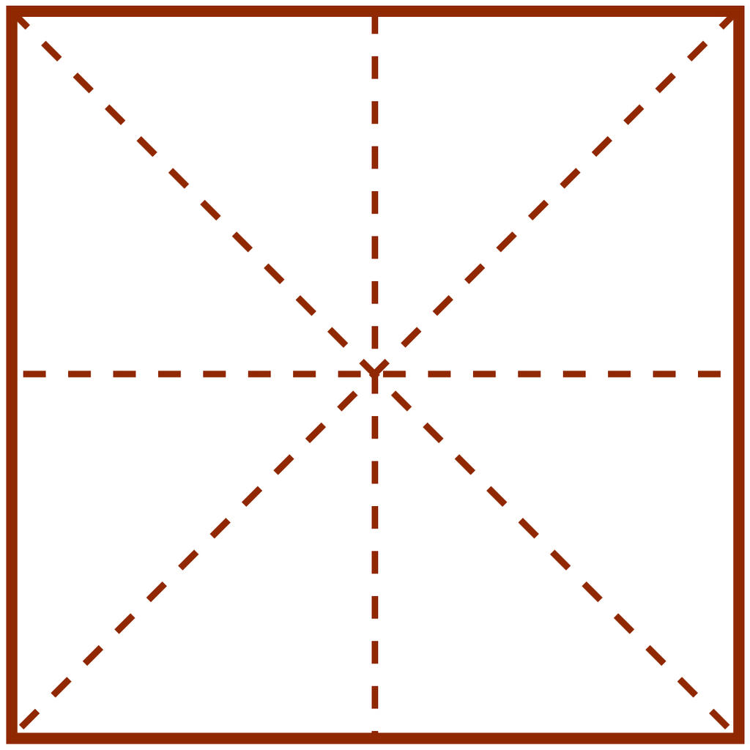
_
月
水
人

Slide 7
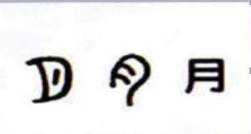
_

Slide 8
_
水 shuǐ water
The ancient written form of 水 is like running water.The zigzag lines in the centre symbolize running water,the dots on both sides symbolize drops water or waves.

Slide 9
_
人 rén man
The ancient written form of 人 is in the shape of a man who is standing sideway.

Slide 10
_
象形字
Pictographic Scripts
Pictographic scripts can simple drawings representing people or objects referred to.They are derived from pictures of natural pheonmena,people,human,features,animals,plants and tools of production or instruments for daily use that are easy to draw.

Slide 11
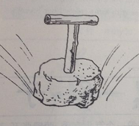
_
工 gōng to work
The ancient written form of 工 is in the shape of a tool.The character originally means tool,and has by extension come to mean“worker”.

Slide 12
_
女 nǚ female
The ancient written form of 女 is in the shape of woman who is going down on her knees with arms crossed her breast.

Slide 13
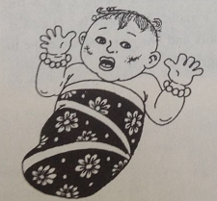
_
子 zǐ son
The ancient written form of 子 is like a baby with head,both arms stretching out and legs in his infancy.

Slide 14
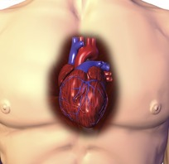
_
心 xīn heart
The ancient written form of 心 is like a heart.

Slide 15
_
门 mén door
The ancient written form of 门 is in the shape of the two parts of a door.

Slide 16
门
女

Slide 17
子
心
人

Slide 18
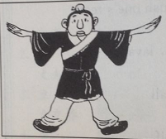
_
大 dà big
The ancient written form of 大 is in the shape of a man standing with two hands and feet apart.

Slide 19
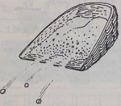
_
小 xiǎo small
The ancient written form of 小 is composed of three dots,simbolizing grains of sands,or tiny things.

Slide 20
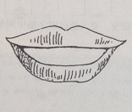
_
口 kǒu mouth
The ancient written form of 口 is like a human open mouth

Slide 21
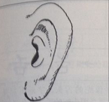
_
耳 ěr ear
The ancient written form of 耳 is like a human ear

Slide 22
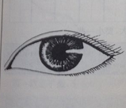
_
目 mù eye
The ancient written form of 目 is like a human eye which later is written with the left end up and the right end down.In modern Chinese the character is not used alone.

Slide 23
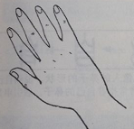
_
手 shǒu hand
The ancient written form of 手 is in the shape of five fingers of a hand.

Slide 24
大
小
口

Slide 25
耳
目
手

Slide 26
床前明月光，
疑是地上霜。
举头望明月，
低头思故乡。
chuáng qián míng yuè guāng，
yí shì dì shàng shuāng。
jǔ tóu wàng míng yuè，
dī tóu sī gù xiāng。
静夜思 李白
jìng
yè
sī
lǐ
bái

Slide 27
hóng dòu shēng nán guó，chūn lái fā jǐ zhī？
yuàn jūn duō cǎi xié，
cǐ wù zuì xiāng sī.
红豆生南国，春来发几枝？
愿君多采撷，此物最相思。
红豆 王维
hong
dou
wang
wei

Slide 28
dú zài yì xiāng wéi yì kè，měi féng jiā jié bèi sī qīn。
yáo zhī xiōng di dēng gāo chù，biàn chā zhū yú shǎo yì rén。
独在异乡为异客，每逢佳节倍思亲。
遥知兄弟登高处，遍插茱萸少一人。
jiǔ
yuè
jiǔ
rì
yì
shāndōngxiōngdi
wang
wei
九月九日忆山东兄弟 王维

Slide 29
作业 zuòyè homework
工、人、女、子、心、门
大、小、口、耳、目、手

Slide 30
谢谢，再见！

