Slide 1
College of International Education
Jinzhou Medical University
汉 字 书 写 2
汉 字 书 写
Annie

Slide 2
复习
Review
汉字的派生笔画
The derived Strokes
The writing of new characters
汉字的书写

Slide 3
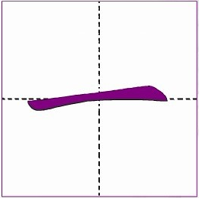
_
1.横 héng Horizontal stroke
The horizontal stroke should only go from left to right.
It would be wrong if it is done other.

Slide 4
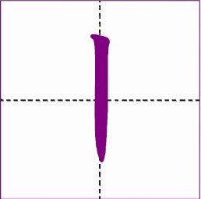
2.竖 shù Vertical stroke
The vertical stroke can only be written from top to bottom,never from bottom to top.

Slide 5
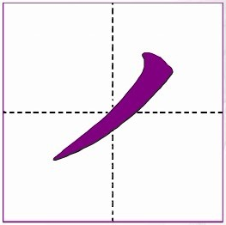
3.撇 piě Left-falling stroke
A left-falling stroke is written from the top right to the bottom left.

Slide 6
4.捺 nà Right-falling stroke
A right-falling stroke is written from the top left to the bottom right with increasing force.

Slide 7
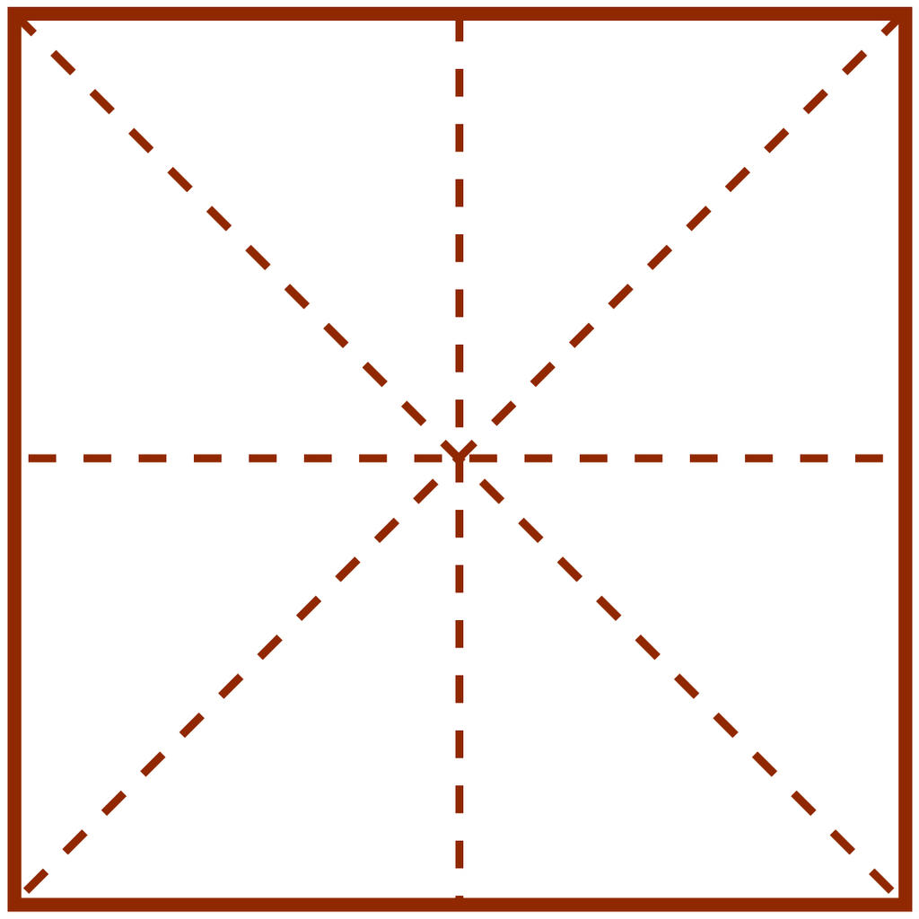
六
汉

Slide 8
5.点 diǎn Dot
The dot of a character begins from the top and slants to the right side with a reinforced pause.

Slide 9
5.点 diǎn
xià downward direction
liù six
下
六

Slide 10
5.点 diǎn
shǎo short of
bù not
少
不

Slide 11
6.提 tí Rising stroke
A rising stroke forcibly begins from the lower left to the upward right.

Slide 12
6.提 tí
hàn Han,Chinese
汉

Slide 13
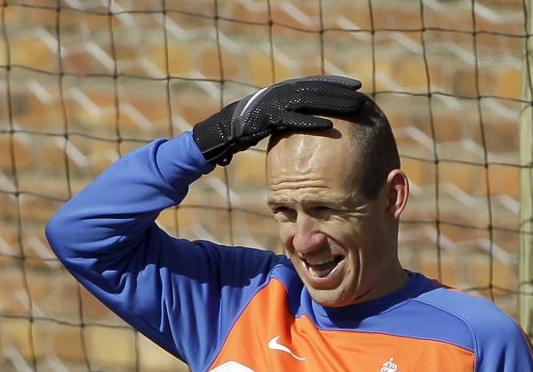
Practice
tóu head
头

Slide 14
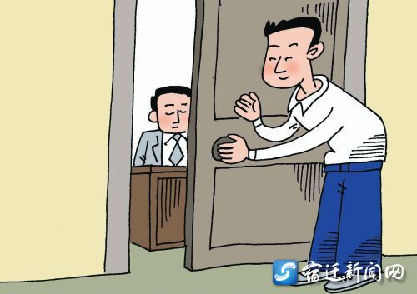
Practice
guān to close
关

Slide 15
Study New Strokes
The Derived Strokes

Slide 16
The Combination of the Strokes
A.Two strokes are seperated.
B.Strokes link up with one another .
C.Two strokes go across one another.

Slide 17
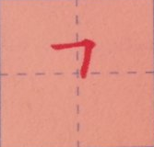
_
1.横折 héng zhé Horizontal Turning
A horizontal turning begins with a horizontal stroke from left to right,then turns down at a right angle.

Slide 18
_
wǔ five
五

Slide 19
_
bǎi hundred
jīn now
百
今

Slide 20
_
hòu behind,after
后

Slide 21
_
lǐ inside
gèng even,further
里
北

Slide 22
_
2.竖弯 shù wān Vertical Turning
A vertical turning is writen from top to bottom with a right turning or a short curve without being broken.
乚

Slide 23
_
sì four
四

Slide 24
_
3.竖弯钩 shù wān gōu Vertical Upward Turning
A vertical upward turning is writen from top to bottom, then turning upward without being broken.
乚

Slide 25
_
qī seven
七

Slide 26
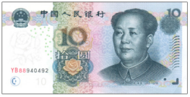
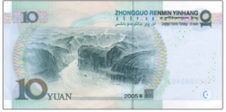
_
yuán yuan
元

Slide 27
_
xiān first
diàn electricity
先
电

Slide 28
_
běi north
北

Slide 29
_
4.横折弯钩 héng zhé wān gōu
Horizontal Bending with an Upward Hook
The horizontal bending with an upward hook begins with a line written from left to right before its bending at a right angle ended with a rising hook on the right .Although changed in various directions,the whole stroke should be completed without being broken.

Slide 30
_
jiǔ night
九

Slide 31
_
jǐ which
fēng wind
几
风

Slide 32
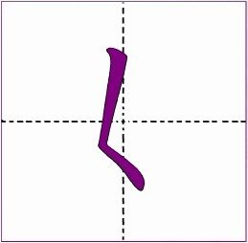
_
5.撇点 piě diǎn Left-falling Dot
A left-falling dot begins from the top right,then turns to the left,and bends to the right without being broken.

Slide 33
The left-falling dot of 女 should be completed as one stroke.Its second stroke is a left-falling one,joining the horizontal in the middle.
女
nǚ female
女人 nǚrén woman

Slide 34
6.横撇 héng piě Left Horizontal Falling
A left horizontal falling starts from left to the right and continues its lower part by turning to the left without being broken.

Slide 35
A left horizontal starts from left to the right and continues its lower part by turning to the left without being broken.
多
duō
too much ,too many

Slide 36
_
Game time
六 下 汉
五 四 七
九 元 今
里 风 更

Slide 37
练习 Practice
数字 Number:一 二 三 六 八 十
十一 十二 十三 十六 十八 二十
三十 六十 八十 一千 三千 六千

