Slide 1
College of International Education
Jinzhou Medical University
汉 字 书 写 3
汉 字 书 写
Annie

Slide 2
复习
Review
汉字的派生笔画
The derived Strokes
The writing of new characters
汉字的书写

Slide 3
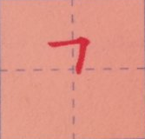
_
1.横折 héng zhé Horizontal Turning
A horizontal turning begins with a horizontal stroke from left to right,then turns down at a right angle.

Slide 4
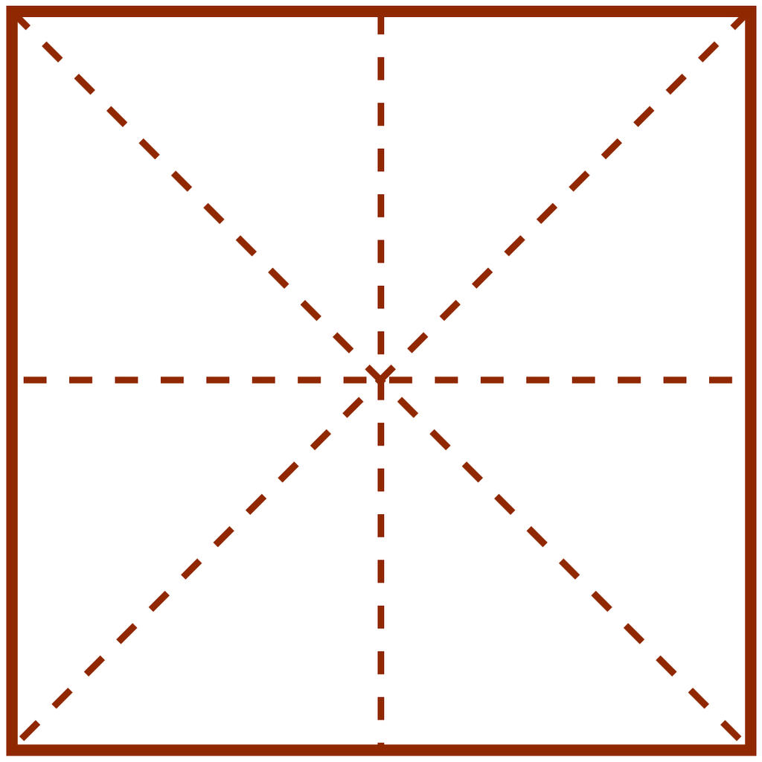
_
2.竖弯 shù wān Vertical Turning
A vertical turning is writen from top to bottom with a right turning or a short curve without being broken.
乚

Slide 5
_
3.竖弯钩 shù wān gōu Vertical Upward Turning
A vertical upward turning is writen from top to bottom, then turning upward without being broken.
乚

Slide 6
_
4.横折弯钩 héng zhé wān gōu
Horizontal Bending with an Upward Hook
The horizontal bending with an upward hook begins with a line written from left to right before its bending at a right angle ended with a rising hook on the right .Although changed in various directions,the whole stroke should be completed without being broken.

Slide 7
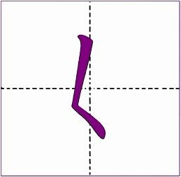
_
5.撇点 piě diǎn Left-falling Dot
A left-falling dot begins from the top right,then turns to the left,and bends to the right without being broken.

Slide 8
6.横撇 héng piě Left Horizontal Falling
A left horizontal falling starts from left to the right and continues its lower part by turning to the left without being broken.

Slide 9
_
Study New Strokes
才 了 我 心 买

Slide 10
_
1.竖钩 shù gōu Vertical Hook
A vertical hook is written from top to bottom with a left upward hook.

Slide 11
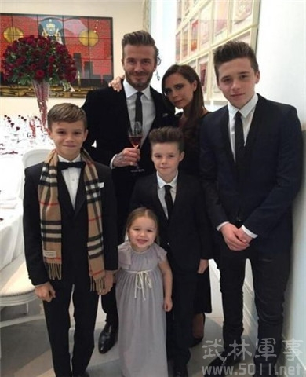
_
gē elder brother
哥

Slide 12
_
2.弯钩 wān gōu Curved Hook
A curved hook can be formed by a curve and a vertical hook.

Slide 13
_
le a modal particle
了

Slide 14
_
zǐ son
子

Slide 15
_
hǎo good
好

Slide 16
_
3.斜钩 xié gōu Slant Hook
A slant hook can be formed by an arch written from the top left to the lower right and a small upward hook.

Slide 17
_
wǒ I,me
我

Slide 18
_
4.卧钩 wò gōu Lying Hook
A lying hook is shaped like a upturned arch with an upward hook.

Slide 19
_
xīn heart
心

Slide 20
_
5.横钩 héng gōu Horizontal Hook
A horizontal hook begins with a level stroke which bends at its right end in the form of a small hook.
乛

Slide 21
_
mǎi to buy
买

Slide 22
_
xué to study
学

Slide 23
_
nǐ you
你

Slide 24
_
6. 竖提shùtí Vertical Rising
A horizontal rising stroke is a vertical stroke with a short rising from the botom to the right.

Slide 25
_
bǐ than,to compare
比

Slide 26
_
hěn very
很

Slide 27
_
7. 竖折shùzhé Vertical Turning
A vertical turning to the right begins with a vertical stroke ,
then turns to the right at a right angle.

Slide 28
_
chū to go out
出

Slide 29
_
8. 竖折折钩shùzhézhégōu
Vertical and Redoubled Turning
A vertical and redoubled turning begins with a vertical stroke and a turning to the right,and then goes down with an upward hook to the left.It is considered one stroke without being broken anywhere.

Slide 30
_
dì younger brother
弟

Slide 31
_
9. 横折钩héngzhégōu Horizontal Turning with a Hook
The writing of the horizontal turning with a hook begins with a horizontal stroke written from the left to the right,connected with a vertical and a hook to the left.

Slide 32
_
mén, door
门

Slide 33
_
men, plural suffix
们

Slide 34
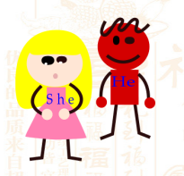
_
tā, he/him
他

Slide 35
_
认读词、词组和句子
Read the Following Words,Phrases and Sentences
数字：四 五 七 九 十四 十五 十七 十九
四十 五十 七十 九十
一百 二百 三百 四百 五百 六百 七百
今： 今天 今年
后： 后天 后边
子： 孩子
好： 你好 好人 好学生

Slide 36
作业 zuòyè homework
才 心 哥 好
我 他 学 你

