Slide 1
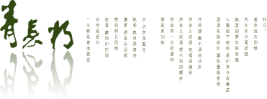
Written Chinese
汉字书写
教师：孔丽娜

Slide 2
Lesson Four
The derived strokes—派生笔画

Slide 3
Review--复习
Derived Strokes--派生笔画
To Learn Characters--学写汉字
Homework--作业

Slide 4
Review--复 习
找一找 search
妈 婆 认 众 从 学 仔 感 齿 想

Slide 5
复习
Vertical Rising
Vertical Turning
Horizontal Turning
with a Hook
Vertical and
Redoubled Turnig
Left-falling Turning

Slide 6
1.横折提 héngzhétí Horizontal Turning with Rising Stroke
A horizontal turning with rising stroke begins with a very short horizontal stroke, then turns down and rises up to the right. The stroke should be completed without being broken.
语 认 说 讶

Slide 7
2.横撇弯钩 héngpiěwāngōu Horizontal with a Left Falling and a Curve
As the name implies, a horizontal with a left falling and a curve begins with a very short horizontal stroke that is followed by a left falling and a curve. The whole stroke should be completed without being broken.
那 娜 阳 阴

Slide 8
3.横折折撇 héngzhézhépiě Horizontal and Redoubled Turning
with a Left Falling
A horizontal and redoubled turning with a left falling can be formed by writting a short horizontal and redoubled turning, and ending with a left falling.
这 进 选 还

Slide 9
4.横折折折钩 héngzhézhézhé gōu
Horizontal and Redoubled Turning with a Hook to the Left
A horizontal and redoubled turning with a hook to the left begins with a short level stroke, then turns to the lower left, and repeats in the same manner, ends up with a hook to the left. However zigzag it may be, the stroke cannot be broken anywhere.
奶 扔 仍

Slide 10
学写汉字

Slide 11
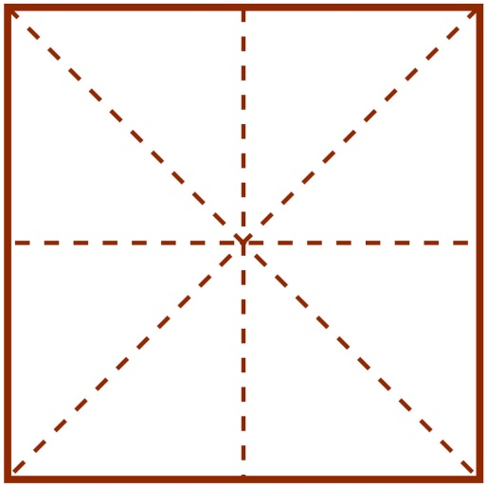
1.yǔ language
语

Slide 12
2.nà that
那

Slide 13
3.zhè this
这

Slide 14
4.nǎi milk
奶

Slide 15
The principle of the stroke order of chinese characters
Princile 规则 | Example 例字
先横后竖 A horizontal stroke should be written before a vertical one. | 十
先撇后捺 A left falling should be written before a right falling. | 人
先上后下 An upper stroke should be written before a lower one. | 三
先左后右 A left component should be given before a right one. | 汉

Slide 16
The principle of the stroke order of chinese characters
Princile 规则 | Example 例字
先外后内 Outer strokes should be written before inner ones. | 月
先进人后关门. Inside strokes should be completed before an enclosing stroke of a frame. | 四
先中间后两边 Inside strokes should be completed before an enclosing stroke of a frame. | 小

Slide 17
The principle of the stroke order of chinese characters
Princile 规则 | Example 例字
先横后竖+先上后下 The horizontal stroke is written before the vertical stroke, and the upper stroke is completed before the lower one. | 五
先左后右+先横后竖 The left stroke is written before the right one, and the horizontal is written before the vertical. | 午
先撇后捺+先上后下 The left-falling stroke is written before the right-falling one, and the upper stroke is written before the lower one. | 个
先中间后两边+先上后下 The middle stroke is written before the ones on both sides, and the upper stroke is written before the lower one. | 业

Slide 18
复习
你多才cái多艺yì，是shì个gè多面miàn手shǒu。
大大小小、多多少少，样样yàng都dōu能néng干gàn。

Slide 19
月

Slide 20
小

Slide 21
业

Slide 22
作业
1. 练习本节课所学的笔画
2. 按顺序书写本节课所学的汉字

Slide 23
点击添加文本
标题
标题
点击添加文本
点击添加标题
点击添加文本
标题
标题
点击添加文本
点击添加文本
标题
标题
点击添加文本

Slide 24
点击添加文本
标题
标题
点击添加文本
点击添加标题
点击添加文本
标题
标题
点击添加文本
点击添加文本
标题
标题
点击添加文本

Slide 25
点击添加标题
点击添加标题
点击输入文本
点击添加文本
点击添加文本
点击添加文本
添加文本
添加文本
添加文本
添加文本
添加文本

