Slide 1
Chinese
Traditional
Sports

Slide 2
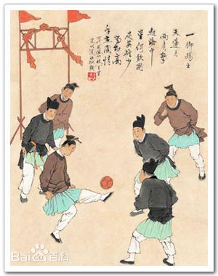
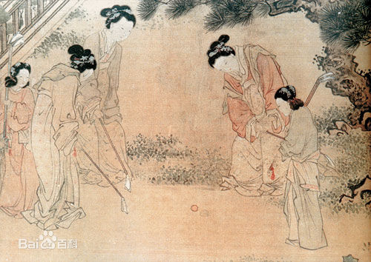

Slide 3
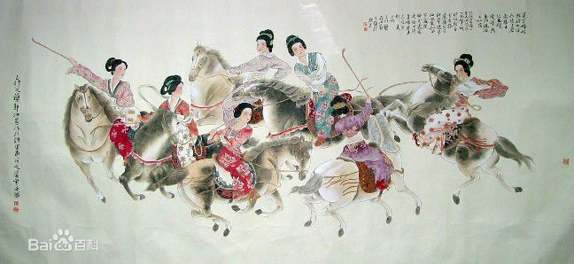

Slide 4
1. Chinese Traditional Sports in the past dynasties
2. Chinese Ethic Sports
3. Representatives of Chinese Traditional Sports

Slide 5
Chinese Traditional Sports in the past dynasties

Slide 6
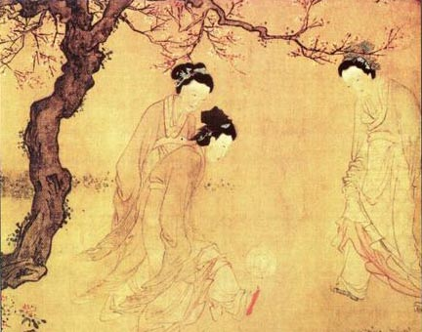
Chinese Traditional
Sports
Cuju, a primitive soccer

Slide 7
Chinese Traditional
Sports
Chuiwan, similar to golf

Slide 8
Chinese Traditional
Sports
Jiju, a primitive polo

Slide 9
Chinese Ethic Sports

Slide 10
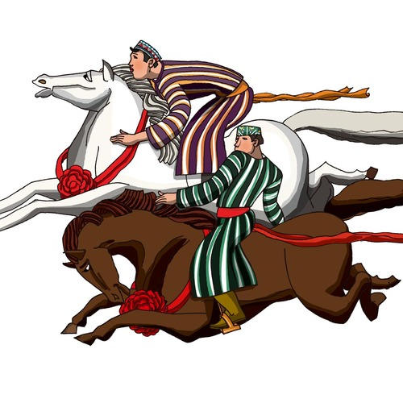
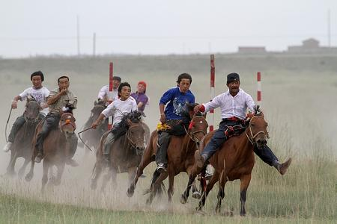
Chinese Ethnic Sports
Horse racing---- Uzbekistan

Slide 11
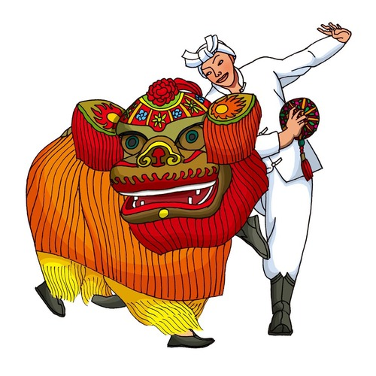
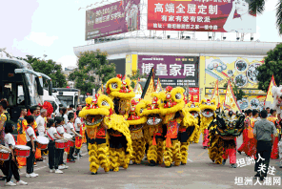
Chinese Ethnic Sports
Lion dance----Han

Slide 12
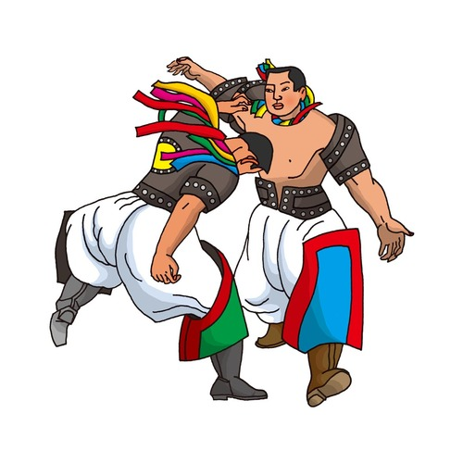
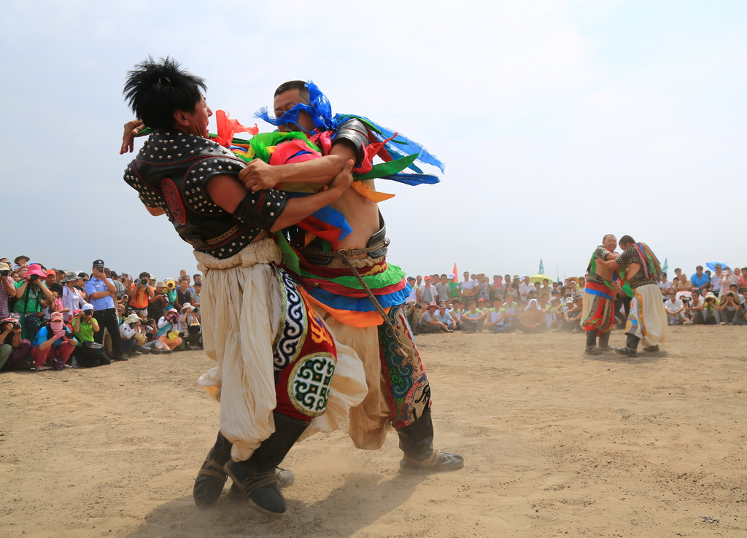
Chinese Ethnic Sports
Wrestling-----Mongol Nationality

Slide 13
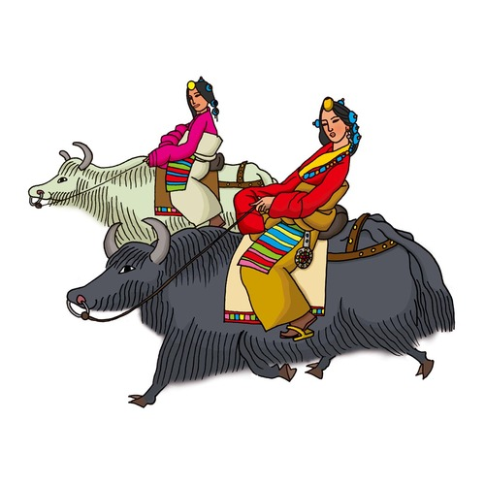
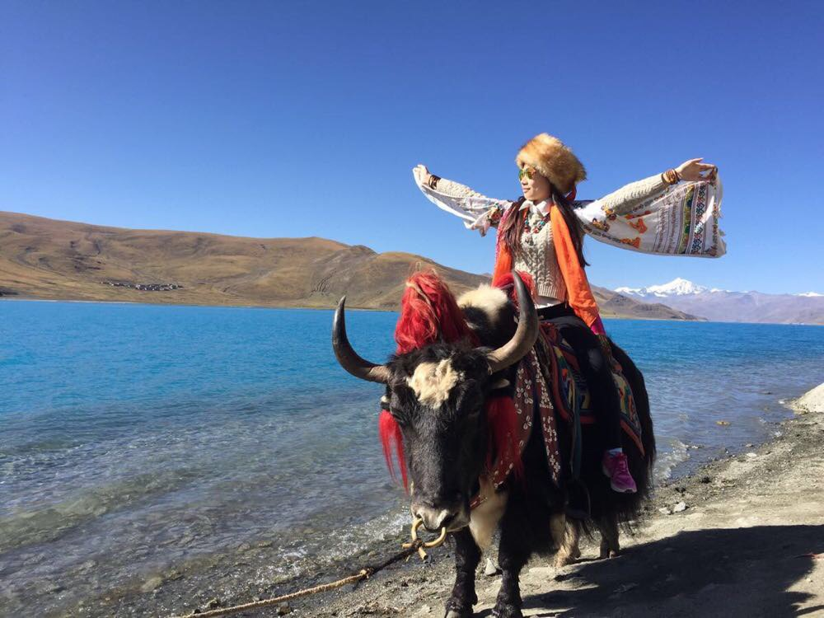
Chinese Ethnic Sports
Racing yak----the Zang [Tibetan] nationality

Slide 14
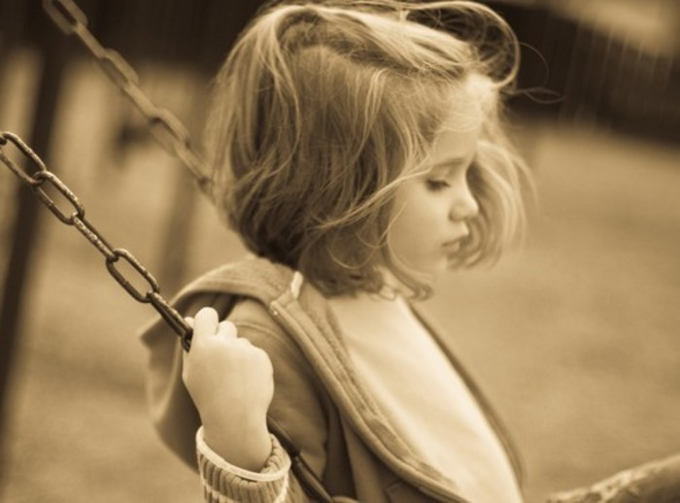
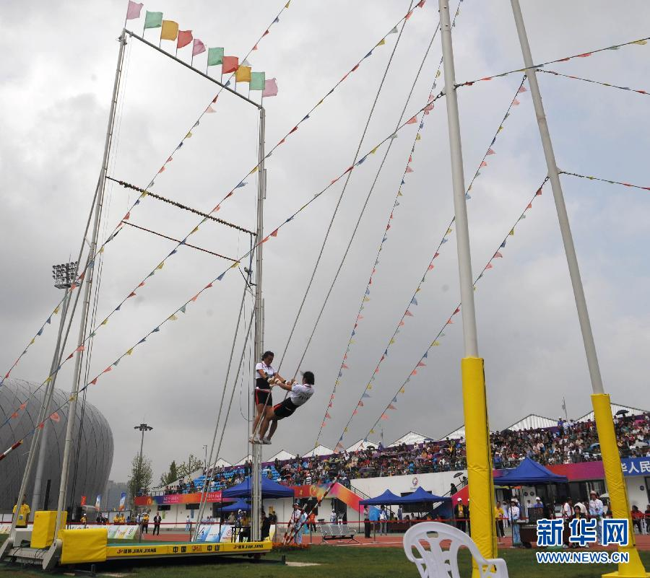
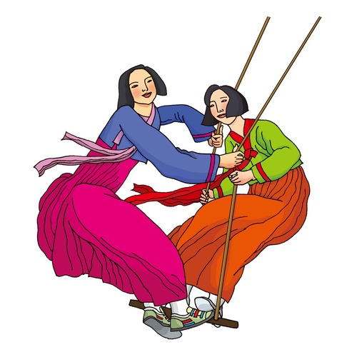
Chinese Ethnic Sports
Swinging----the Zang [Tibetan] nationality

Slide 15
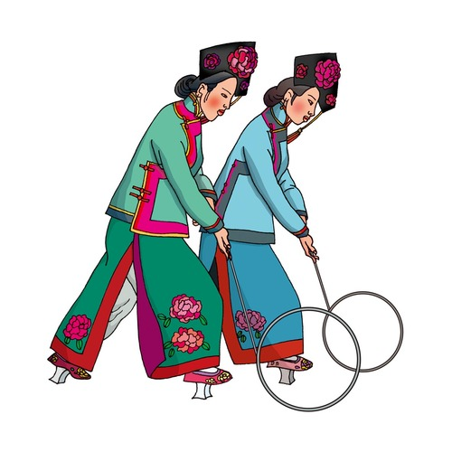
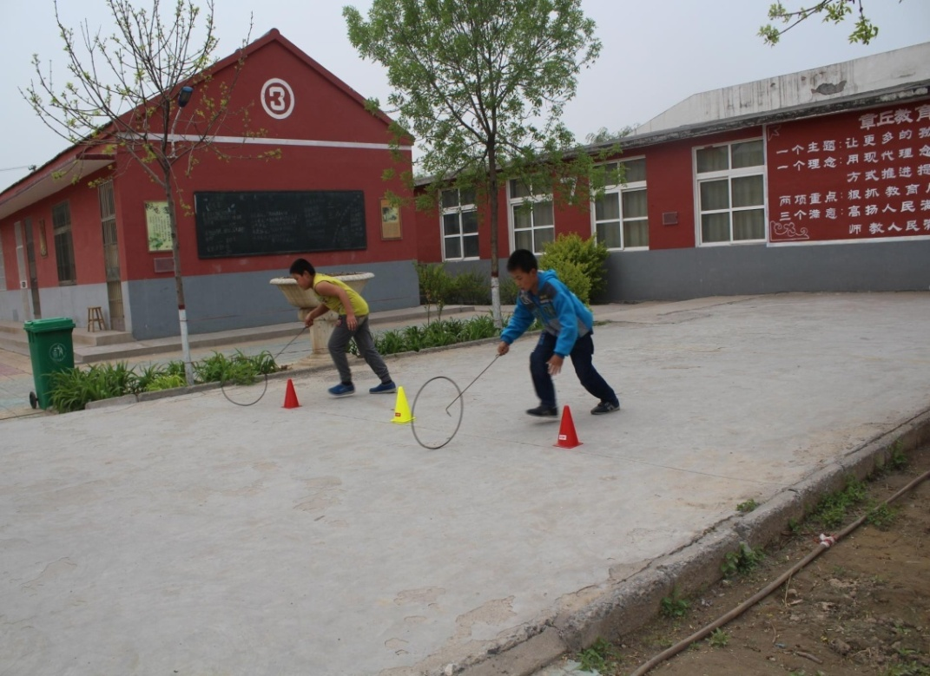
Chinese Ethnic Sports
Rolling a hoop-----Manchu

Slide 16
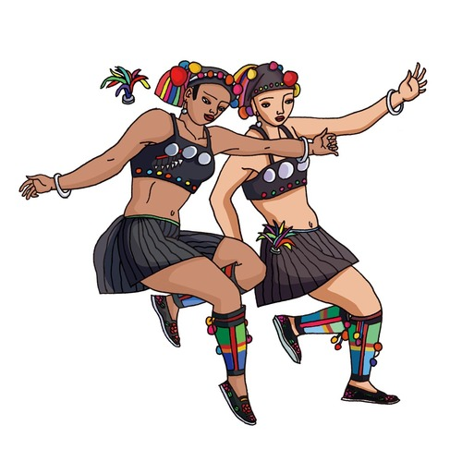
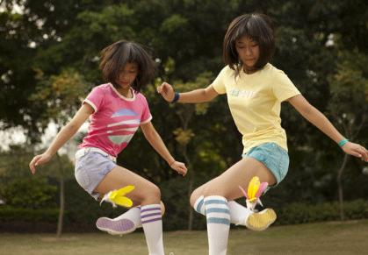
Chinese Ethnic Sports
Kicking shuttlecock----the Hani nationality

Slide 17
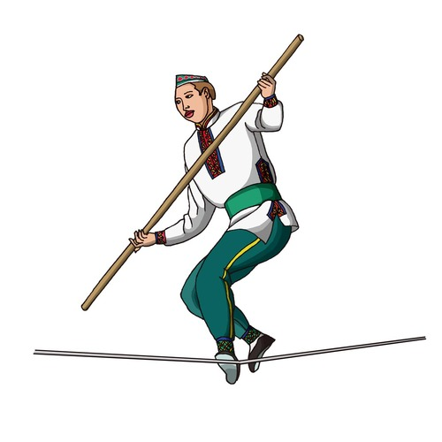
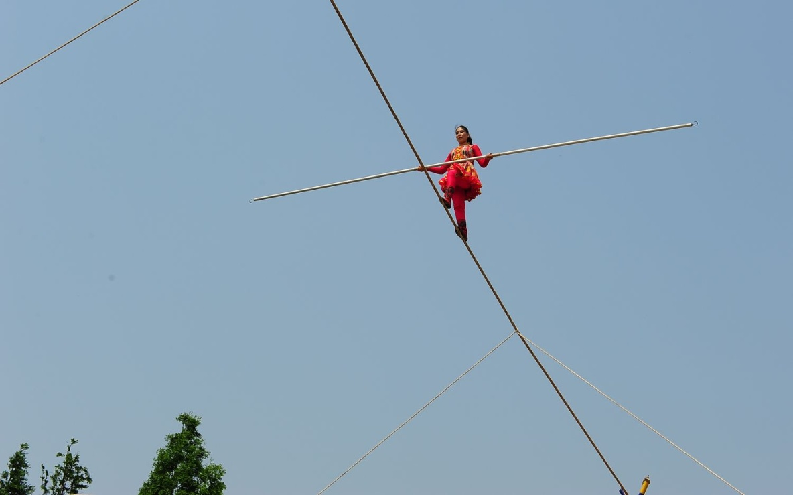
Chinese Ethnic Sports
Wire walking ---- the Tatar nationality

Slide 18
Chinese kungfu

Slide 19
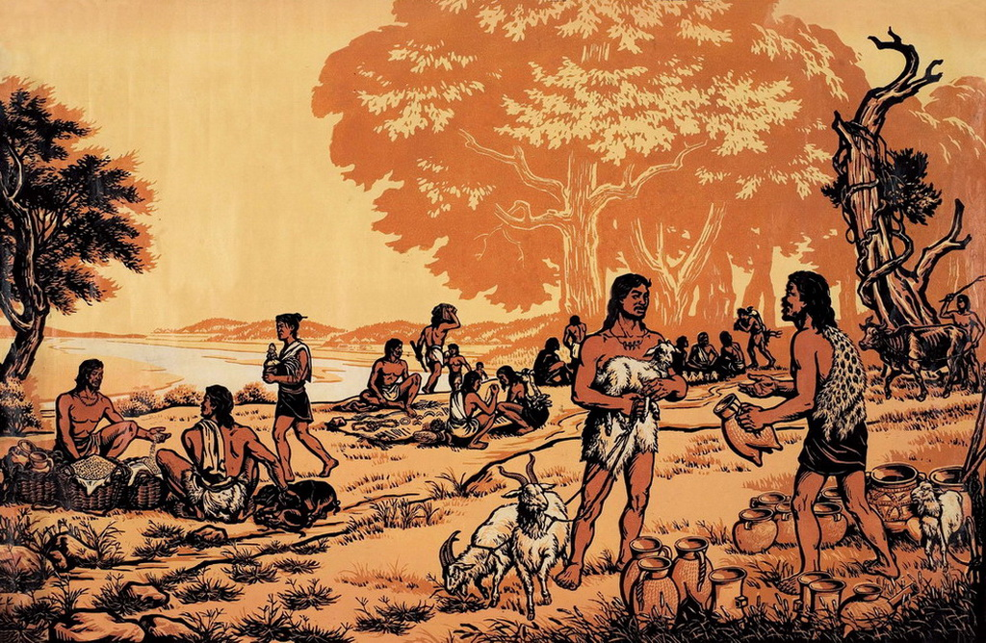
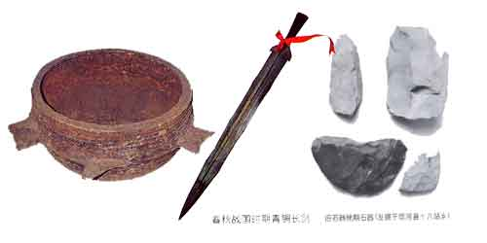
Chinese kungfu
Brief Introduction to Kung Fu
In order to survive, people in primitive society had to hunt for food efficiently, so they learned the primary attack means. Gradually stone and wooden tools are added as weapon.
When the war become more and more ,the dictators attach great importance to attack means. So people continually gain experience and skills from war practice.
At last ,all these skills passed on from generation to generation. Now we call it Kung fu!

Slide 20
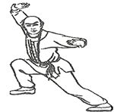
Chinese kungfu
Brief Introduction to Kung Fu
Chinese martial arts is our national sports as one of the main method for thousands of years of our people to exercise and self-defence.

Slide 21
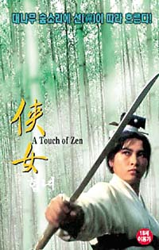
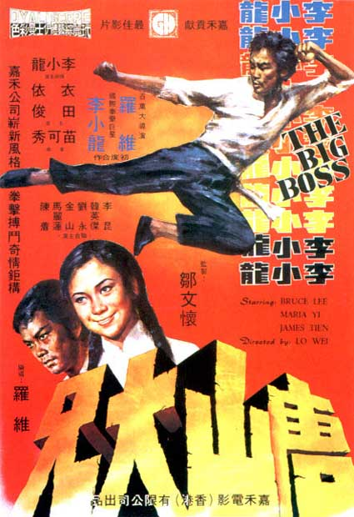
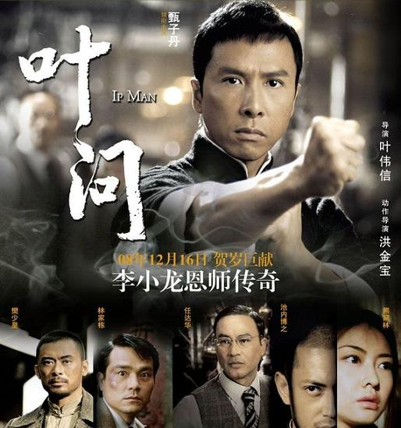
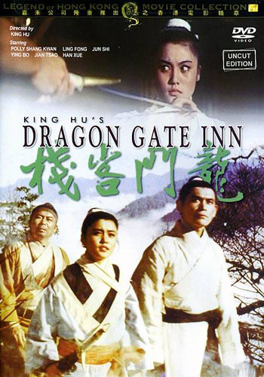
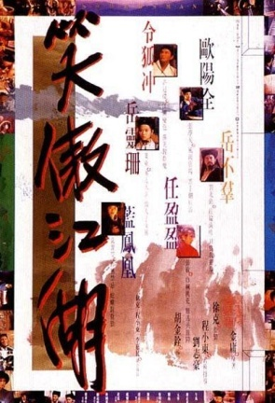
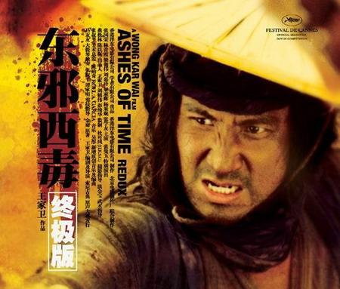
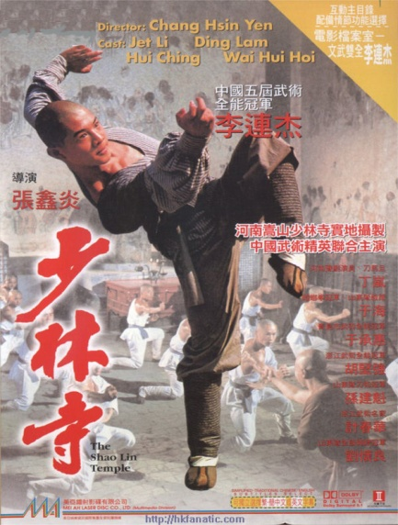
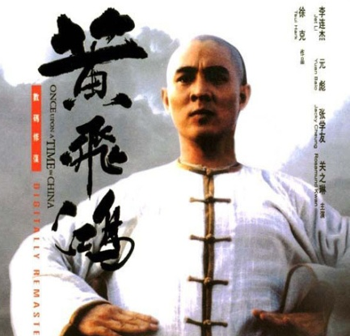
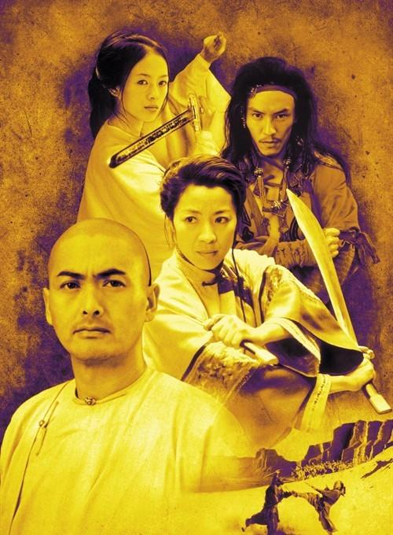
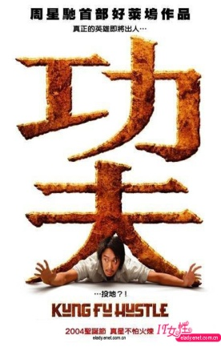
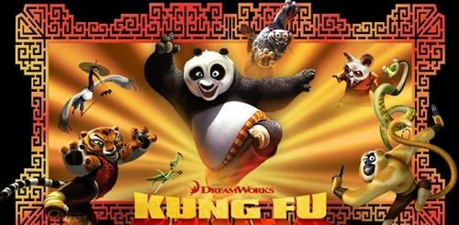
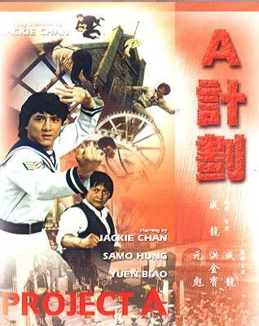
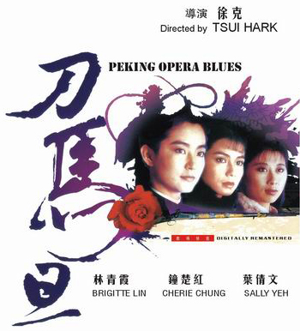
Famous Martial Stars

Slide 22
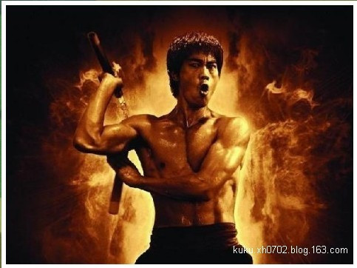
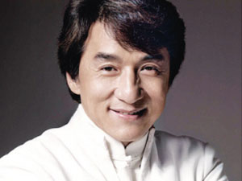
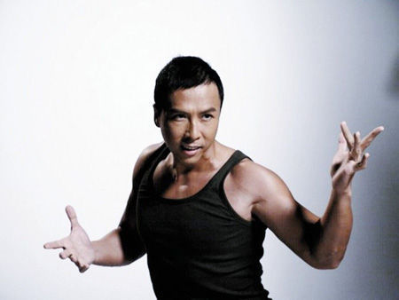
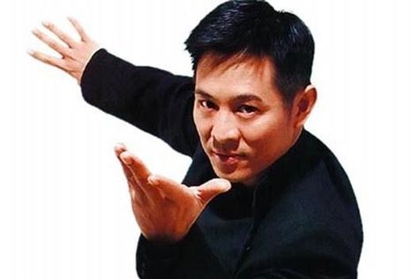
Famous martial stars：
Bruce Lee
Jackie Chan
Jet Li
Donnie Yen

Slide 23
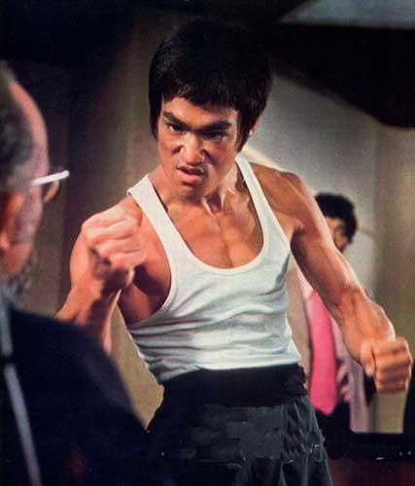
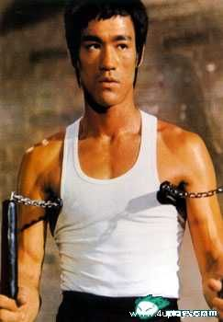

Slide 24
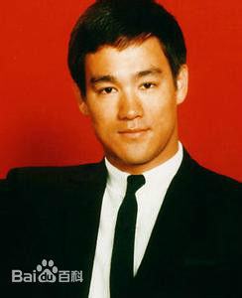
Stars
李小龙 1940年11月27日出生
English name：Bruce Lee
Master work:《唐山大兄》、
《精武门》、《猛龙过江》、
《龙争虎斗》
Bruce lee said,
“I never said I was the first one,
but I would never admit that I was
the second.”

Slide 25
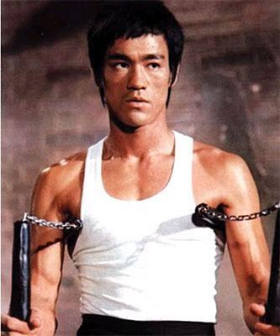
The influence of Bruce Lee on Kungfu:
Found the jeet kune do(截拳道)
Introduce Kungfu to the English-Chinese dictionary.
Start martial arts films and bring Kungfu into the world.
Make nunchakus（双节棍） become popular in the world.

Slide 26
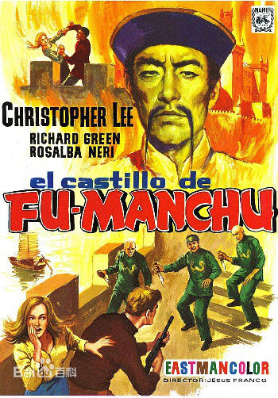
The influence of Bruce Lee on Chinese image in the world:
1. It is the first time to show our Chinese are not the sick man of Asia in the world, and from the evil to the brave.
2. Attract many foreigners come to China learning Kungfu.

Slide 27
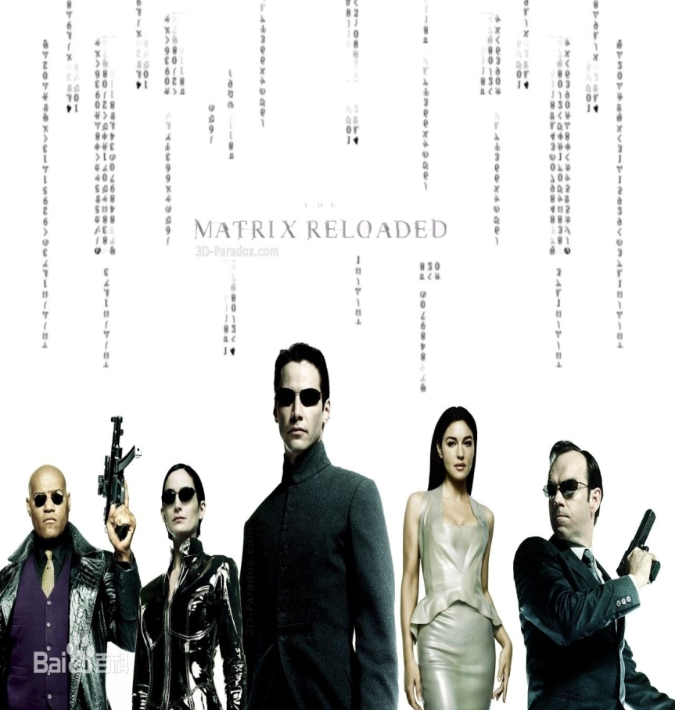
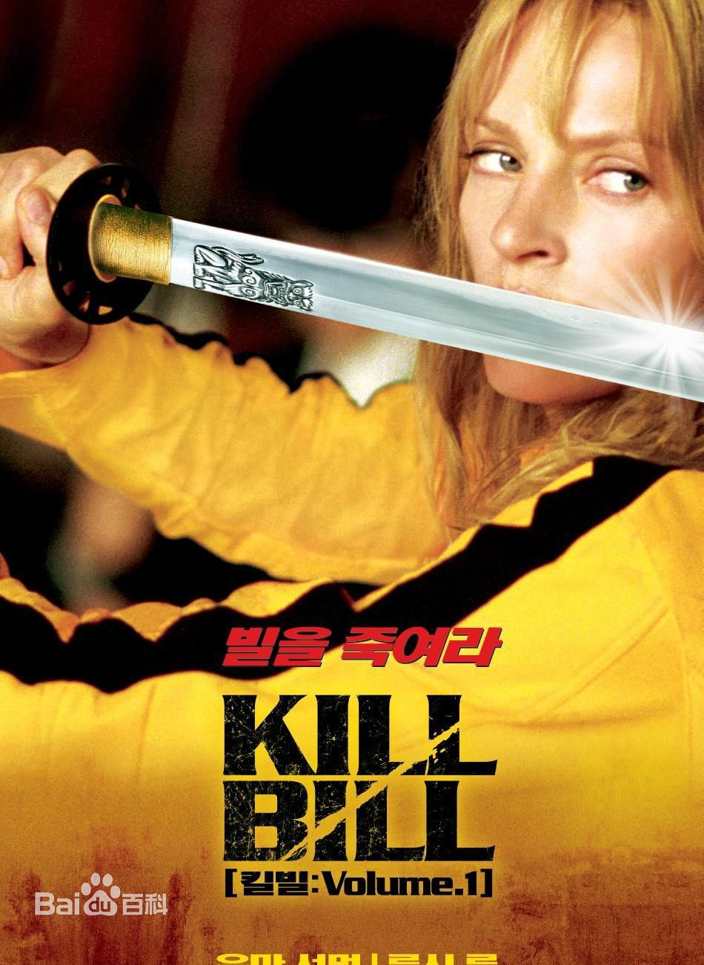
The influence of Bruce Lee on movies:

Slide 28
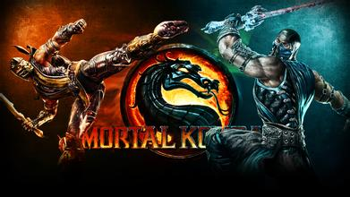
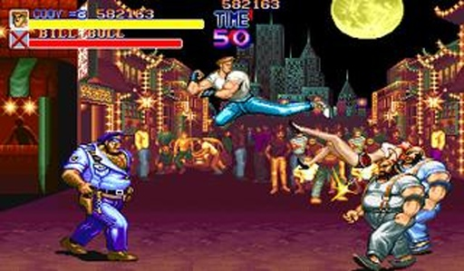
The influence of Bruce Lee on video games:

Slide 29
The influence of Bruce Lee on comics:

Slide 31
成龙，Jackie Chan、Jacky Chan 1954年4月7日。 He was born in Hong Kong ,and his ancestral home is Shandong. The great China film star and international kung fu movie superstar,

Slide 32
Why Jackie Chan became famous 1. He created comic Kongfu movie. 2. He is known for acrobatic fighting style 3. He refuses standin for dangerousscenes.

Slide 33
Li Lianjie born 26 April 1963), better known by his stage name Jet Li, is a Chinese film actor, film producer, martial artist, and retired Wushu champion who was born in Beijing.

Slide 34
After three years of intensive training with Wu Bin, Li won his first national championship for the Beijing Wushu Team. After retiring from Wushu at age 19, he went on to win great acclaim in China as an actor making his debut with the film Shaolin Temple (1982)
Ten cents
One hundred million

Slide 36
Donnie Yen (born 27 July 1963), also known as Yen Ji-dan (甄子丹), is a Hong Kong actor, Chinese martial artist, film director and producer, action choreographer, and multiple-time world wushu tournament champion.

Slide 37
Yen is credited by many for contributing to the popularization of the traditional martial arts style known as Wing Chun. He played Wing Chun grandmaster Yip Man in the 2008 film Yip Man, which was a box office success.

Slide 38
One of Bruce Lee ‘s master is also known to us ,his name is Ye Wen(叶问）.
His Wing Chun is famous in China .

Slide 39
Category of Kung Fu
Chinese kungfu
1. external (外家拳) and internal (内家拳)
2. northern (北拳) and southern (南拳)
3. imitative-styles (象形拳)

Slide 40
Southern boxing
Chinese kungfu
Wing Chun
咏春拳

Slide 41
Chinese kungfu
Wing Chun practitioners（练习者） believe that the person with better body structure will win. A correct Wing Chun stance is like a piece of bamboo, firm but flexible, rooted but yielding. This structure is used to either deflect external forces or redirect them into the ground.

Slide 42
Northern boxing
Chinese kungfu
Tai Chi
太极拳

Slide 43
Imitative-styles
Chinese kungfu
Drunken boxing
醉拳

Slide 44
Drunken Boxing
Performance of this kind of boxing looks like a drunken man’s waddling and blundering. However, the performer is only drunken in appearance but not in mind or consciousness.

Slide 45
Imitative-styles
Chinese kungfu
Mantis Boxing
螳螂拳

Slide 46
Chinese kungfu
Shao Lin
The Shaolin Monastery also known as the Shaolin Temple, is a Buddhist temple in Dengfeng County, Henan Province, China. Dating back 1,500 years when founded by Fang Lu-Hao, Shaolin Temple is the main temple of the Shaolin school of Buddhism to this day.

Slide 47
Chinese kungfu
Shao Lin
The basics of Shaolin boxing: Standing on the poles.

Slide 48
Chinese kungfu
Shao Lin
The style of Shaolin boxing:
1. vigorous, forceful movements.
2. Expertise in striking.

Slide 49
Chinese kungfu
Five-animal exercise
This boxing skills imitate actions of five kinds of animals:
tiger, deers, bears, apes and cranes.

Slide 50
The influence of Chinese Kung Fu

Slide 51
The influence of Chinese Kung Fu

Slide 52
T’ai Chi Chuan
Teach the Teacher Report

Slide 53
Outline
T’ai Chi Chuan
1、Characteristics of Tai chi
2、Theory of Tai chi
3、Types of Tai chi
4、Benefits of Tai chi

Slide 54
T’ai Chi Chuan
T'ai Chi Ch'uan is one of the Chinese Traditional
martial arts.
T'ai Chi Ch'uan
Supreme Ultimate Fist

Slide 55
Characteristics：
T’ai Chi Chuan
1、Slow Movement
2、Natural breathing
3、Physical relaxation
4、Use their power on a point
5、Break the balance of the enemy

Slide 56
Theory of the Tai Chi
T’ai Chi Chuan
Yin
Tai Chi diagram is a black-and-white two fish pattern consisting of a circular pattern, commonly called Yin Yang fist.
Yang

Slide 57
T’ai Chi Chuan
As an ancient Kongfu, T’ai chi includes many forms.
Push-hand
Sword
Broadsword
T’ai Chi Fan

Slide 58
Push-hand
T’ai Chi Chuan
The push-hand is well known for its tactic and technique, the powerful and aggressive opponent being defeated by a small clever attack or an abrupt explosive power.

Slide 59
T’ai Chi Sword
T’ai Chi Chuan

Slide 60
T’ai Chi Fan
T’ai Chi Chuan

Slide 61
T’ai Chi Broadsword
T’ai Chi Chuan

Slide 62
Benefits:
T’ai Chi Chuan
The benefits of Taijiquan covers many aspects of physical and mental, to keep the physical and mental health, prevention and cure all kinds of disease is very favorable

Slide 63
Benefits
T’ai Chi Chuan
1、Chronic conditions
Promotion
balance control, flexibility, cardiovascular fitness
Reduce the risk
falling in elderly patients,
those recovering from chronic stroke,
heart failure, high blood pressure, heart attacks,Parkinson's,

Slide 64
Stress and Mental Health
T’ai Chi Chuan
Benefits
T'ai chi ch'uan also have some effect on noradrenaline and cortisol production with an effect on mood and heart rate.

Slide 65
International Tai Chi
T’ai Chi Chuan
Tai Chi become a quintessence of Chinese culture. Many foreigners learn Tai Chi in china.

Slide 66
Chinese Yo-Yo

Slide 67
Chinese Yo-Yo
Chinese yoyo is a toy made of bamboo, with several discs having small holes on them fixed to one or both ends of an axle. When you shake the axle with a string, the discs will spin, making a humming sound.

Slide 68
Chinese Yo-Yo
Chinese Yo-Yo, a national sport unique to the Chinese people, is not only a way of exercising but also a kind of elegant art performance.

Slide 69
Chinese Yo-Yo
Pretty Prima Donna, a team performance of Chinese yo-yo, is one of the most representative and well-known acrobatic peroformances of its liking on the international arena.

Slide 70
Pearl Ball

Slide 71
Pearl Ball
Essential equipments:
球 BALL

Slide 72
Pearl Ball
Bat 球拍
Brail 抄网

Slide 73
Pearl Ball
Court for pearl ball:

Slide 74
谢谢！

