Slide 1
Chapter 5
Chinese Traditional Art2
中国传统艺术
李舒慧 Annie

Slide 2
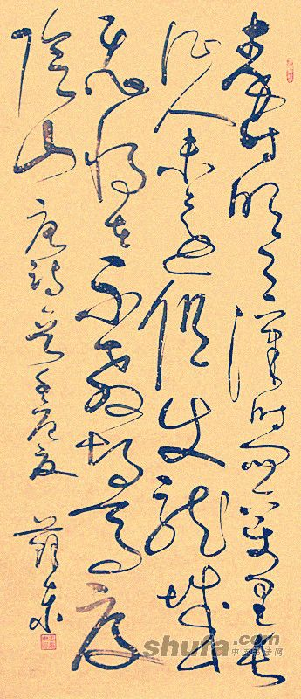
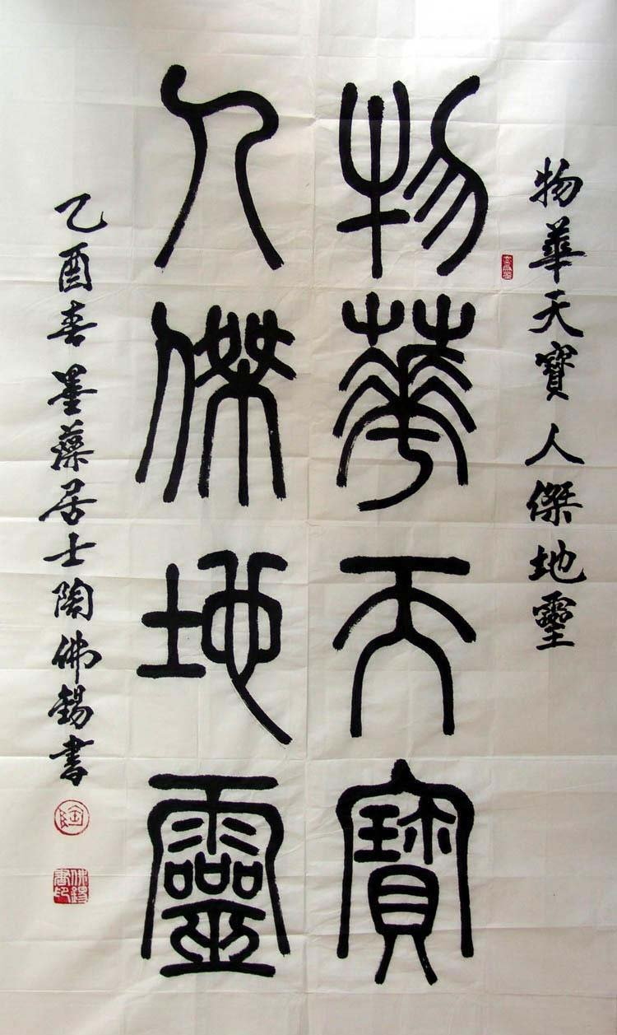

Slide 3
Chinese Calligraph and Painting

Slide 4
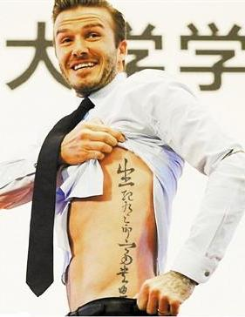
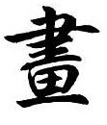
It's the longest living character in the world.
Chinese Character is world famous.

Slide 5
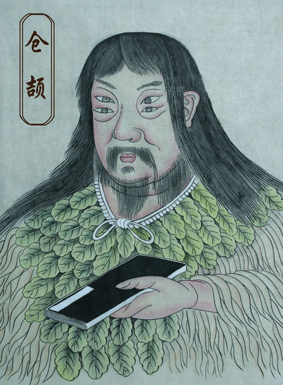
Legend about "Invention of Characters by Cang Jie".

Slide 6
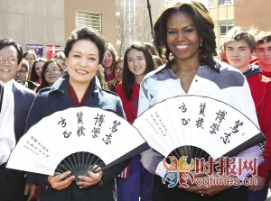
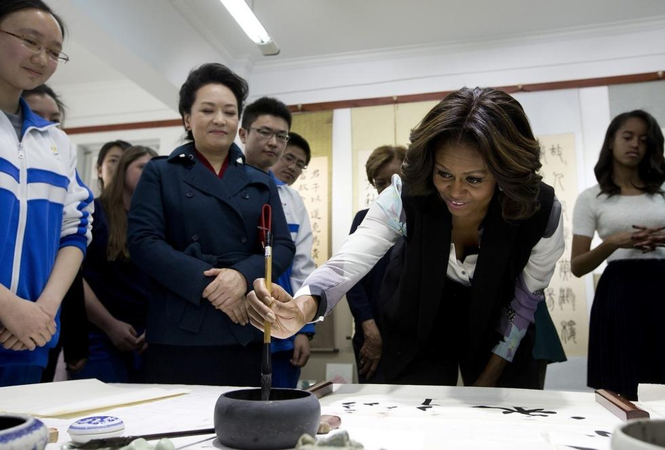

Slide 7
Chinese Calligraphy
Calligraphy
Chinese Calligraphy is a kind of art.Its occurrence is based on the development of Chinese characters and the culture of China.

Slide 8
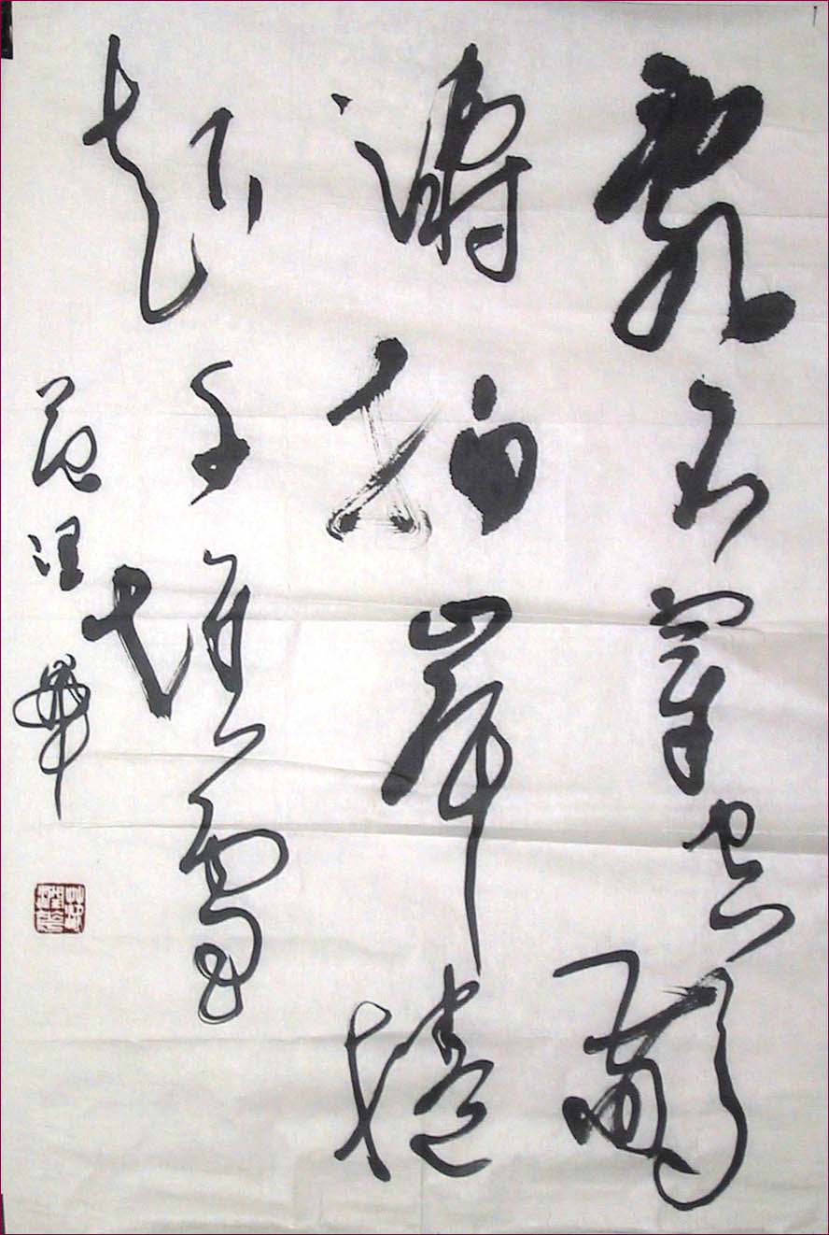
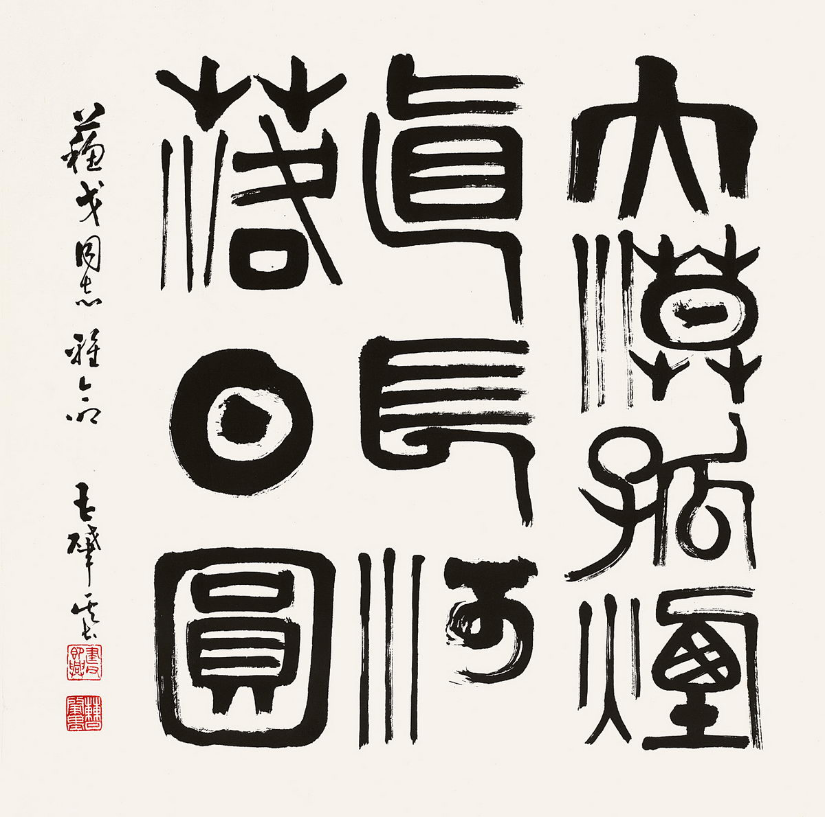
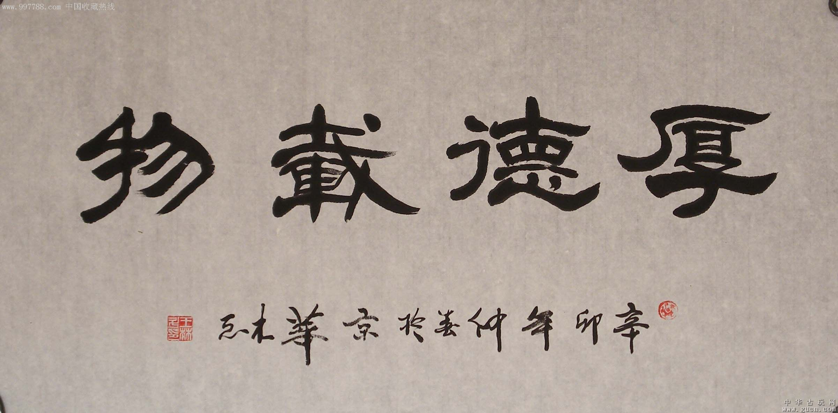
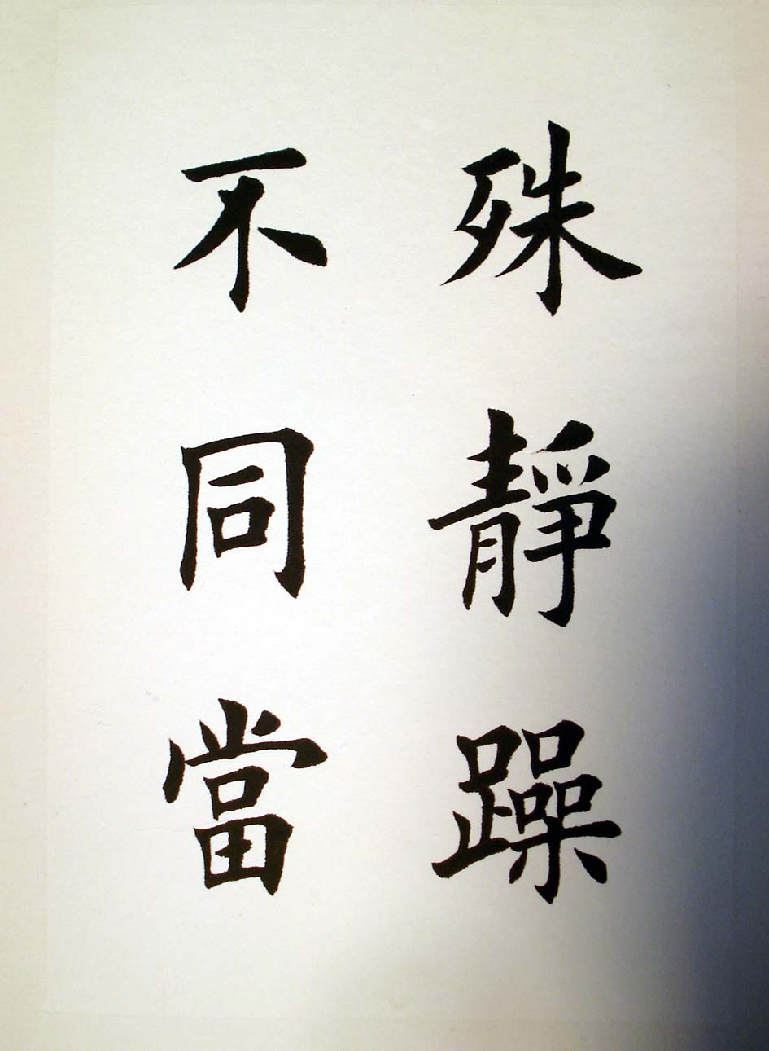
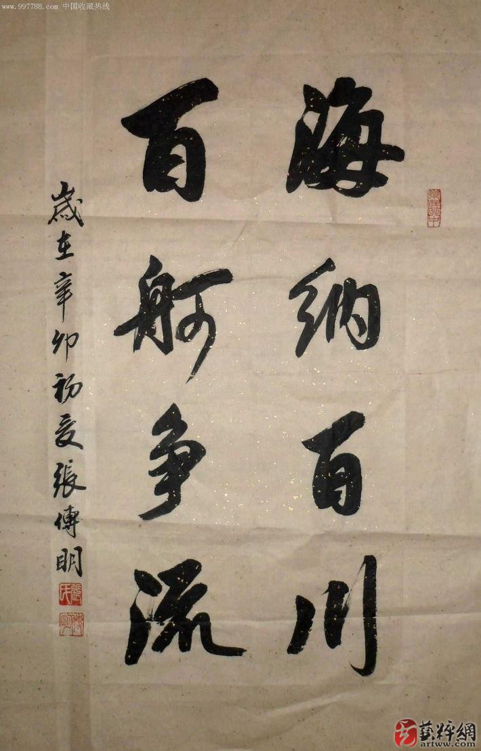
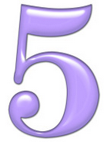
Classification
Chinese scripts are generally divided into five categories:
1.Seal character(zhuan)
2.Official script(li)
3.Regular script(kai)
4.Cursive script(cao)
5.Running script(xing)

Slide 9
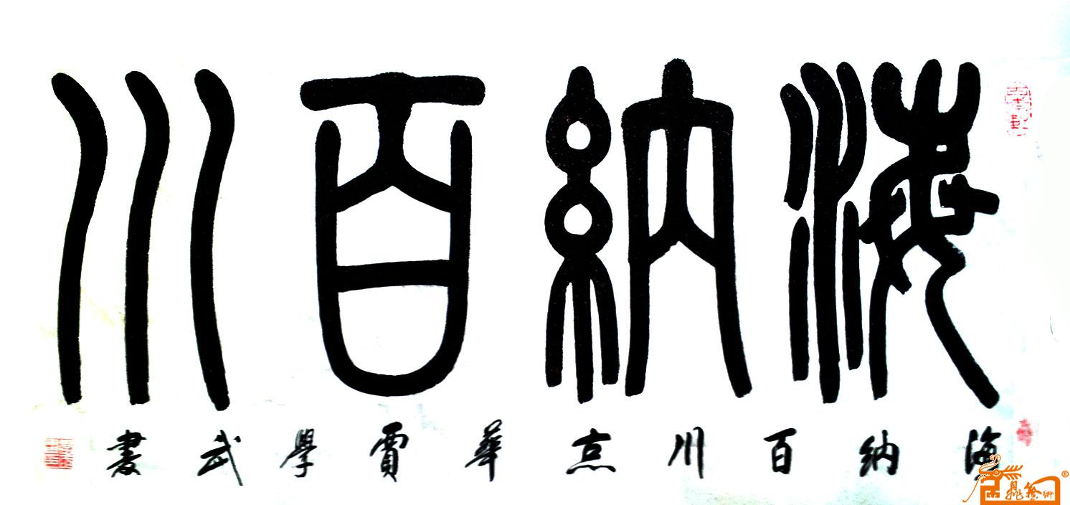
Zhuan
Seal character was the earliest form of writing.

Slide 10
Li
It was between Qin Dynasty[221 B.C. - 207 B.C.] and Han Dynasty[201B.C. - 207]

Slide 11
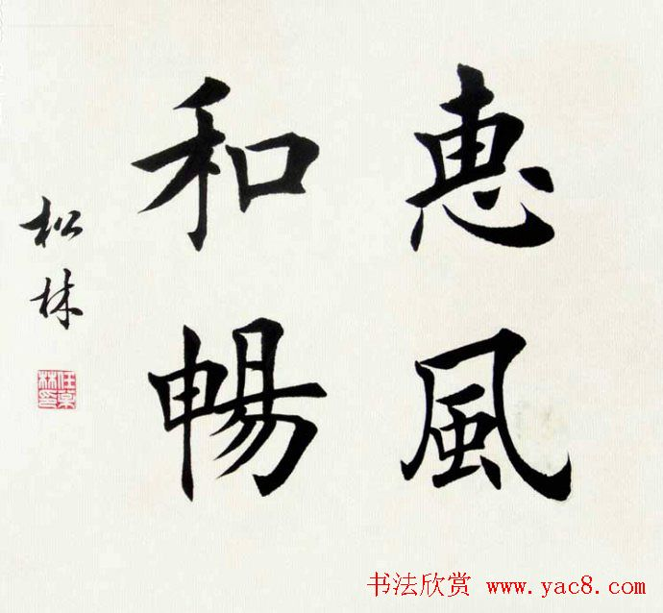
Kai
It was from over 1700 years ago during three kindom period.

Slide 12
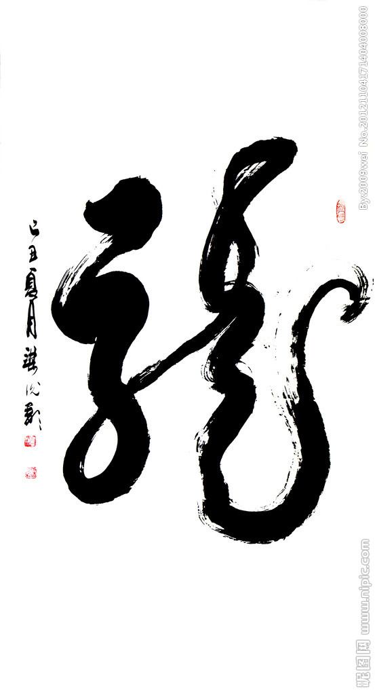
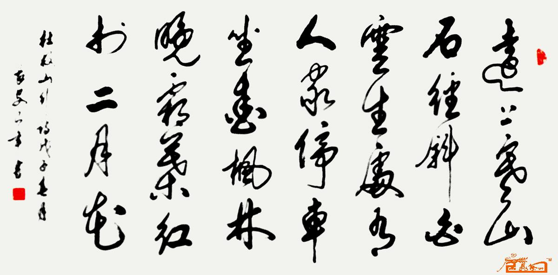
Cao
It was from Han Dynasty[201B.C. - 207] .

Slide 13
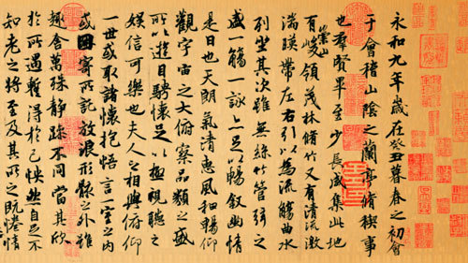
Xing
It was from Western Han Dynasty[202B.C.-9].
Between Calligraphy--Kai and Calligraphy--Cao.

Slide 14
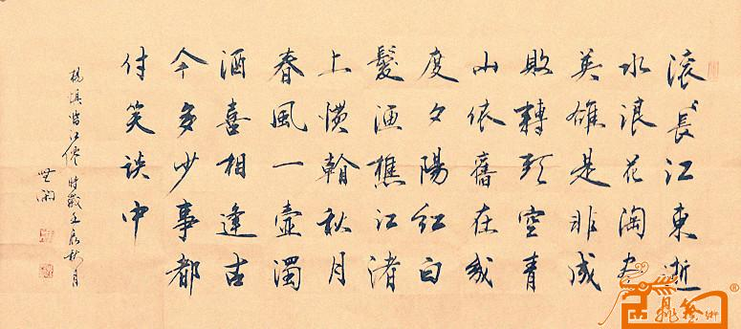
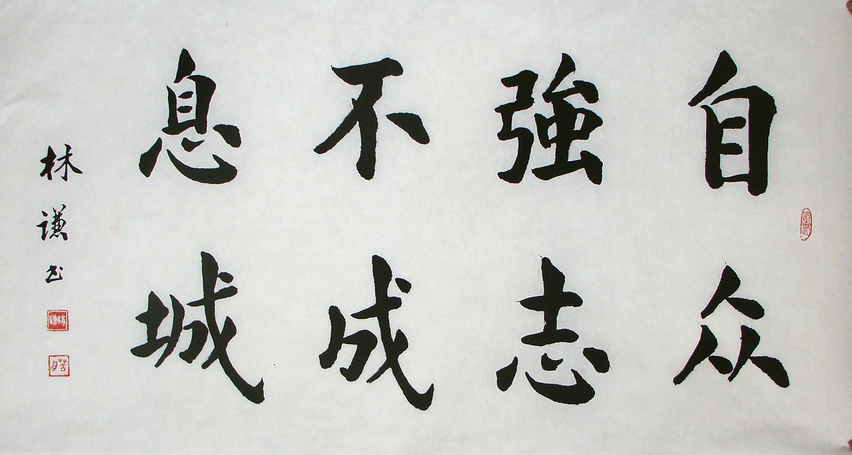
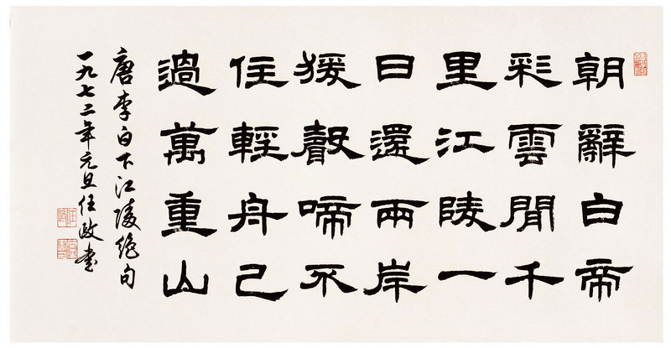
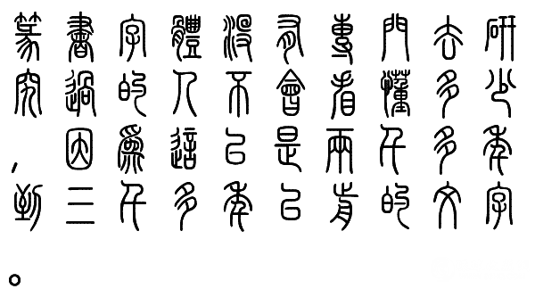

Slide 15
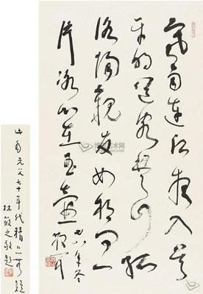
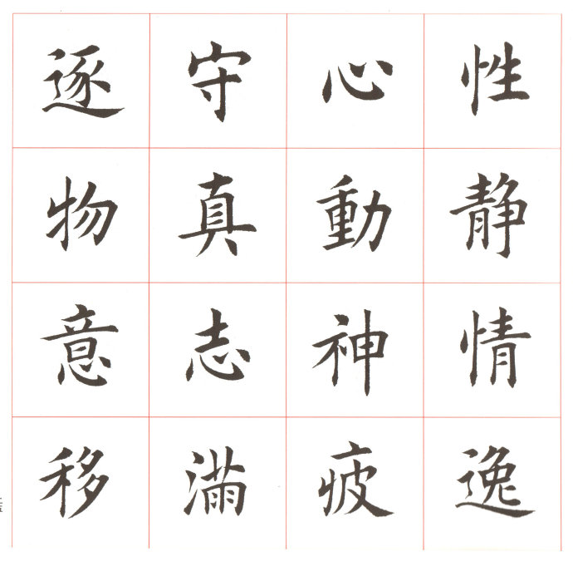
"The style of handwriting is the man."

Slide 16
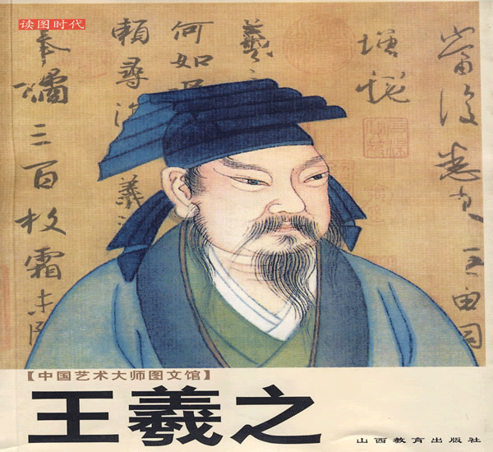
Calligraphers
Wang Xizhi was a very famous calligrapher in Han Dynasty[201B.C. - 207] in China.
He was known in China as
the "God of calligraphy".

Slide 17
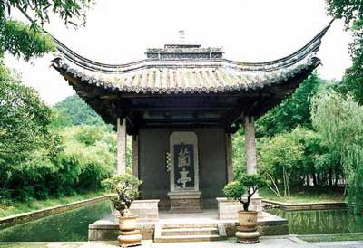
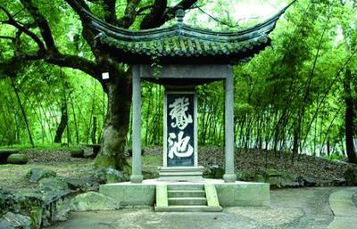
Lanting The Goose Pond
Lanting:Shaoxing,Zhejiang Province
Where Wang Xizhi wrote his world famous work

Slide 18
The best Xingshu in the world

Slide 19
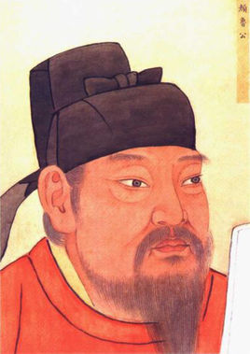
Calligraphers
“Yan Zhenqing”——a calligrapher of the Tang Dynasty[681-907], specializing in kaishu(the regular style of Chinese calligraphy).

Slide 20
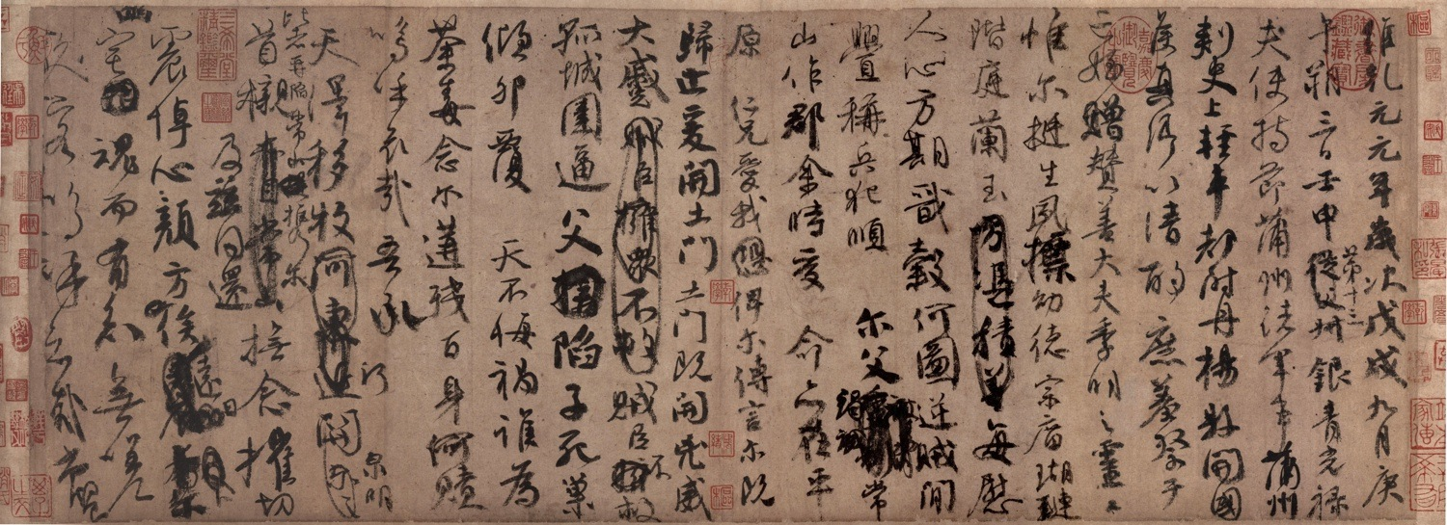
Master Pieces
In memory of his nephew who died of the war.

Slide 21
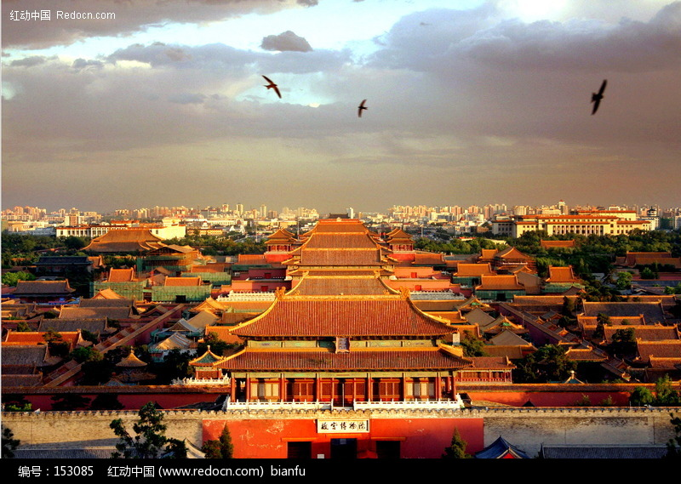
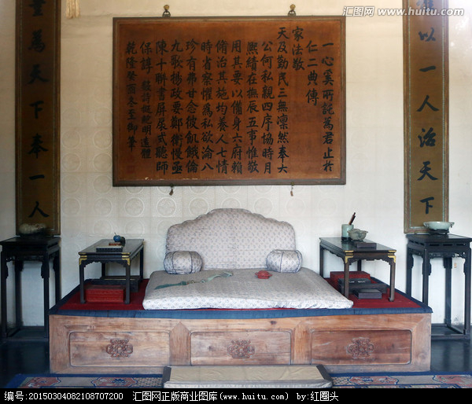
Calligraphy Element

Slide 22
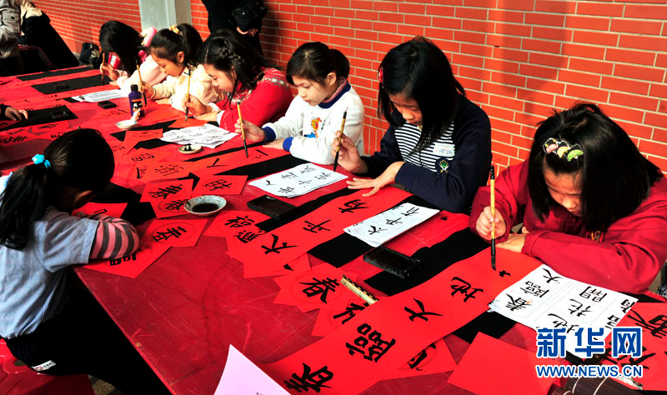
Calligraphy Element

Slide 23
Calligraphy Element

Slide 24
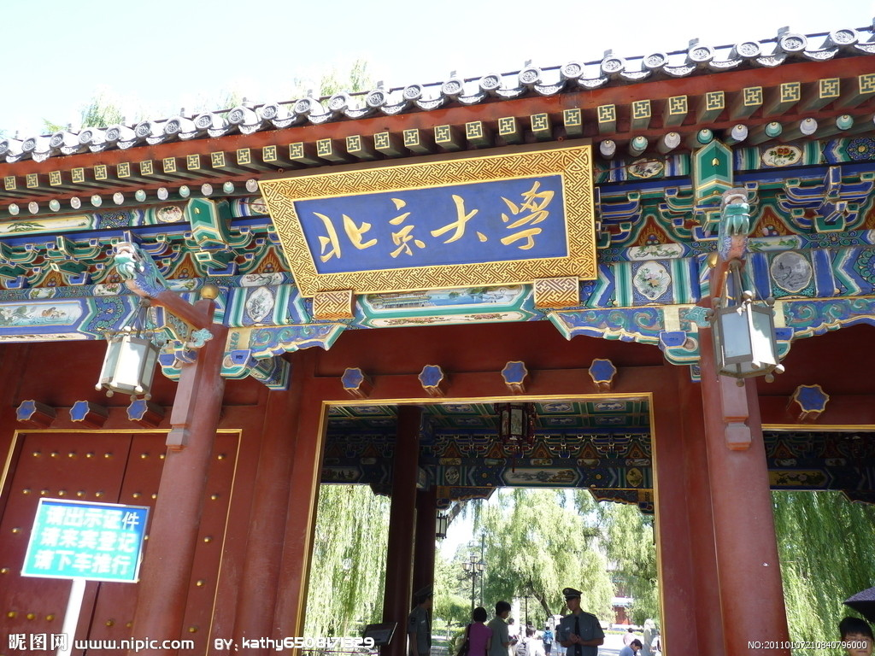
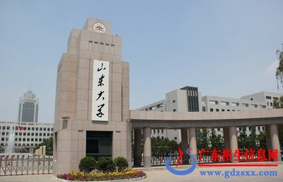
Calligraphy Element

Slide 25
Calligraphy Element

Slide 26
The Four Treasures of the Study
文房四宝
Including writing brush、ink stick、paper and inkstone.

Slide 27
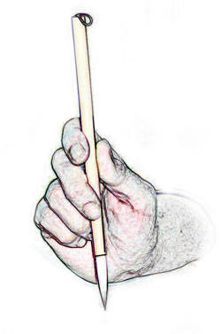

Slide 30
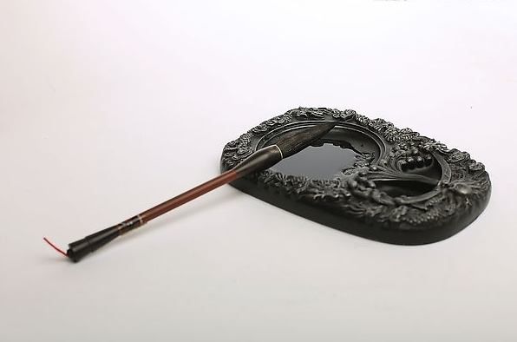

Slide 31
1.Writing brush is made of animal wool and bamboo.
2.Ink stick,the most famous ink in China,which is produced by Huizhou,Anhui province.
3.Paper is also made in Anhui. It can remained intact for hundreds of years.
4.Inkstone has three thousand years in China, it's not only a stationary,but also a rare arts and crafts.

Slide 32
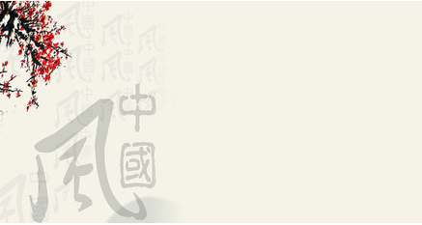
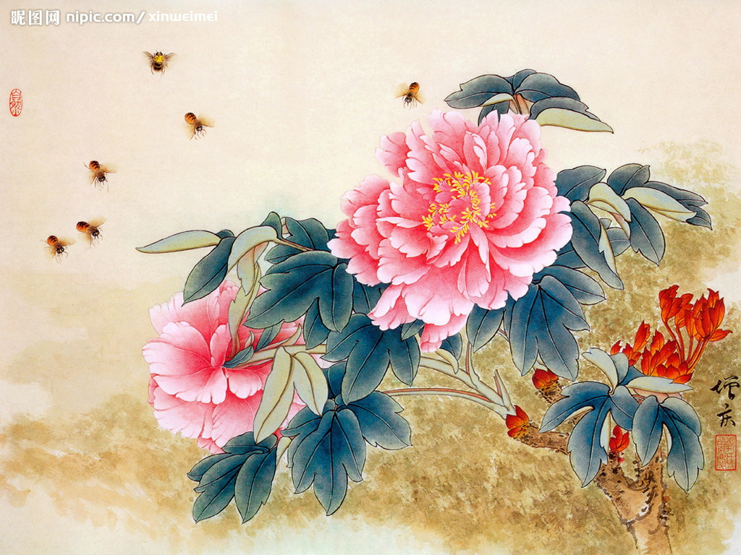
Chinese Paitings
Chinese Paitings

Slide 33
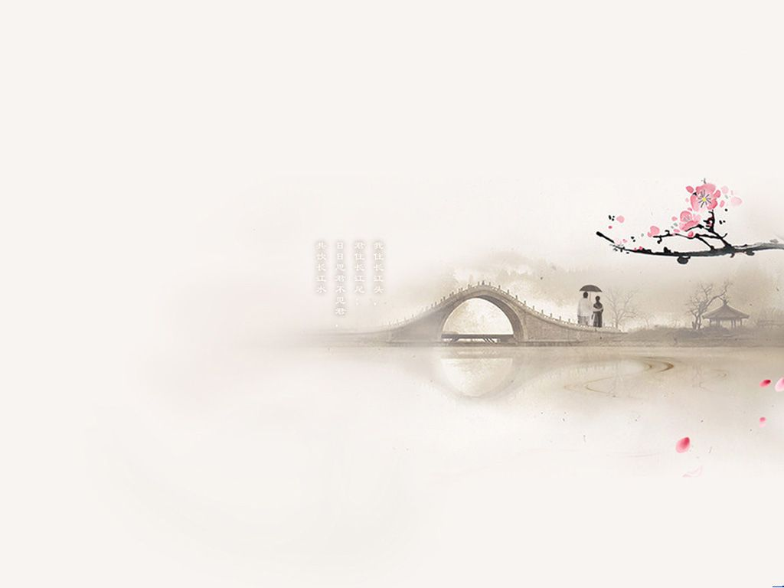
category
Figure paintings
Flower and bird paintings
Landscape paintings

Slide 34
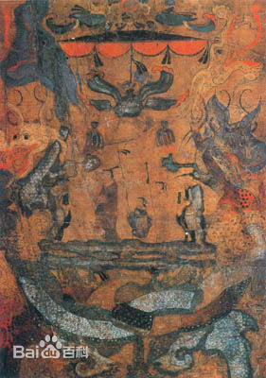
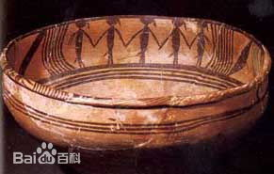
category
Ancient Paintings
Figure paintings
Flower and bird paintings
Landscape paintings
Tomb painting
Painted pottery

Slide 35
category
Category
Figure paintings
Flower and bird paintings
Landscape paintings
Figure paintings
Flower and bird paintings
Landscape paintings

Slide 36
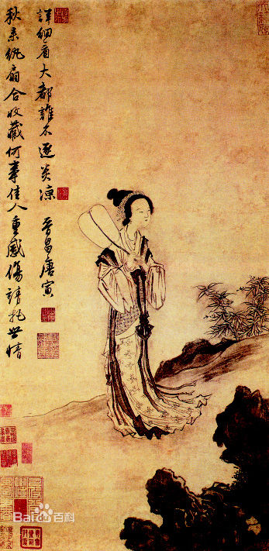
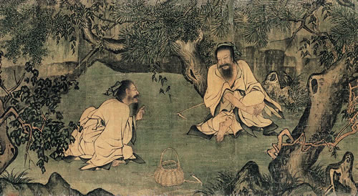
Figure Paintings
Southern Tang Dynasty
[937—975]
Ming Dynasty
[1368－1644]

Slide 37
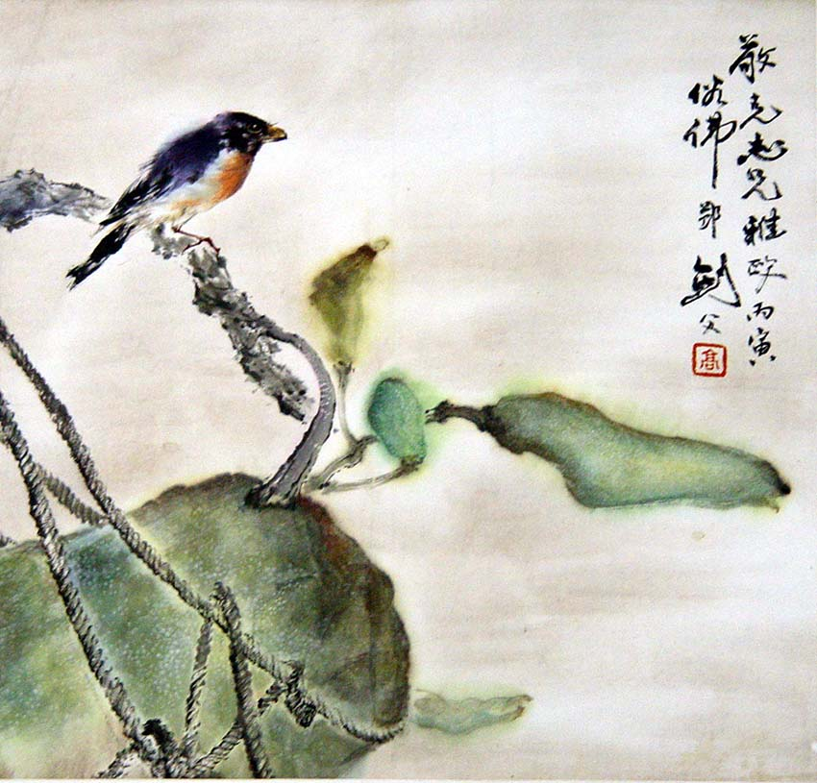
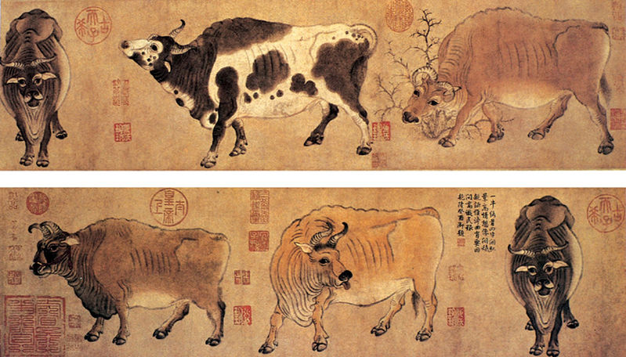
Flower and Bird Paintings

Slide 38
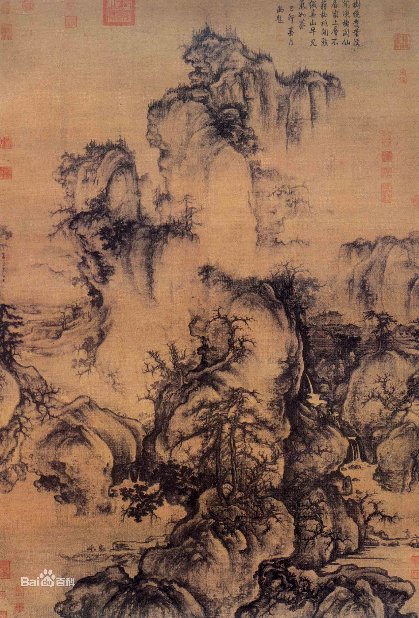
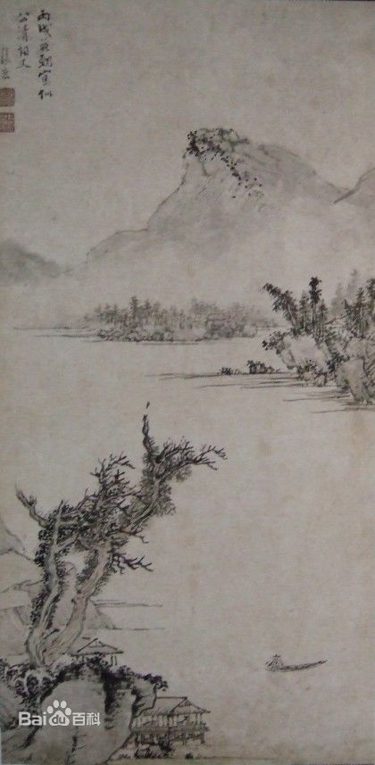
Landscape Paintings
Song Dynasty
[960—1279]
Ming Dynasty
[1368－1644]

Slide 39
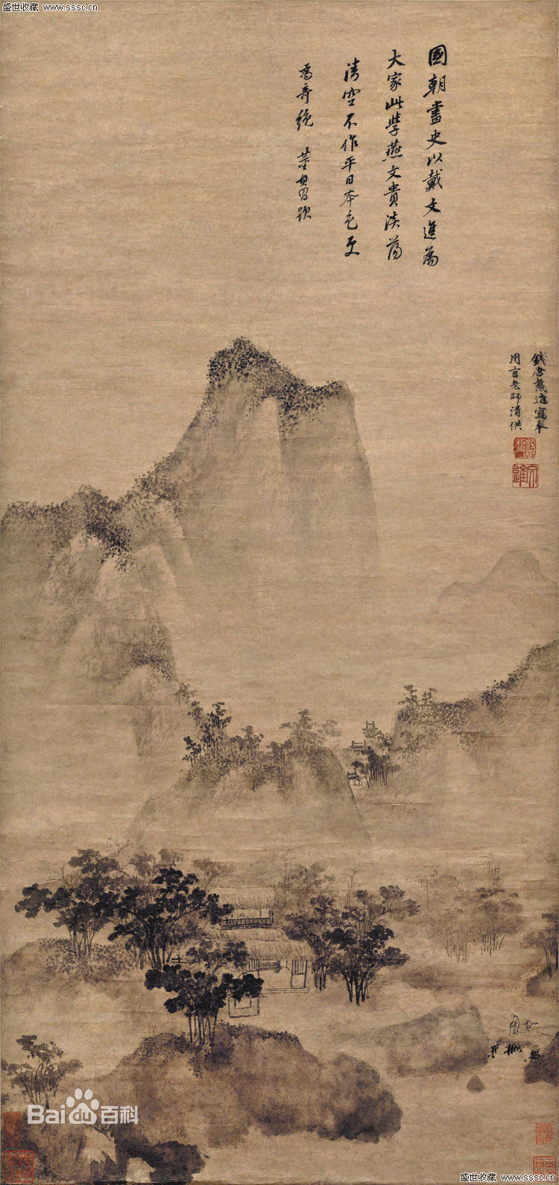
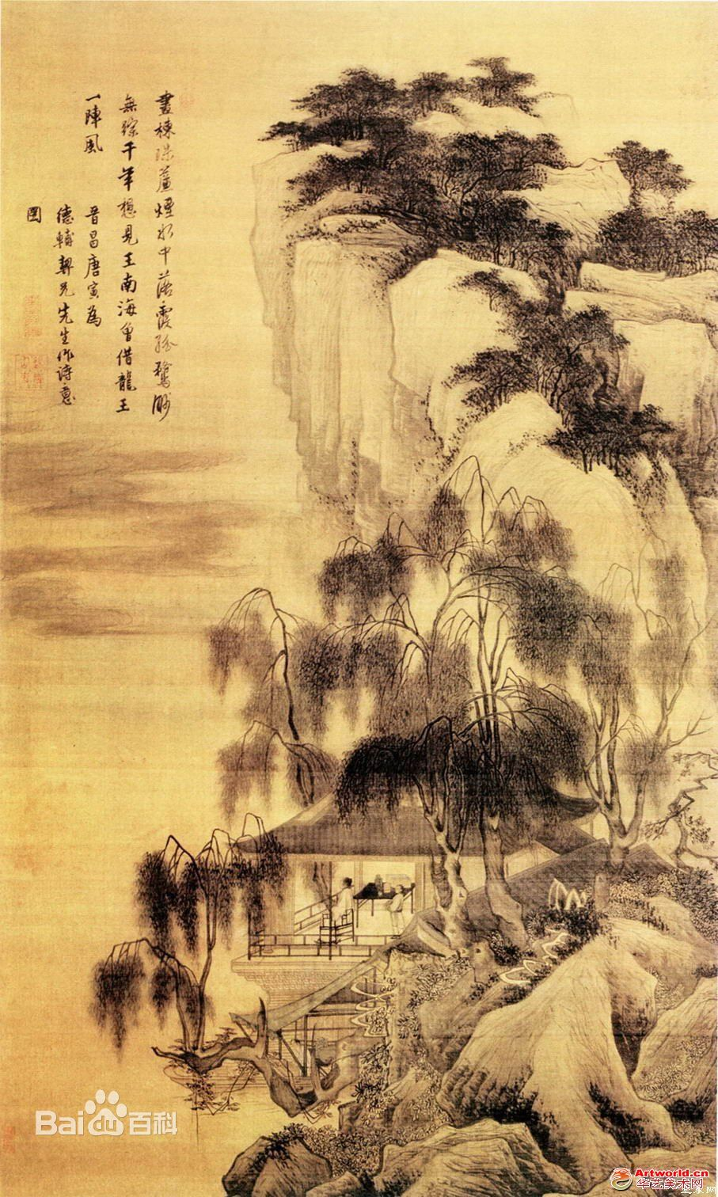

Slide 40
Elaborate paintings

Slide 41
Freehand brushwork painting

Slide 42
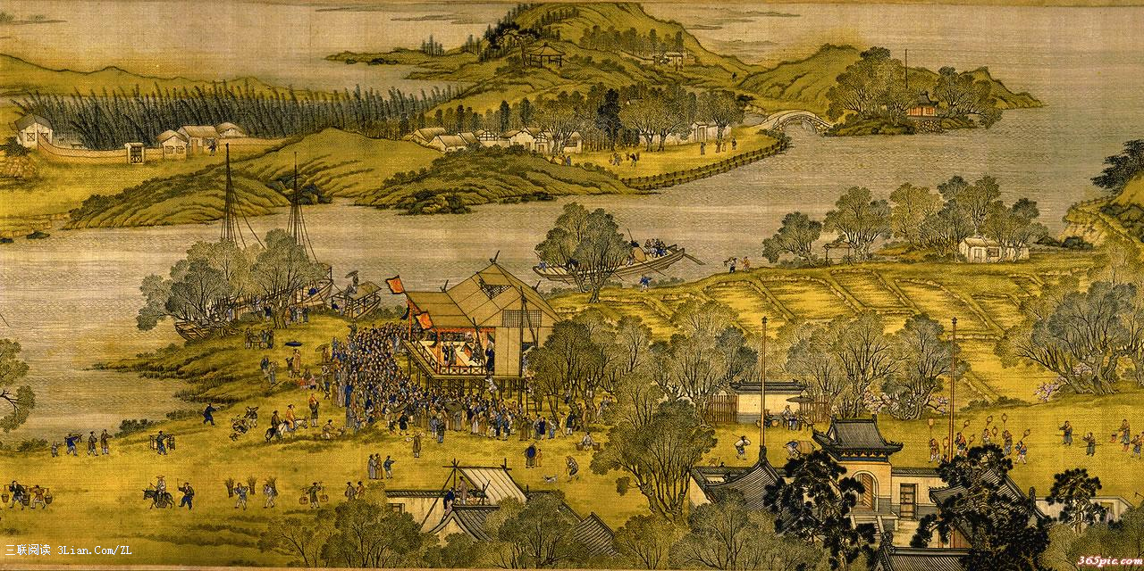
Riverside Scene at Clean & Bright Festival
25.2cm width; 528.7cm length; 814 figures;73 animals

Slide 43
Riverside scene at Clean & Bright Festival

Slide 44
Riverside scene at Clean & Bright Festival

Slide 45
Riverside scene at Clean & Bright Festival

Slide 47
category
Figure paintings
Flower and bird paintings
Landscape paintings

Slide 48
Questions
1.What are “The four treasures of the study”?
2.Are you fond of calligraph?
3.Do you want to study how to write calligraph?

Slide 49
Thank You!

