Slide 1
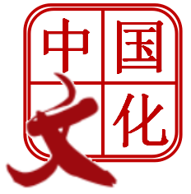
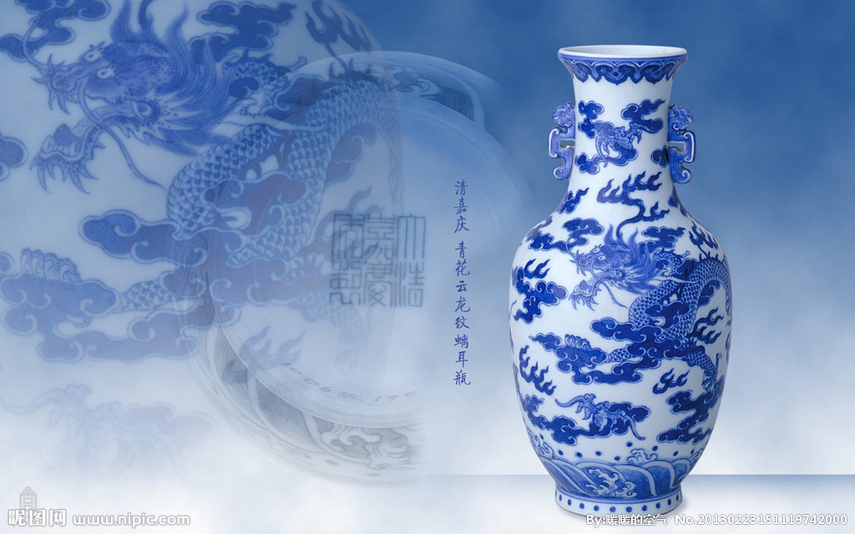
mm,.,.,//R3SSSSS
College of International Education
Jinzhou Medical University

Slide 2
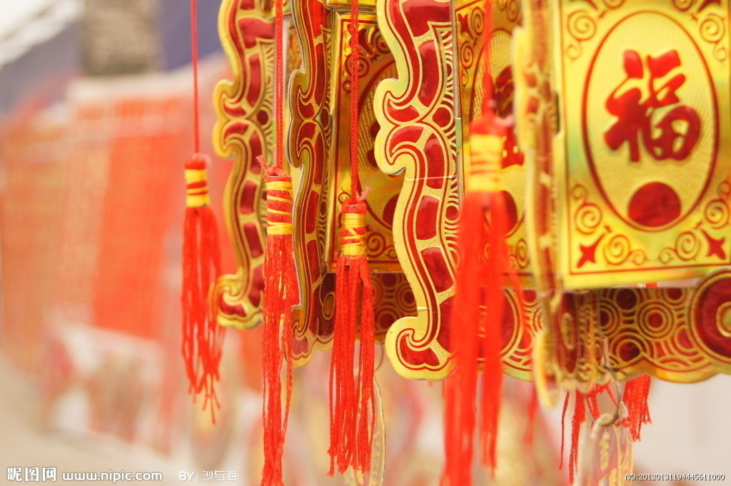
College of International Education
Jinzhou Medical University
Chapter 1:
The Etiquette of Marriage

Slide 3
1.Ancient China
1. The marriage system of ancient China is monogamy.
2. The marriage is decided by parents.
3. Groom and bride should meet each other before get married.
4. Both families will prepare gifts, but the groom side should prepare more.
5. The groom and bride should wear white color.
6. The groom will ride horse on the wedding day.
7. After the wedding ceremony, there will be a big banquet
8. Both groom and bride should participate in the banquet.
9. People would put some fruits and nuts in bed.
10. The bride can eat them if she feels hungry.
11. After getting married the couple should wear wedding rings.

Slide 4
1.Ancient China
1. The marriage system of
ancient China is monogamy.

Slide 5
(1).monogamy with concubines

Slide 6
1.Ancient China
2. The marriage is decided
by parents.

Slide 7
(2). Arranged marriage

Slide 8
1.Ancient China
3. Groom and bride won't
meet each other before
getting married.

Slide 9
(3). shouldn't meet each other

Slide 10
(3) Red scarff on the wedding

Slide 11
1.Ancient China
4. Both families will prepare
gifts, but the groom side
should prepare more.

Slide 12
(4). bride brings more gifts

Slide 13
1.Ancient China
5. The groom and bride
should wear white color
on the wedding.

Slide 14
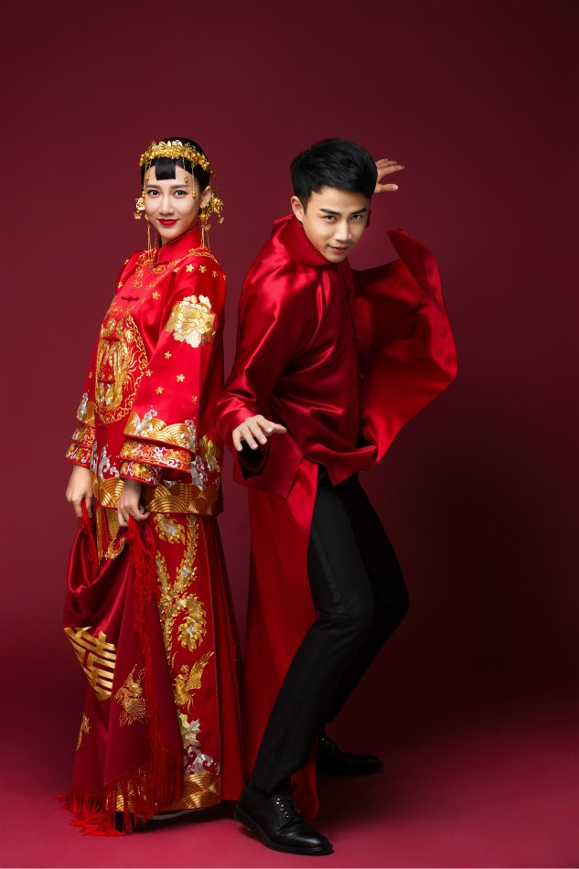
5.wear red color

Slide 15
1.Ancient China
6. The groom will ride horse
on the wedding day.

Slide 16
6.groom will ride a horse

Slide 17
1.Ancient China
7. After the wedding ceremony,
there would be a big banquet.

Slide 18
(7). the big banquet

Slide 19
1.Ancient China
8. Both groom and
bride should participate
in the banguet.

Slide 20
(8) Bride should wait in bedroom

Slide 21
1.Ancient China
9. People would put some
fruits and nuts in bed.

Slide 22
(9) Fruits and nuts in bed

Slide 23
1.Ancient China
10. The bride can eat the
fruits and nuts if she
feels hungry.

Slide 24
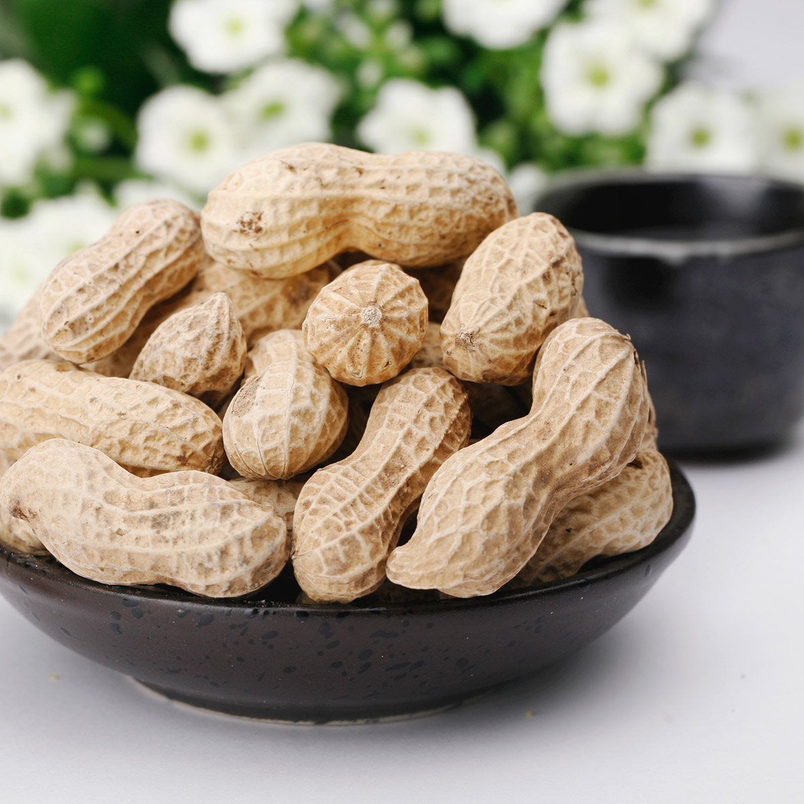
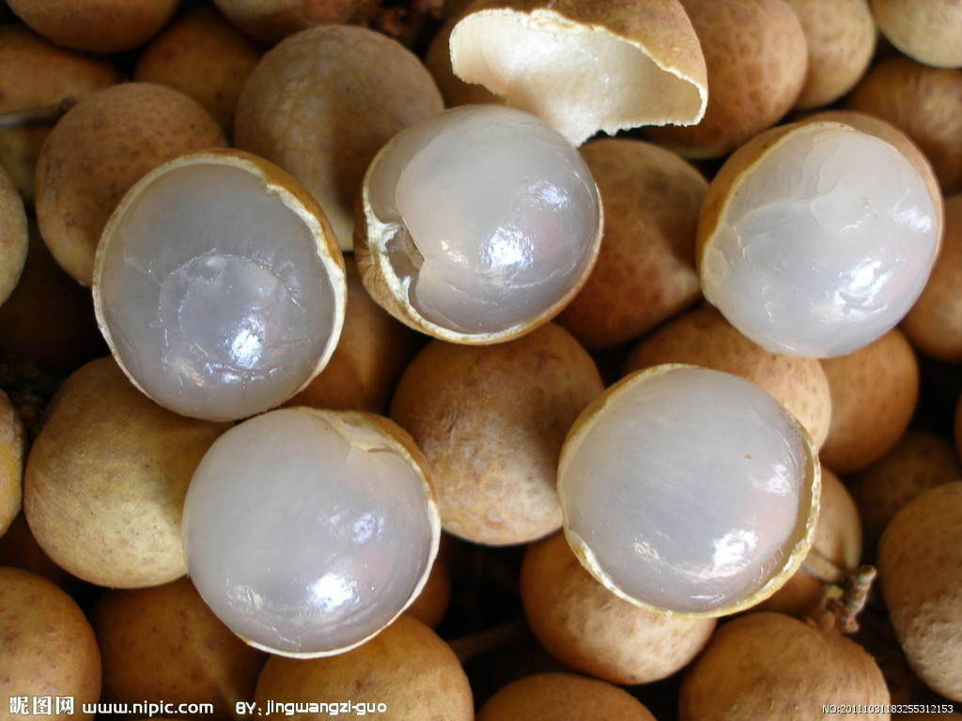
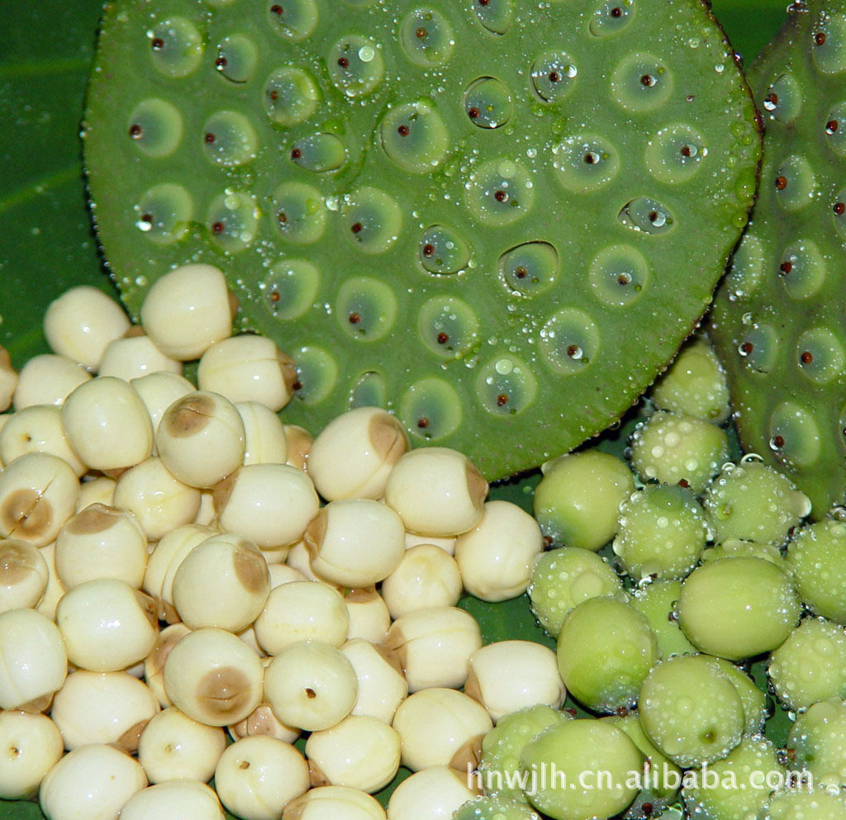
(10) Bride can't eat “best wishes”

Slide 25
1.Ancient China
11. After getting married the
couple should wear
wedding rings.

Slide 26
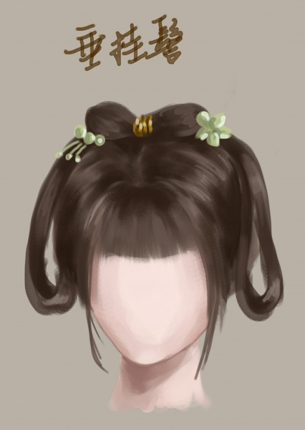
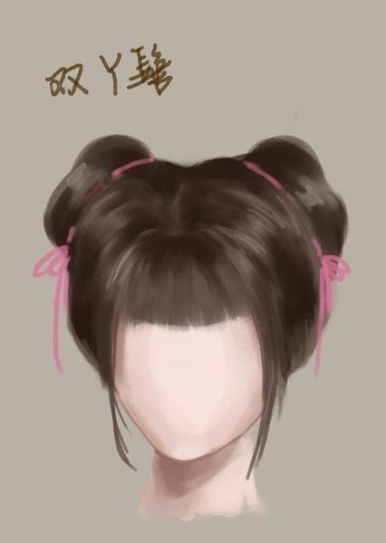
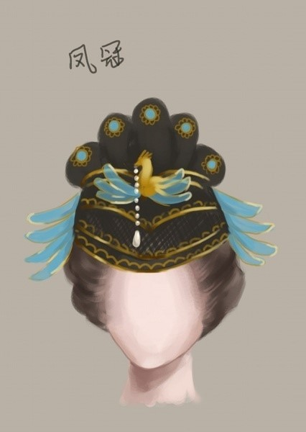
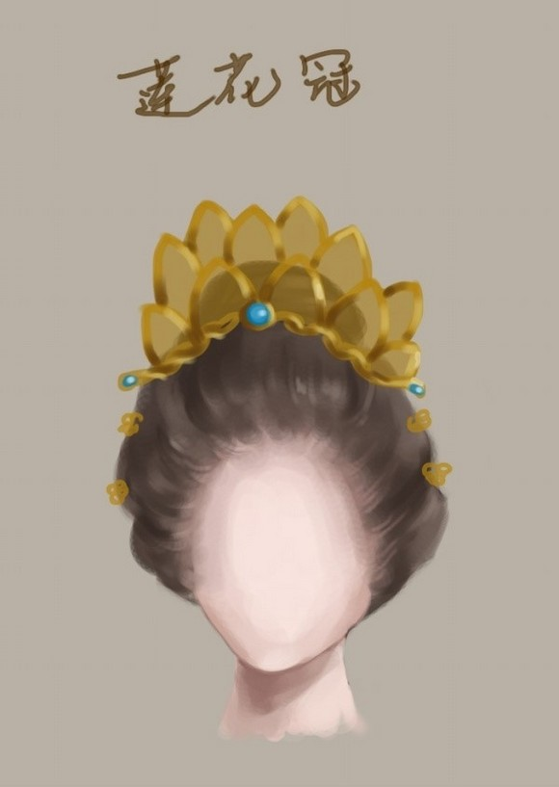
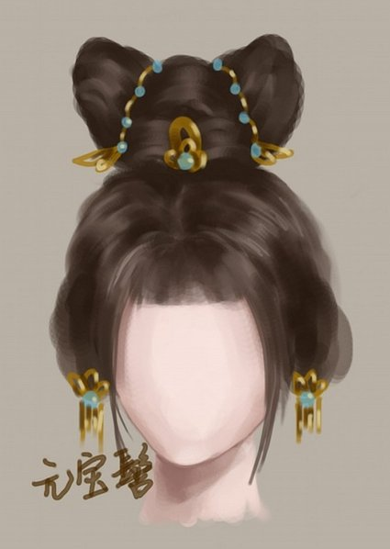

Slide 27
1.Ancient China
1.Monogamy with several concubines.
2.Arranged marriage.
3.Groom and bride can't meet each other.
4.Bride prepare more gifts.
5.Wear red color.
6.Groom rides horse.
7.there is a banquet.
8.Bride can't participate in the banquet.
9.People would put some fruits and nuts in bed.
10.Bride should change hair style.

Slide 28
Which items are changed today ?
1. Monogamy with several concubines.
2. Arranged marriage.
3. Groom and bride can't meet each other.
4. Bride prepare more gifts.
5. Wear red color.
6. Groom rides horse.
7. There is a banquet.
8. Bride can't participate in the banquet.
9. People would put some fruits and nuts in bed.
10.Bride should change hair style.

Slide 29
2. Modern China
1. Monogamy with several concubines.
Changed

Slide 30
(1).Monogamy

Slide 31
2. Modern China
2. Arranged marriage.
Changed

Slide 32
(2). Love marriage

Slide 33
2. Modern China
3. Groom and bride can't
meet each other.
Changed

Slide 34
3. Date

Slide 35
(3) can't meet one night before

Slide 36
2. Modern China
4. Bride prepare more gifts.
Changed

Slide 37
4. Gifts depand

Slide 38
(4) Bride will send the gifts to grooms home before wedding

Slide 39
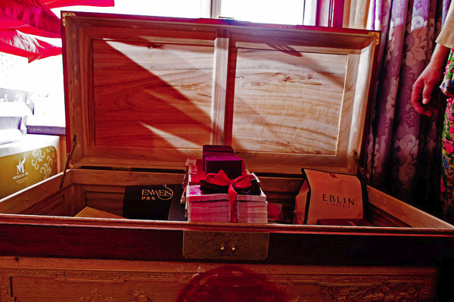
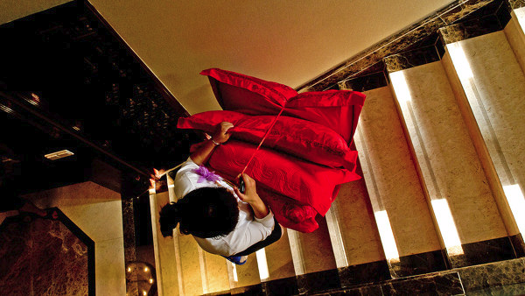
(4) Bride will send the gifts to grooms home before wedding

Slide 40
2. Modern China
5. Wear red color.
Inherited

Slide 41
(5). white color becomes the fashion, but red color still necessary.

Slide 42
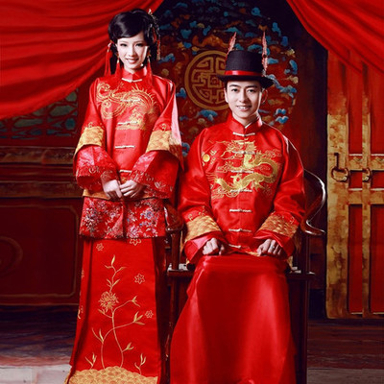
(5) white color becomes the fashion, but red color still necessary.

Slide 43
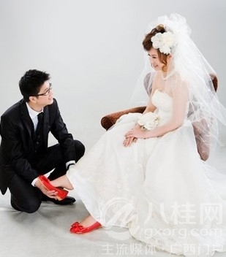
(5). white color becomes the fashion, but red color still necessary.

Slide 44
2. Modern China
6. Groom rides horse.
Changed

Slide 45
6. horse is optional, but most people choose cars.

Slide 46
2. Modern China
7. There is a banquet.
Inherited

Slide 47
(7)banquet is a party for wedding

Slide 48
2. Modern China
8. Bride can't participate in
the banquet.
Changed

Slide 49
(8). Bride will participate in the banquet

Slide 50
2. Modern China
9. People would put some
fruits and nuts in bed.
Inherited

Slide 51
8. Fruits and nuts depands on the will

Slide 53
2. Modern China
10. Bride should change
hair style.
Changed

Slide 54
9. exchange rings

Slide 55
The Etiquette of Wedding

Slide 56
1.the night before wedding, the groom and bride can't meet each other.

Slide 57
make up and set out

Slide 58
gethering the cars and set out

Slide 59
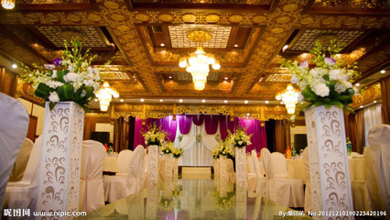
the Route

Slide 60
convoy

Slide 61
pick up the bride

Slide 62
tricks on groom and brothers

Slide 63
tricks on groom and brothers

Slide 64
red package for sisters

Slide 65
red shoes for bride

Slide 66
eat noodles for good wish

Slide 67
eat noodles for good wish

Slide 68
go to new home

Slide 69
convoy wandering around

Slide 70
visiting new home

Slide 71
western style wedding

Slide 72
Chinese wedding

Slide 73
serving tea to parents

Slide 74
serving tea to parents

Slide 76
banquet after wedding

