Slide 1
Chapter 3 Folk Arts and Crafts
《第三章 民间工艺》
主讲教师：孔丽娜

Slide 2
1. Chinese knot（中国结）
2. Shadow Play（皮影）
3. Chinese Embroidery（刺绣）
4. Paper Cutting（剪纸）
5. Chinese Kite（风筝）

Slide 3
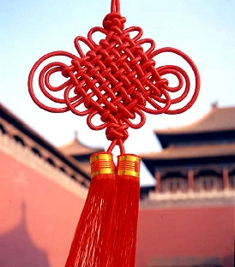
1. Chinese knot
The introduction to
Chinese knot:
Chinese characteristics
Just by twining a red string,
the wish is conveyed.

Slide 4
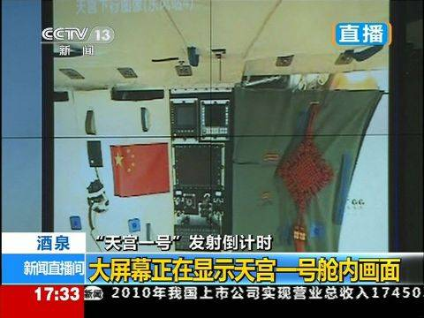
1. Chinese knot

Slide 5
1. Chinese knot
(1) Symbolization of Chinese knot:
The Chinese character of "结"（knot）is a word
expressing power, harmony, and full of affection.
结合 ---unite
结交-----make friends with
结缘-----form ties of affection
团结-----unity
结→
吉

Slide 6
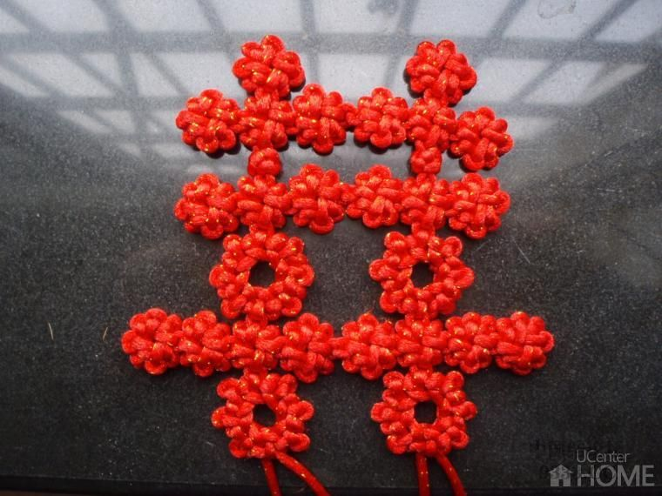
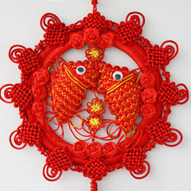
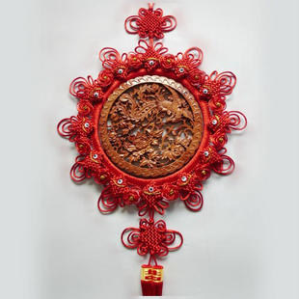
1. Chinese knot
(2) kinds of
Chinese knot:
Panchang Knot
Shuangxi Knot
Tuanyuan Knot
Shuangyu Knot

Slide 7
1. Chinese knot
(3) The origin of Chinese knot:
The Chinese knot is a folk hand-woven ornament peculiar to China and originated from ancient people's keeping records by tying knots.
According to "Xi Ci" in the Book of Changes, “上古结绳而治，后世圣人易之以书契。”
Zheng Xuan of the Eastern Han Dynasty(25-220) wrote in Notes of the Book of changes that " 结绳为约，事大，大结其绳；事小，小结其绳。"
The Chinese knot was used as an ornamental work of art since the Tang and Song dynaties(618-907) and flourished in the Ming and Qing dynaties(1368-1911).

Slide 8
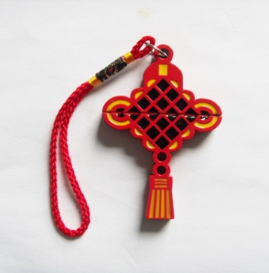
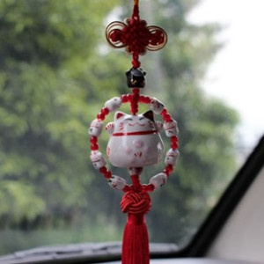
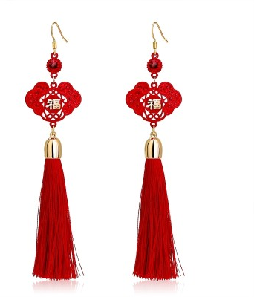
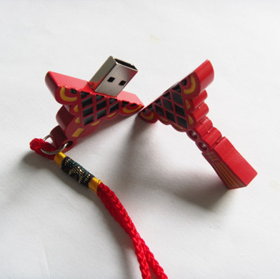
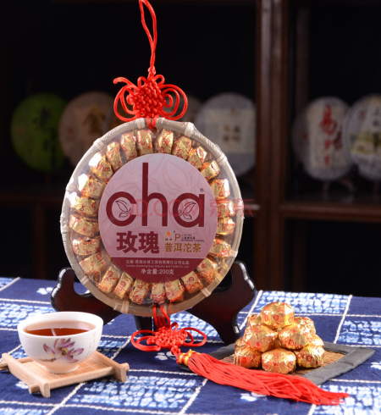
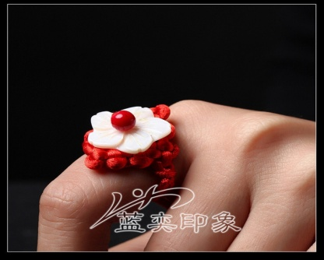
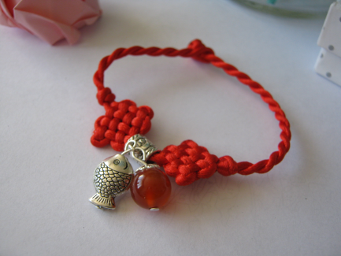
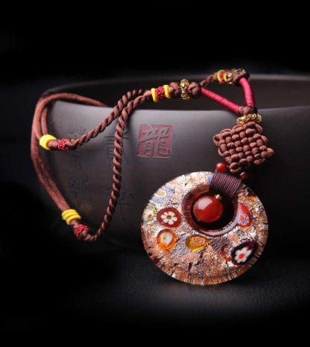
1. Chinese knot
(4)Products of Chinese knot:

Slide 9
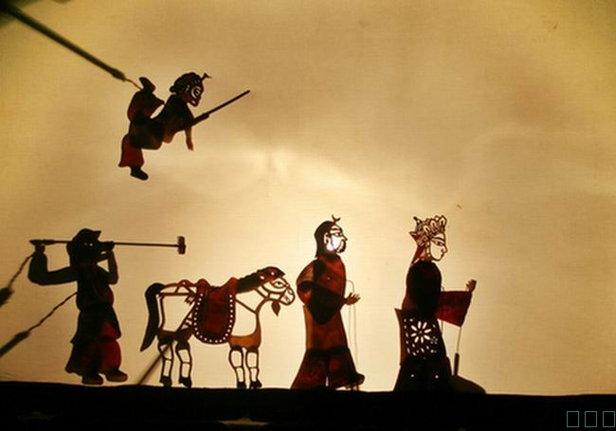
2. Shadow Play
(1)Shadow play is a form
of folk drama with full
bodies local flavor. It acts
out stories by using puppet
shadows on lighted hide
or paperboard.

Slide 10
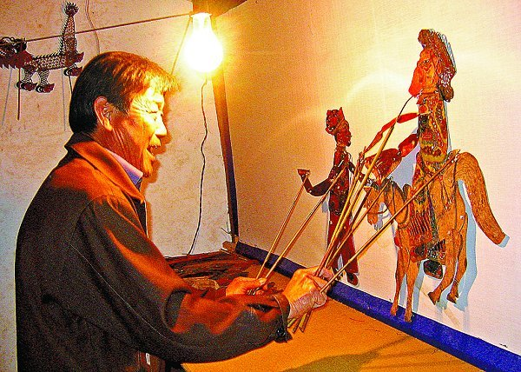
2. Shadow Play
(1)In performance, actors
manipulate the puppets
behind the white screen
while telling stories
in locally popular tune
along with percussion
and string music.

Slide 11
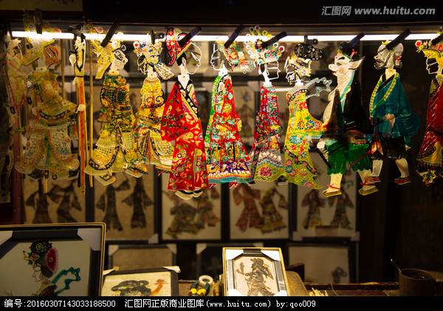
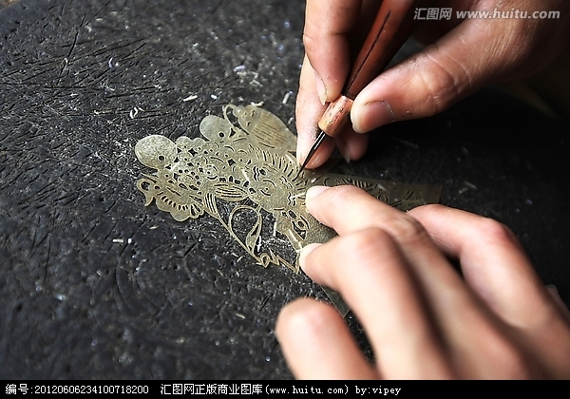
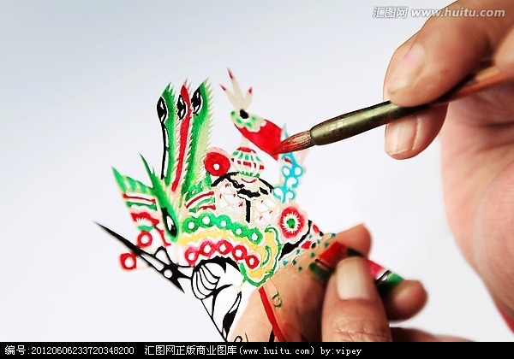
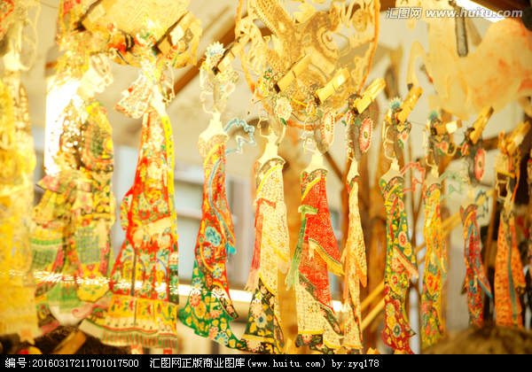
2. Shadow Play
(2) The process of making shadow puppet:
To choose donkey skin.
To be carved with knives.
To be colored.

Slide 12
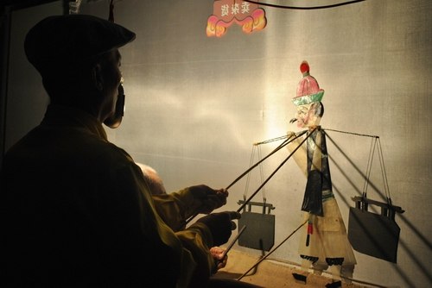
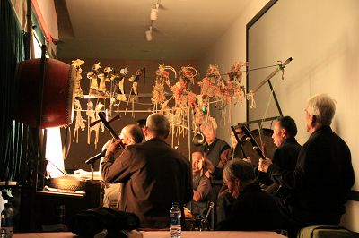
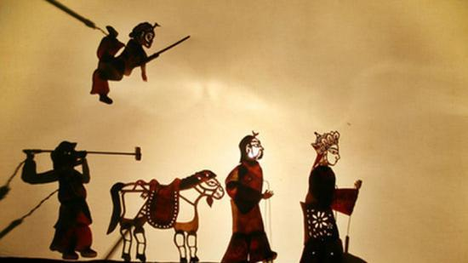
2. Shadow Play
(3)The show of Shadow PlayThe screen for shadow plays is made of a piece of white cloth on which the strong light makes the puppets transparent and brightly-colored in the performance. Artists move the puppets with bamboo spikes so that the audience can see the vivid images on the other side of the white screen.

Slide 13
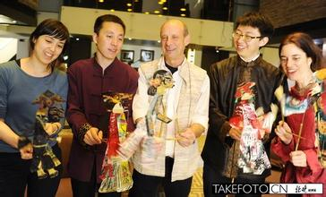
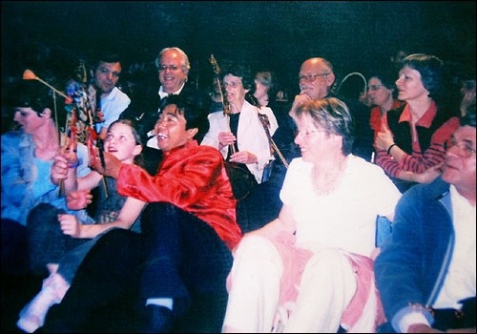
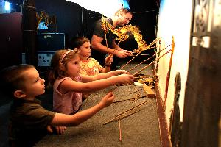
2. Shadow Play
Shadow play is the first Chinese drama art to go abroad.
Since the 13th century, the Chinese shadow play has been successively spread into Persia, Arab and Turkey in Asia
and England, France, Germany, Italy and Russia as a result
of military expedition and communication.

Slide 14
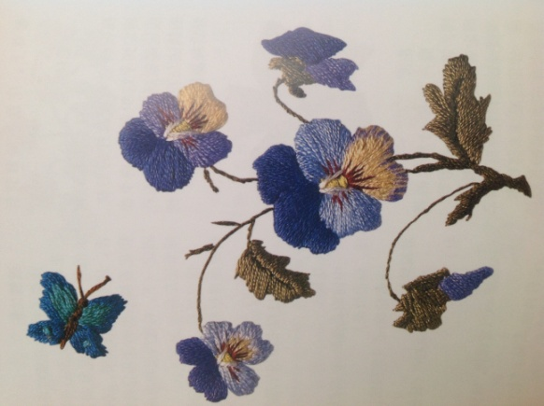
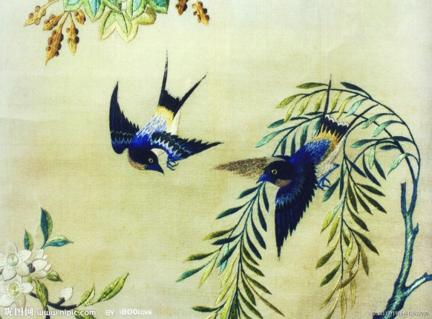
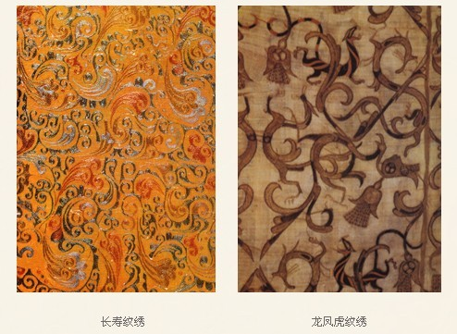
3. Chinese Embroidery
(1)Embroidery, also known as XIUHUA in Chinese, has a history of at least three thousand years. The earliest embroidey that remains today is unearthed from the Chu tomb of the Warring States Period in Changsha, Huan Provience.

Slide 15
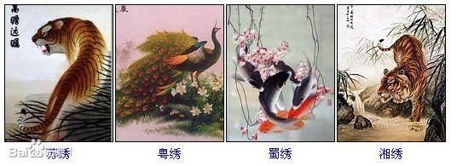
3. Chinese Embroidery
(2)Four major regional styles of Chinese Embroidery:
Suzhou embroidery (Su Xiu) Hunan embroidery (Xiang Xiu)
Sicuan embroidery (Shu Xiu) Guangdong embroidry (Yue Xiu)

Slide 16
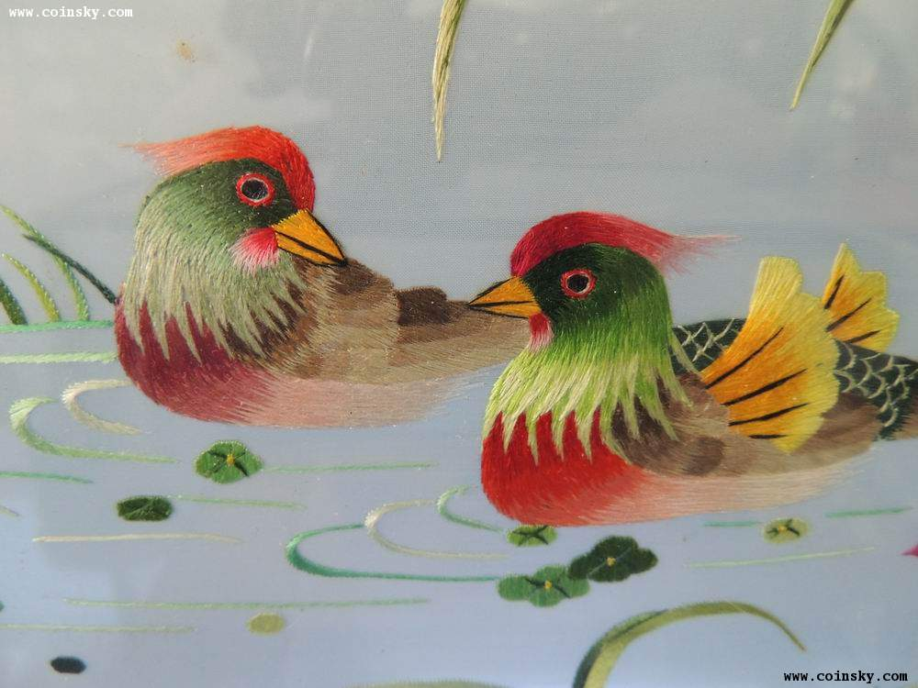
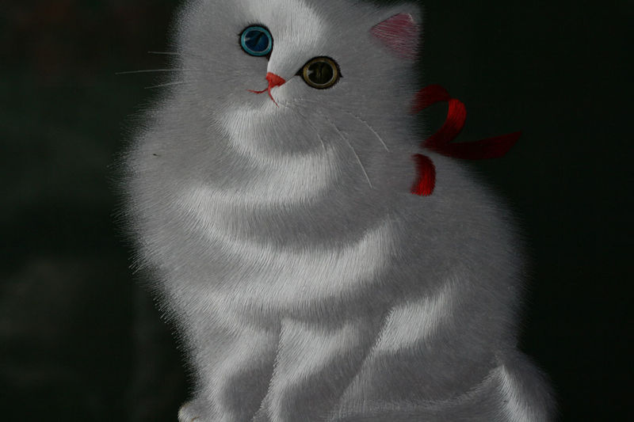
3. Chinese Embroidery
A. Suzhou embroidery (Su Xiu):
Main subject: Animals
Key features: Fine close stitch, Elegant color, Double-faced embroidery

Slide 17
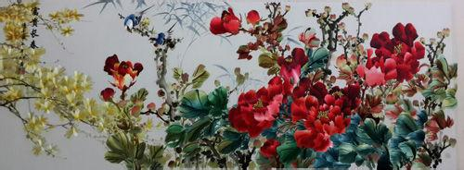
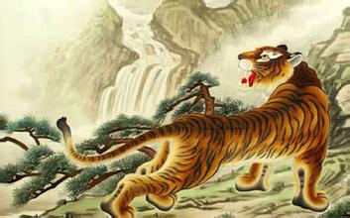
3. Chinese Embroidery
B. Hunan embroidery (Xiang Xiu):
the embroidered flower gives off fragrance;
the embroidered bird makes sounds;
the embroidered tiger is capable of running;
the embroidered human figure is true in spirit.

Slide 18
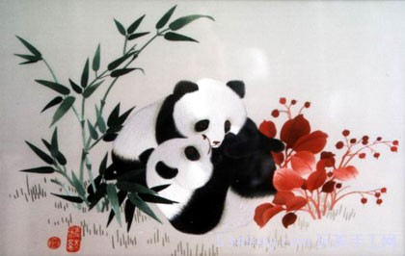
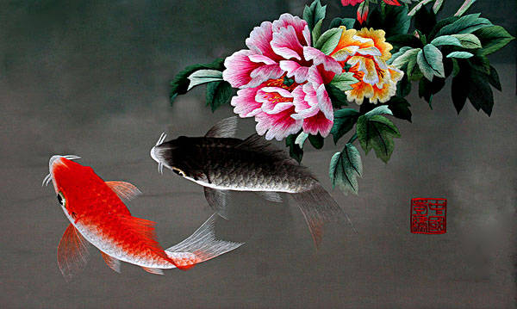
3. Chinese Embroidery
C. Sicuan embroidery (Shu Xiu):
Key features: careful knitting, glossy threads, neat stitch and bright colors.

Slide 19
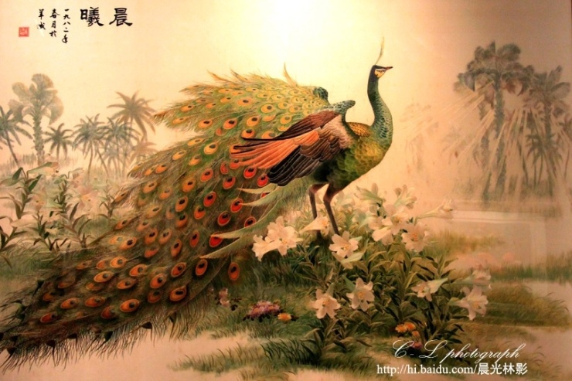
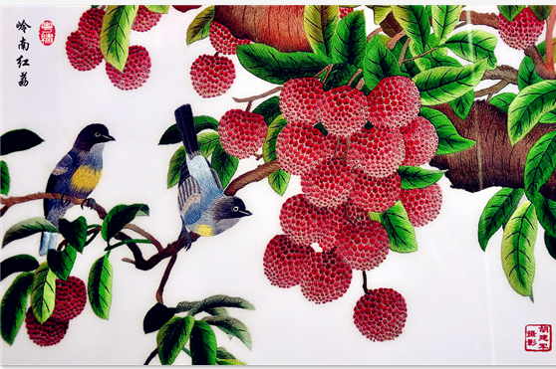
3. Chinese Embroidery
D. Guangdong embroidry (Yue Xiu):
Main subject: peacocks and leeches
Key features: multiple usages of threads, bright colors, special focus on luxuriant visual effect.

Slide 20
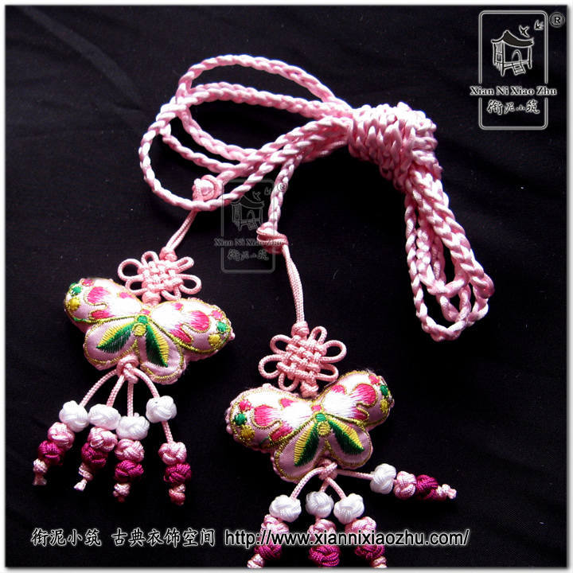
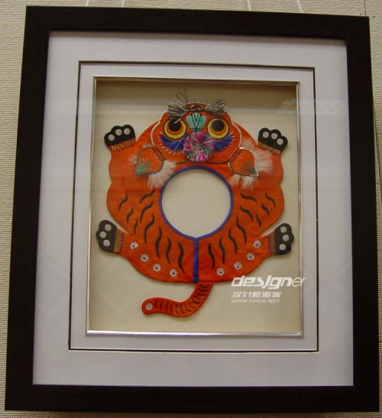
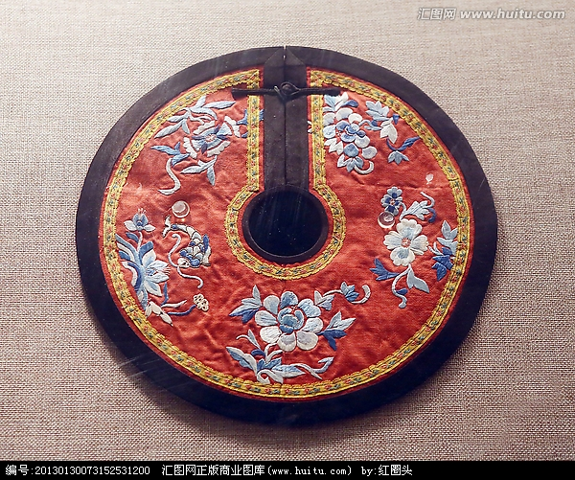
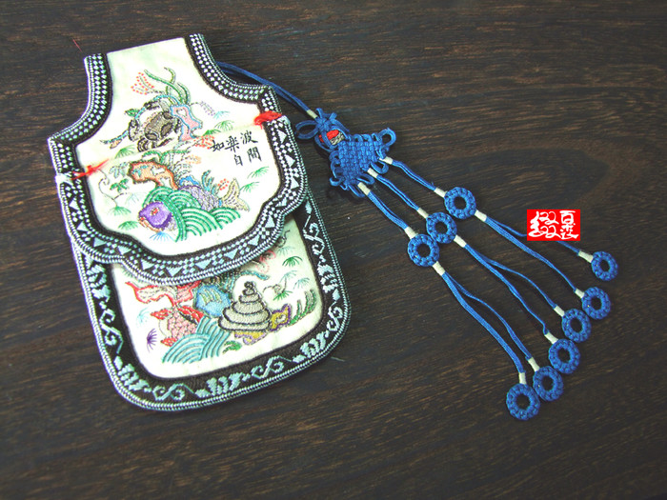
3. Chinese Embroidery
(3) The products of embroidery:

Slide 21
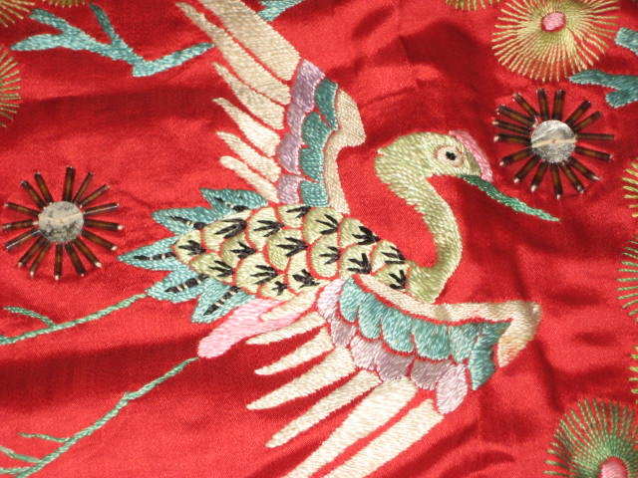
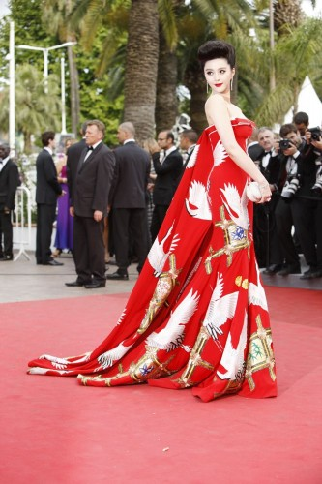
3. Chinese Embroidery
(3) The products of embroidery: red-crowned crane gown

Slide 22
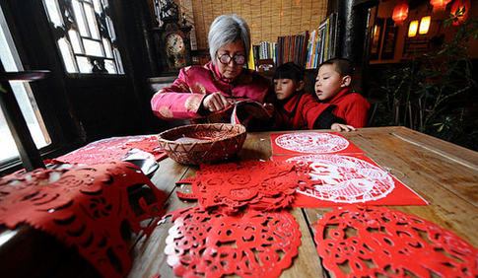
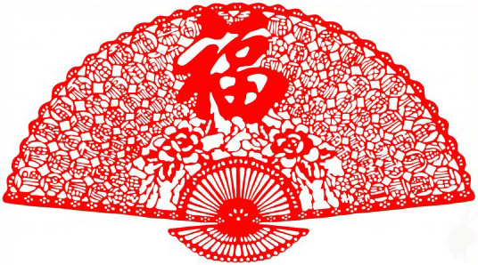
4. Paper Cutting
(1)Paper cutting is a traditonal Chinese folk hanicraft, which is also valuable in the treasure house of the world's art. In 2010, Chinese paper cutting was approved by UNESCO's Intergovenmental Committee for the Safeguarding of Intangible Cultural Heritage and was added on the Representative List of the Intangible Cultural Heritage of Humanity.

Slide 23
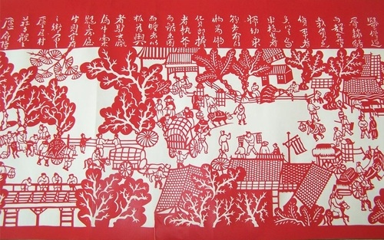
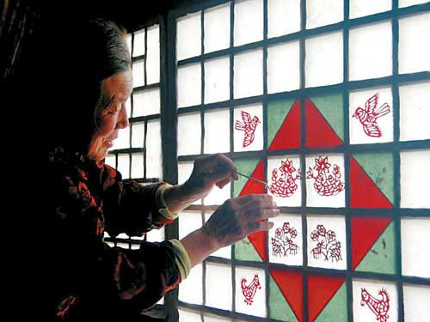
4. Paper Cutting
(2)The emergence of paper cutting:
It is said that paper cutting has existed ever since the invention of paper. The emergence of paper cutting and spread of paper cutting is intricately linked with the customs of Chinese festivals.

Slide 24
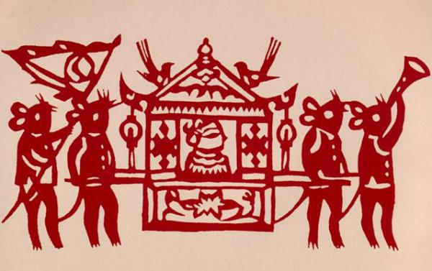
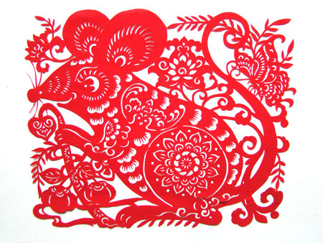
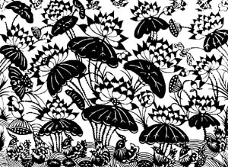
4. Paper Cutting
Try to distinguish the northern style from the southern one:

Slide 25
4. Paper Cutting
(3)The different styles of embroidery:
Motifs of the paper cuts made in
the northern China seek out
primitive simplicity, while their
southern xounterparts embrace
luxuriance and magnificence.
The shaping of those of the north is bold and
unconstrained while the southern ones are fine and delicate.
The style of the northern ones are powerful and vigorous, while the southern ones appear beautiful and graceful.
The lines of the northern paper cuts are bold and forceful while those of the south are fine and smooth.

Slide 26
4. Paper Cutting
(4)The themes of paper cutting:
Most of the thems of folk paper cuts come from real life. Creators of paper cuts choose to show their enthusiasm towards life and understanding of nature by means of paper cutting.

Slide 27
4. Paper Cutting

Slide 28
5. Chinese Kite
(1)Introduction:
2012 is the year of the dragon. In the traditional Chinese calendar, February 2nd is the day when “the dragon raises his head”. On this traditional festival, hundreds of kite lovers from Taiyuan City would gather together to fly dragon kites.

Slide 29
5. Chinese Kite
(2)The origin of Chinese Kite:

Slide 30
5. Chinese Kite
(3)The auspicious patterns on Chinese Kite:
Pray for happiness.
Offering birthday congratulations.
Celebrating happy events.
Practicing divination for good marriage.

Slide 31
5. Chinese Kite
A. Pray for happiness:

Slide 32
5. Chinese Kite
B. Offering birthday congratulations:

Slide 33
5. Chinese Kite
C. Celebrating happy events:

Slide 34
5. Chinese Kite
D. Practicing
divination for
good marriage:

Slide 35
Review:
1. What is the symbolization of Chinese knot?
2. What are the differences between southern and
northern style of paper cutting?
3. Could describe the key features of Su Xiu?
4. Could desbcribe the process of making a puppt？

Slide 36
Paper Cutting Practice

Slide 37
谢谢！

