Slide 1
College of International Education
Jinzhou Medical University
汉 字 书 写 8
汉 字 书 写
Annie

Slide 2
复 习
考 试

Slide 3
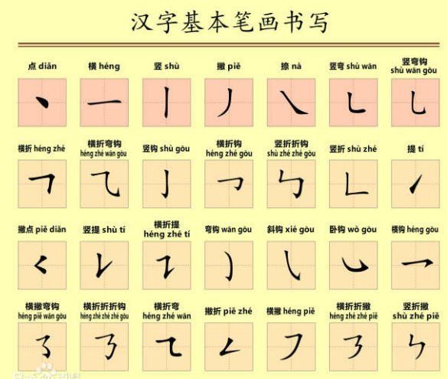

Slide 4
_
象形字
Pictographic Scripts
Pictographic scripts can simple drawings representing people or objects referred to.They are derived from pictures of natural pheonmena,people,human,features,animals,plants and tools of production or instruments for daily use that are easy to draw.

Slide 5
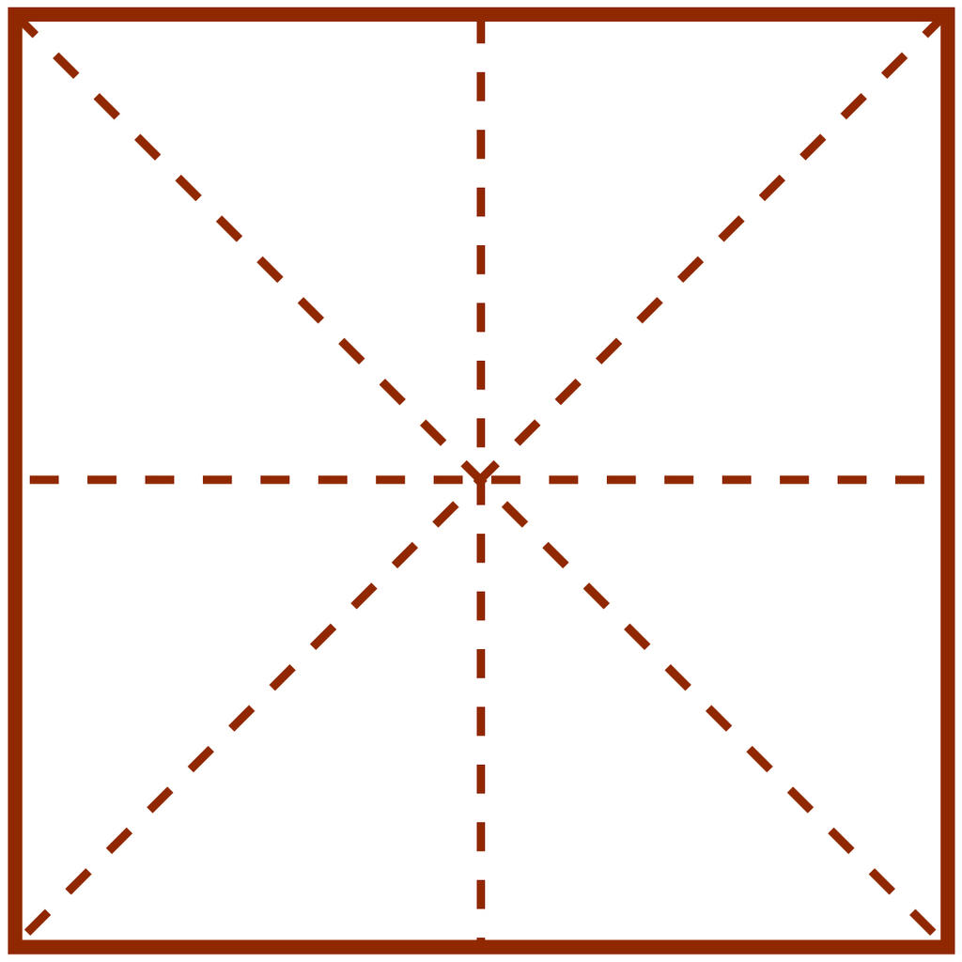
门
女

Slide 6
子
心
人

Slide 7
_
指事字
Self-explanatory Characters
Self-explanatory Characters are single characters whose abstract meanings expressed by the combination of their strokes.They may be classified into two types:
One type of them is purely symbolic,for example:
一 二 三 四 五 上 下 八

Slide 8
Another type is of pictographic scripts with an explanatory symbol.For example,本（roots of a tree）is composed by adding a symbolic“一”to the lower end of 木.

Slide 9
上
下
本

Slide 10
_
形声字
Pictophonetic Characters
和字的意思有关的偏旁叫做形旁，和字的发音有关的偏旁叫做声旁。
由声旁和形旁组成的字，就是形声字。
A type most of the Chinese characters belong to,are compound characters with two components:the idea component,indicative of general meaning,and the sound component,indicative of the general sound.

Slide 11
_
汉字的偏旁
The Radicals of Chinese Characters
古代称合体字的左边为偏，右边为旁。现在，合体字的上下、左右、内外统称为偏旁。例如：“星”字的偏旁是“日”和“生”，“的”字的偏旁是“白”和“勺”。多数偏旁本身就是独立成字的，例如“日、口、目”等。
In terms of the traditional Chinese phiology the left side of a character is knowns as 偏，and the right side of a character is known as 旁.Now we use 偏旁（radical) to mean the side components (left,right,upper,lower,inside and outside) of all characters.

Slide 12
_
zuǒ zhōng yòu
左
中
右

Slide 13
_
shàng xià
上
下

Slide 14
_
1.The radical of “口”
“口”is relevant to a mouth or its function.It often appears as the left side of a character,but may also be upper or lower component of a character.

Slide 15
_
1 | 2
吗
吧
呢
ma ba ne

Slide 16
_
2.The radical of “日”
“日”is generally relevant to the sun,time,rays or light.It appears on the left of a character,but sometimes may be on the top or bottom of a character.

Slide 17
_
1
2
1 | 2
早
晚
明
zǎo wǎn míng

Slide 18
_
3.The radical of “目”
“目”is related to eyes or vision.It may be used as a left component of a character,but occasionally as a lower component of it.

Slide 19
_
1 | 2
眼
睛
yan jing

Slide 20
_
4.The radical of “木”
“目”is related to eyes or vision.It may be used as a left component of a character,but occasionally as a lower component of it.

Slide 21
_
1
2
1 | 2
1 | 2 | 3
椅
树
桌
yǐ shù zhuō

Slide 22
_
考试
时间：14:30-15:20

Slide 23
_
下课，再见！

