Slide 1
College of International Education
Jinzhou Medical University
汉 字 书 写
汉 字 书 写 4
Annie

Slide 2
复习
Review
汉字的派生笔画
The derived Strokes
The writing of new characters
汉字的书写

Slide 3
_
1.竖钩 shù gōu Vertical Hook
A vertical hook is written from top to bottom with a left upward hook.

Slide 4
_
2.弯钩 wān gōu Curved Hook
A curved hook can be formed by a curve and a vertical hook.

Slide 5
_
3.斜钩 xié gōu Slant Hook
A slant hook can be formed by an arch written from the top left to the lower right and a small upward hook.

Slide 6
_
4.卧钩 wò gōu Lying Hook
A lying hook is shaped like a upturned arch with an upward hook.

Slide 7
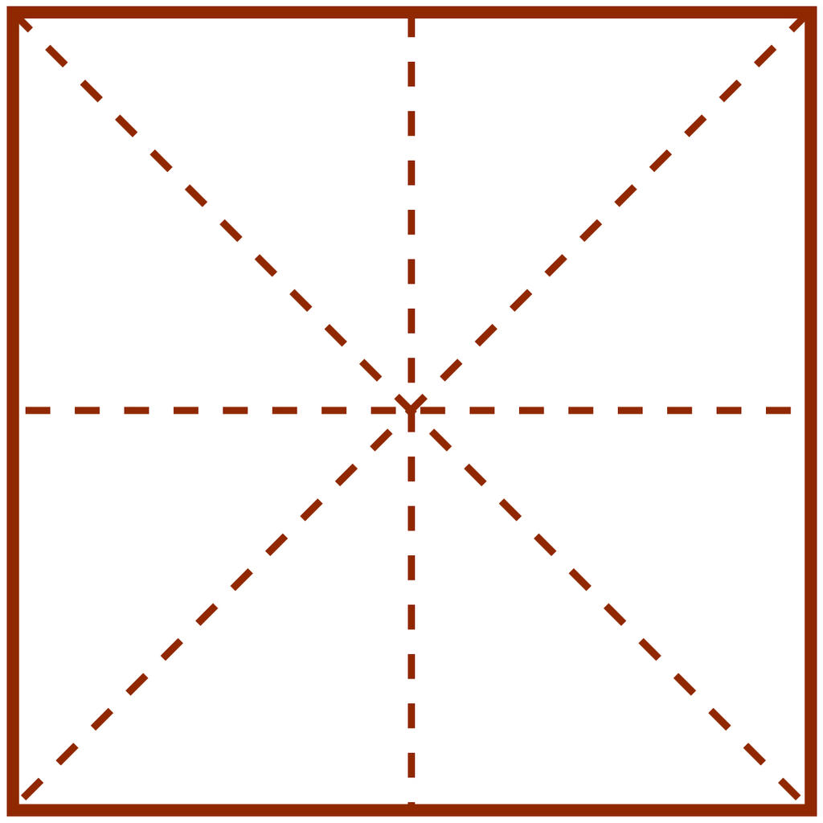
_
5.横钩 héng gōu Horizontal Hook
A horizontal hook begins with a level stroke which bends at its right end in the form of a small hook.
乛

Slide 8
_
我 你 子
心 买 学
很 比 好

Slide 9
_
Study new strokes
公 专
没 奶

Slide 10
_
1.撇折 piězhé Left-falling Turning
A left-turning is composed by writing the left-falling stroke with a turning to the right without being broken.

Slide 11
_
me what
么

Slide 12
_
2.竖折撇shù zhé piě Vertical Turning with a Left Falling
A vertical turning with a left falling is composed by writing a vertical slanting to the left,then a horizontal short stroke that turns to lower left,and finally a left-falling strokes.As one stroke it cannot be broken anywhere.

Slide 13
_
zhuān special
专

Slide 14
_
3.横折弯héngzhēwān Horizontal Turning with a Curve
A horizontal turning with a curve to the right is composed by writing a short horizontal that turns at a right angle with a curve to the right.The stroke cannot be broken anywhere.

Slide 15
_
méi not;without
没

Slide 16
_
4.横折折折钩 héngzhézhézhégōu
Horizontal and Radoubled Turning with a Hook to the Left
A horizontal and redoubled turning with a hook to the left begins with a short level stroke,then turns to the lower left,and repeats in the same manner,ends up with a hool to the left.Howev zigazg it may be,the stroke cannot be broken anywhere.

Slide 17
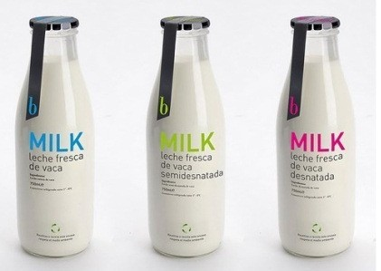
_
nǎi milk
奶

Slide 18
_
5.横折提 héngzhétí
Horizontal Turning with a Rising Stroke
A horizontal turning with a rising stroke begins with a short horizontal stroke,then turns down and rises up to the right.The stroke should be completed without being broken.

Slide 19
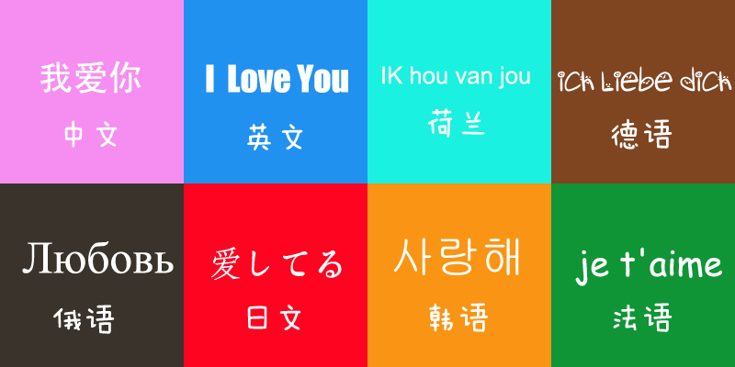
_
yǔ language
语

Slide 20
_
6.横撇弯钩 héngpiě wāngōu
Horizontal with a Left Falling and a Curve
As the name implies,a horizontal with a left falling and a curve begins with a very short horizontal stroke that is followed by a left falling and a curve.The whole stroke should be completed without being broken.

Slide 21
_
nà that
那

Slide 22
_
7.横折折撇 héngzhézhépiě
Horizontal and Redoubled Turning with a Left Falling
A horizontal and redoubled turning with a left falling can be formed by writing a short horizontal and redoubled turning,and ending with a left falling.

Slide 23
_
zhè this
这

Slide 24
_
学 写 汉 字

Slide 25
_
汉字的笔顺规则
The principle of the Stroke for writing Chinese Characters
汉字的书写具有一定的笔顺规则。只有按照合理的笔顺去写汉字，才能提高书写的速度，而且还能使写出的字既美观又大方。
The priciple of the stroke order is a guiding rule for writing Chinese charactere.The right order helps learners write them fast and beautifully.

Slide 26
_
规则 Principle | 例字 Example | 笔顺 Order of Strokes
先横后竖 A horizontal stroke should be written before a vertical one. | 十
先撇后捺 Aleft falling should be written before a right falling. | 人
先上后下 An upper stroke should be written before a lower one. | 三
先左后右 A left component should be given before a right one. | 江
先外后内 Outer strokes should be written before inner ones. | 用
先进入后关门 Insidestrokes should be completed before an enclosing stroke of a frame. | 四
先中间后两边 A middle shtoke should be written before strokes on both sides. | 小

Slide 27
_
以上的笔顺规则都是基本的。有时候，一个汉字的书写，往往需要将两种或两种以上的笔顺规则连续运用才能完成。
What has been stated above is only a basic principle.Sometimes two or more rules may be applied to the writing of a single character.For example:

Slide 28
_
五
午
个
业
The horizontal stroke is written before the vertical stroke and the upper stroke is completed before the lower one.
The left stroke is written before the right one,and the horizontal is written before the vertical.
The left-falling stroke is written before the right-falling one,and the upper stroke is written before the lower one.
The middle stroke is written before the ones on both sides,and the upper stroke is written before the lower one.

Slide 29
_
作业 Homework
列出所学笔画的表格，表明笔画、例字的笔画顺序。

Slide 30
谢谢，再见！

