Slide 1
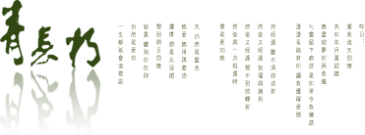
Written Chinese
汉字书写
教师：孔丽娜

Slide 2
Lesson Four
The derived strokes—派生笔画

Slide 3
Review--复习
Derived Strokes--派生笔画
To Learn Characters--学写汉字
Homework--作业

Slide 4
Review--复习

Slide 5
Review--复 习
The Horizontal Hook
The Vertical Hook
The Lying Hook
The Curved Hook
The Slant Hook

Slide 6
Review--复 习
找一找 search
妈 婆 认 众 从 学 仔 感 齿 想

Slide 7
Lead-in
才 比 们 弟 么

Slide 8
派生笔画

Slide 9
1.竖提 shùtí Vertical Rising
A vertical-rising is a vertical stroke with a short rising from the bottom to the right.
比 民 以 很

Slide 10
2.竖折 shùzhé Vertical Turning to the Right
A vertical turning to the right begins with a vertical stroke, then turns to the right at a right angle.
区 出 乐

Slide 11
3.横折钩 héngzhégōu Horizontal Turning with a Hook
The writing of the horizontal turning with a hook begins with a horizontal stroke written from the left to the right, connected with a vertical and a hook to the left.
门 们 因 习 图

Slide 12
4.竖折折钩 shùzhézhégōu Vertical and Redoubled Turnig
A vertical and redoubled turning begins with a vertical stroke and a turning to the right, and then goes down with an upward hook to the left. It is considered one stroke without being broken anywhere.
弟 马 玛

Slide 13
5.撇折 piězhé Left-falling Turning
A left-falling turning is composed by writing the left-falling stroke with a turning to the right without being broken.
公 么

Slide 14
学写汉字

Slide 15
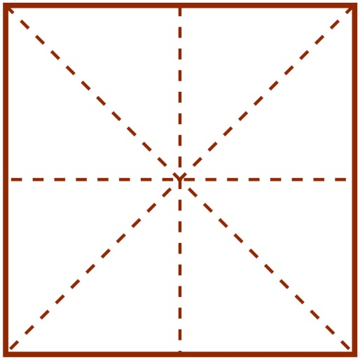
1. yǐ with
可以 can
以

Slide 16
2.hěn very
very good
很好

Slide 17
3.lè happy
yuè music
乐

Slide 18
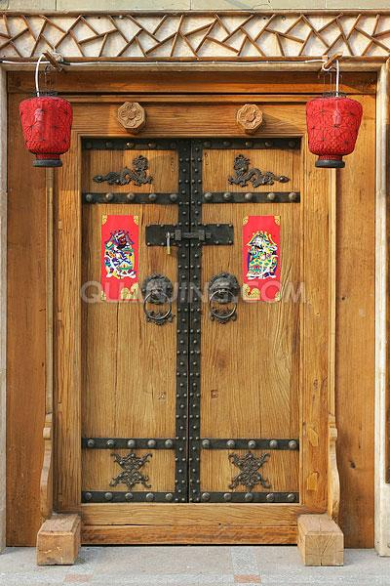
4. mén door
门

Slide 19
5.dì younger brother
弟

Slide 20
6. qù go
去

Slide 21
复习
Vertical Rising
Vertical Turning
Horizontal Turning
with a Hook
Vertical and
Redoubled Turnig
Left-falling Turning

Slide 22
6.横折提 héngzhétí Horizontal Turning with Rising Stroke
A horizontal turning with rising stroke begins with a very short horizontal stroke, then turns down and rises up to the right. The stroke should be completed without being broken.
语 认 说 讶

Slide 23
7.横撇弯钩 héngpiěwāngōu Horizontal with a Left Falling and a Curve
As the name implies, a horizontal with a left falling and a curve begins with a very short horizontal stroke that is followed by a left falling and a curve. The whole stroke should be completed without being broken.
那 娜 阳 阴

Slide 24
8.横折折撇 héngzhézhépiě Horizontal and Redoubled Turning
with a Left Falling
A horizontal and redoubled turning with a left falling can be formed by writting a short horizontal and redoubled turning, and ending with a left falling.
这 进 选 还

Slide 25
9.横折折折钩 héngzhézhézhé gōu
Horizontal and Redoubled Turning with a Hook to the Left
A horizontal and redoubled turning with a hook to the left begins with a short level stroke, then turns to the lower left, and repeats in the same manner, ends up with a hook to the left. However zigzag it may be, the stroke cannot be broken anywhere.
奶 扔 仍

Slide 26
学写汉字

Slide 27
1.yǔ language
语

Slide 28
2.nà that
那

Slide 29
3.zhè this
这

Slide 30
4.nǎi milk
奶

Slide 31
复习
你多才cái多艺yì，是shì个gè多面miàn手shǒu。
大大小小、多多少少，样样yàng都dōu能néng干gàn。

Slide 32
作业
1. 练习本节课所学的笔画
2. 按顺序书写本节课所学的汉字

Slide 33
点击添加文本
标题
标题
点击添加文本
点击添加标题
点击添加文本
标题
标题
点击添加文本
点击添加文本
标题
标题
点击添加文本

Slide 34
点击添加标题
点击添加标题
点击输入文本
点击添加文本
点击添加文本
点击添加文本
添加文本
添加文本
添加文本
添加文本
添加文本

