Slide 1
College of International Education
Jinzhou Medical University
汉 字 书 写 7
汉 字 书 写
Annie

Slide 2
复习
Review
形声字
Pictophonetic Characters
The writing of new characters
汉字的书写

Slide 3
开、方、中、本、卖
太、片、入、人、买

Slide 4
_
形声字
Pictophonetic Characters
和字的意思有关的偏旁叫做形旁，和字的发音有关的偏旁叫做声旁。
由声旁和形旁组成的字，就是形声字。
A type most of the Chinese characters belong to,are compound characters with two components:the idea component,indicative of general meaning,and the sound component,indicative of the general sound.

Slide 5
_
汉字的偏旁
The Radicals of Chinese Characters
古代称合体字的左边为偏，右边为旁。现在，合体字的上下、左右、内外统称为偏旁。例如：“星”字的偏旁是“日”和“生”，“的”字的偏旁是“白”和“勺”。多数偏旁本身就是独立成字的，例如“日、口、目”等。
In terms of the traditional Chinese phiology the left side of a character is knowns as 偏，and the right side of a character is known as 旁.Now we use 偏旁（radical) to mean the side components (left,right,upper,lower,inside and outside) of all characters.

Slide 6
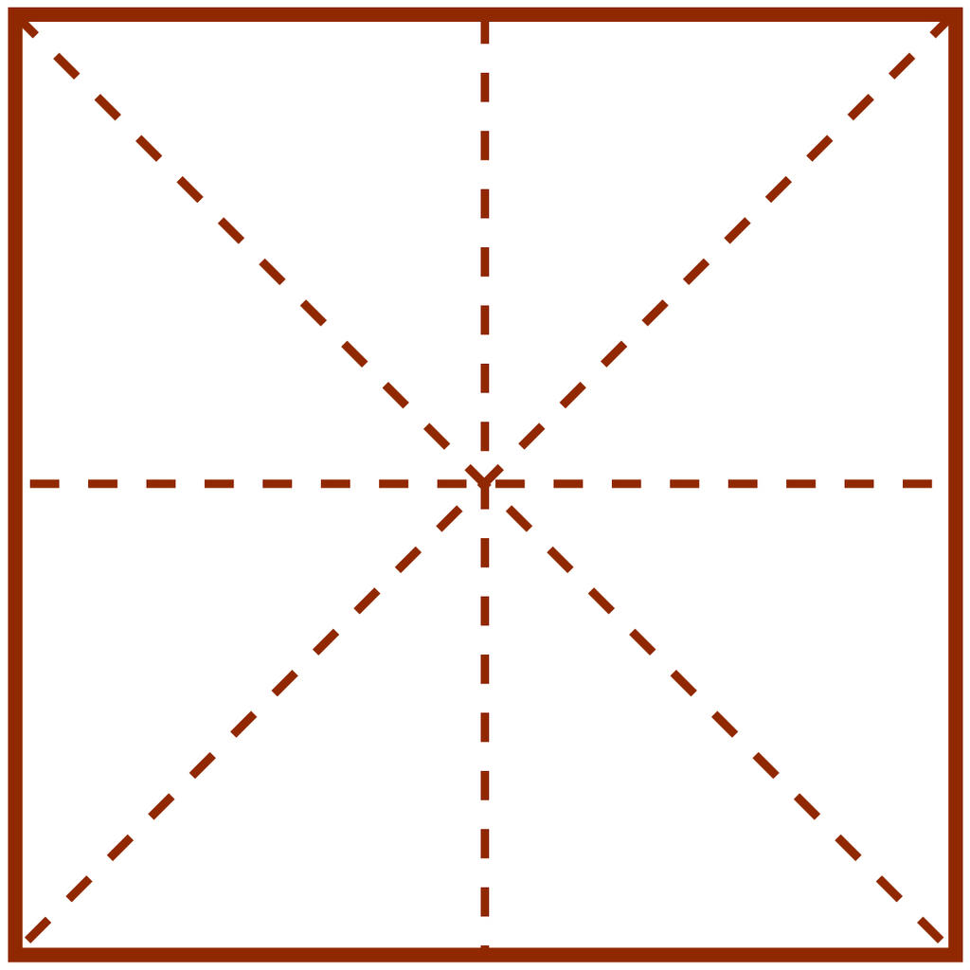
_
zuǒ zhōng yòu
左
中
右

Slide 7
_
shàng xià
上
下

Slide 8
_
1.The radical of “口”
“口”is relevant to a mouth or its function.It often appears as the left side of a character,but may also be upper or lower component of a character.

Slide 9
_
1 | 2
吗
吧
呢
ma ba ne

Slide 10
_
1 | 2
1 | 2
 | 3
咖
啡
喝
kā fēi hē

Slide 11
_
1
2
1 | 2
 | 3
号
告
唱
hào gào chàng

Slide 12
_
2.The radical of “日”
“日”is generally relevant to the sun,time,rays or light.It appears on the left of a character,but sometimes may be on the top or bottom of a character.

Slide 13
_
1
2
1 | 2
早
晚
明
zǎo wǎn míng

Slide 14
_
1
2
1 | 2
昨
星
zuó xīng

Slide 15
_
3.The radical of “目”
“目”is related to eyes or vision.It may be used as a left component of a character,but occasionally as a lower component of it.

Slide 16
_
1 | 2
眼
睛
yan jing

Slide 17
_
1
1 | 2
2
看
睡
kan shui

Slide 18
_
4.The radical of “木”
“目”is related to eyes or vision.It may be used as a left component of a character,but occasionally as a lower component of it.

Slide 19
_
1
2
1 | 2
1 | 2 | 3
椅
树
桌
yǐ shù zhuō

Slide 20
_
1 | 2
3
1 | 2
3
1 | 2
集
楼
桔
jí lóu jú

Slide 21
_
Read the Following Sentences.
1.A:你叫什么名字？
B:我叫……
2.A:你喝咖啡吗？
B:谢谢，我喝茶。
3.A:今天星期几？
B:今天星期五。
4.教室里有桌子和椅子。

Slide 22
_
作业 homework
复习汉字的笔画

Slide 23
_
下课，再见！

