Slide 1
Chapter 4
Chinese Traditional Art
中国传统艺术

Slide 2
Chinese Traditional Music

Slide 3
The brief history of music
Confician thinking considers that music and rituals are inseperable.During the performance of rituals music play the important role of setting the tone and emotion of the occasion.

Slide 4
Chinese classical music is the traditional art or court music of China.It has a long history stretching for more than three thousand years.It has its own unique systems of musical notation,as well as musical tuning and pitch,musical instruments and styles or musical genres.

Slide 5
Pentatonic Scale
Gong Shang Jue Zhi Yu
宫 商 角 徵 羽
五
声
音
阶

Slide 6
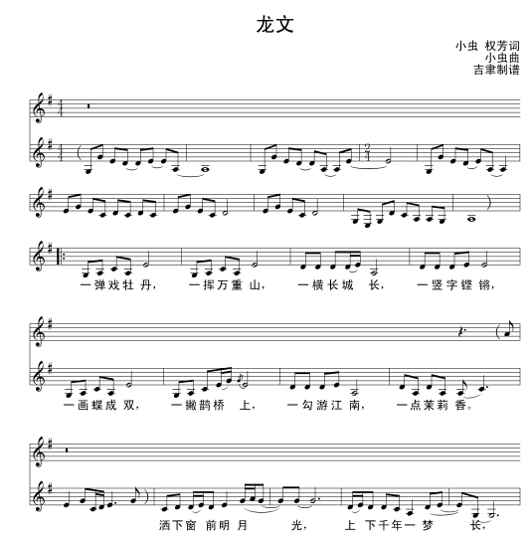
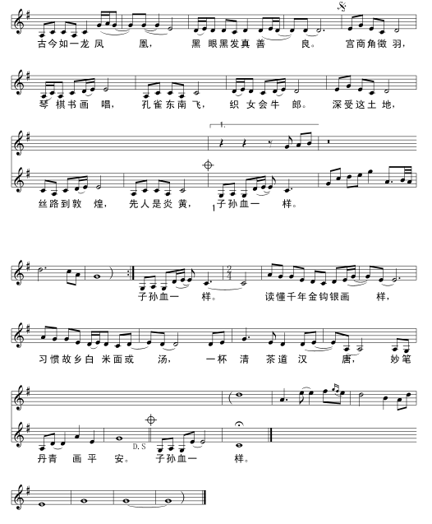

Slide 7
Chinese Music Instruments
Chinese music instruments can be categorized into eight classes by the materials they are made form.
There are eight kinds of materials: metal, stone, clay,leather, silk,wood,bottle-gourd and bamboo.

Slide 8
There is reed and gourd to make Sheng,bamboo to make Xiao(panpipes),wood to make Chu,silk to make Guzheng,clay to make Xun,metal to make Bell,stone to make Sonorous stone,and skin to make Drum.

Slide 9
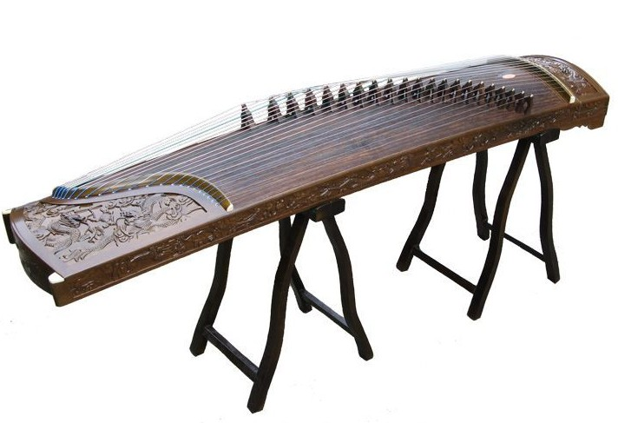
Guzheng-Made by silk,a traditional Chinese musical instrument.It belongs to the zither family of string instruments.

Slide 11
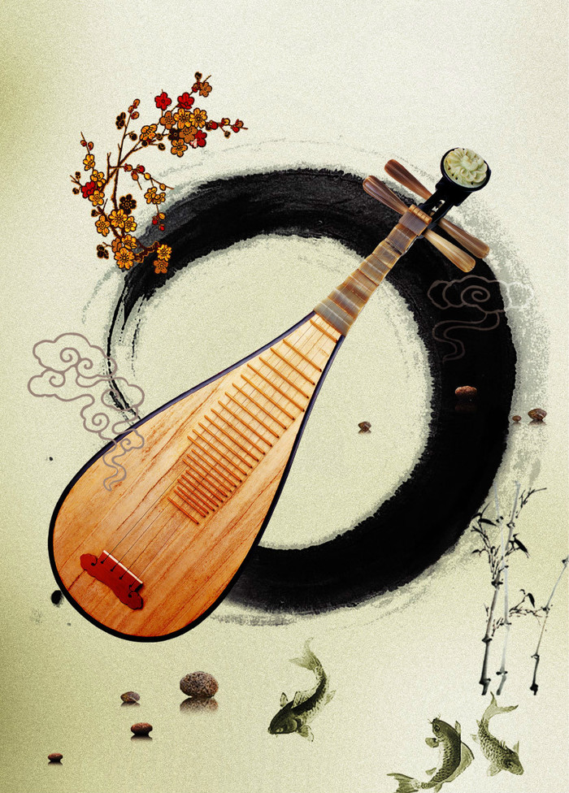
The pipa-is a plucked Chinese string instrument.
The instrument has a pear-shaped wooden body.It has been player for nearly two thousand years of history in China.

Slide 12
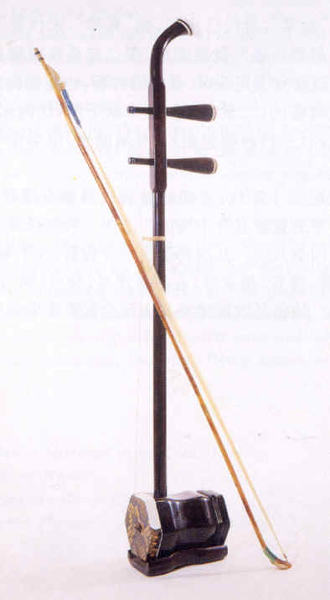
Erhu
It is suitable for the performance of the content of deep sorrow

Slide 13
Drum: made by skin

Slide 14
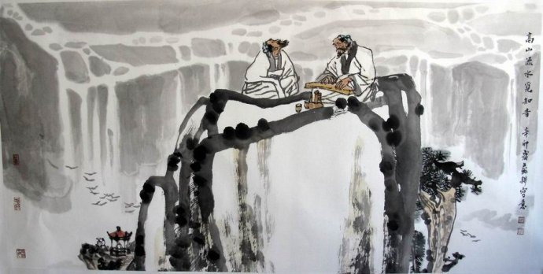
High Mountain and Flowing streams

Slide 15
High Mountain and Flowing streams
It is a gem in the treasure trove of Chinese music.From this name,you can imagine a harmonious picture with green mountains surrounding you and clear streams quietly passing by your feet.The music is played by Chinese zither.It is slow and quiet,sometimes with rhythm and beats like the flowing water.It is a song in praise of the life-long friendship between Yu Boya and Zhong Ziqi.The message is that it is not easy for one to find a true friend who can share everything and understand every feeling of the other.

Slide 16
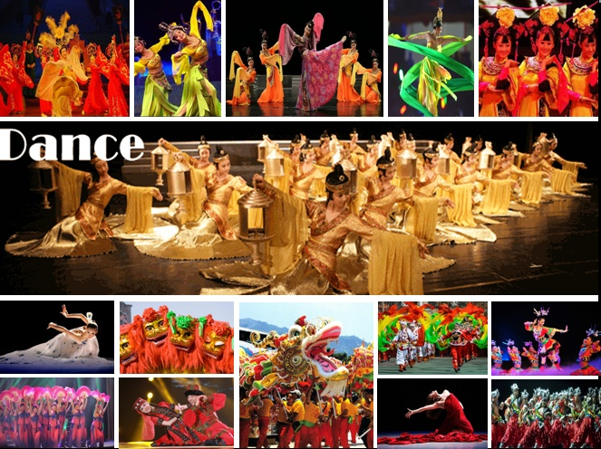
Chinese

Slide 17
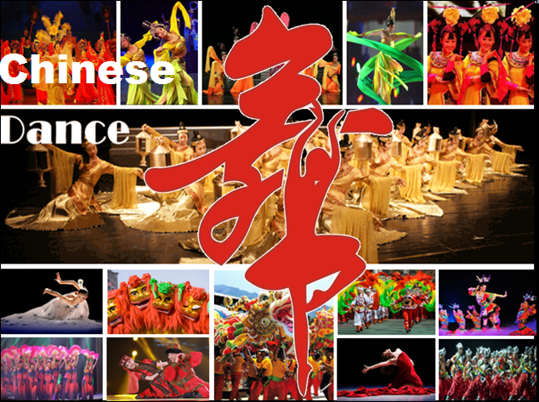

Slide 18
The History of the Chinese Dance.
Chinese Dance
Folk Dance
The Dragon Dance
The Lion Dance
The Fan Dance
Yangge
Ethnic Minority Folk Dance

Slide 19
Dance is one of the ritual entertainments refined by the aristocratic class and was also employed in sacrificial ceremonies inseparable from music,thus playing an important role in society and daily life.

Slide 20
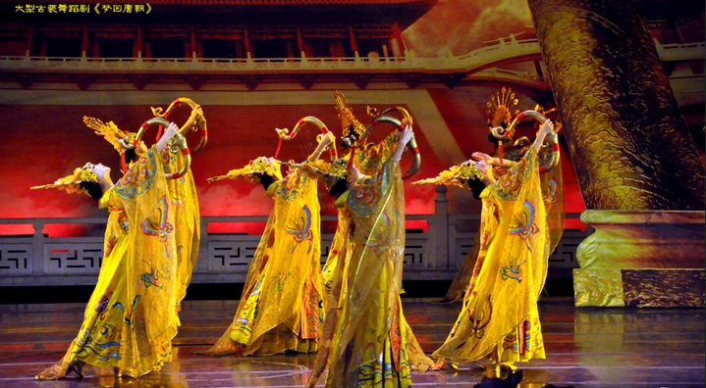
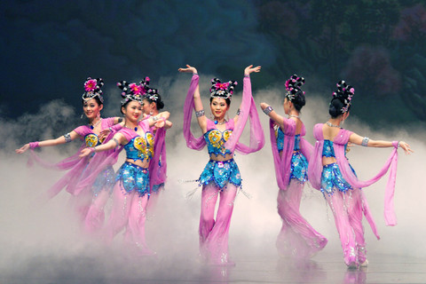
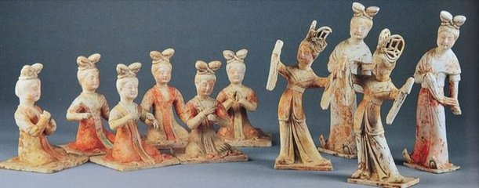
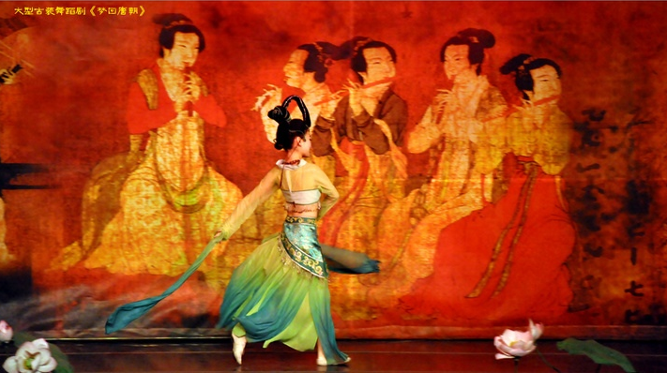
Tang Dynasty
The Tang dynasty was the golden age of Chinese dance and a high point in dance accompanied by music.At that time ,the emperor Tangxuanzong(685-762)of the Tang established two dance academies in Chang'an and Luoyang to train dancers for the court.

Slide 21
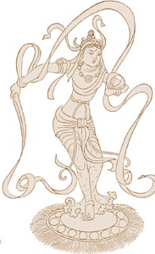
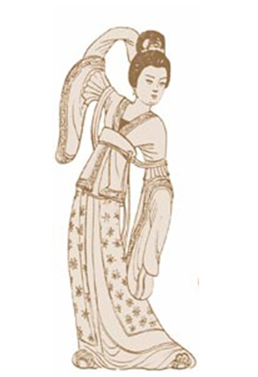
Tang Dynasty
energetic dance
soft dance

Slide 22
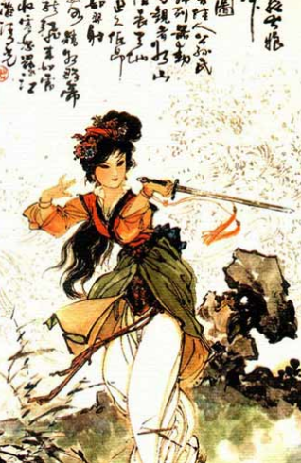
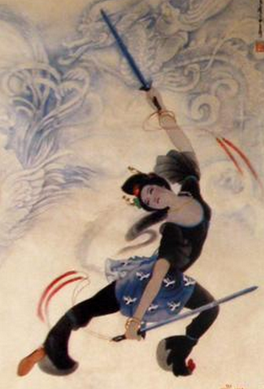
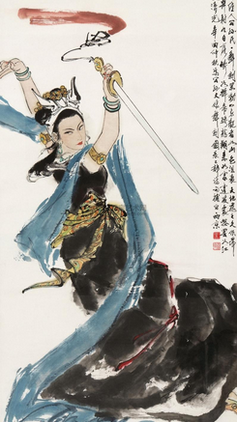
Tang Dynasty
energetic dance ---- vigorous

Slide 23
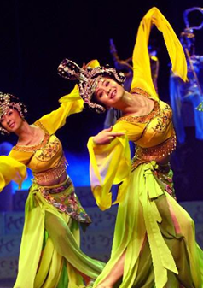
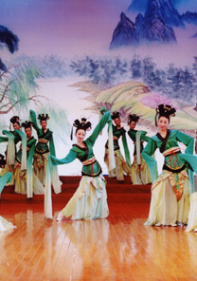
Tang Dynasty
soft dance ----gentle and graceful

Slide 24
Folk Dance

Slide 25
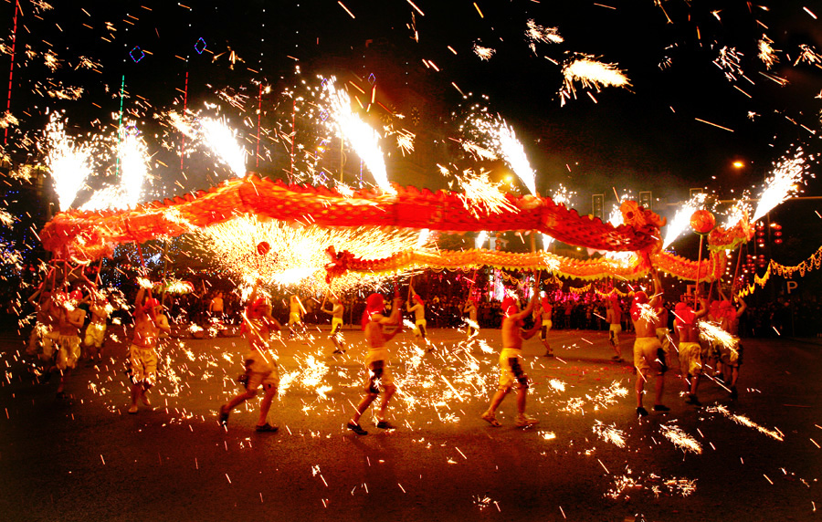
The Dragon Dance
The Dragon Dance originated from the Han Dynasty (206 BC - 24 AD)

Slide 26
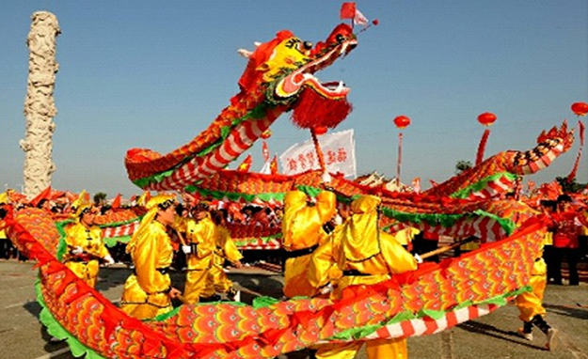
The Dragon Dance
Dragons can bring luck to people. The longer the creature is, the more luck it will bring. Especially if someone touched by the dragon, and even better if touched by a Golden Dragon, good fortune and prosperity will be coming up in the year.

Slide 27
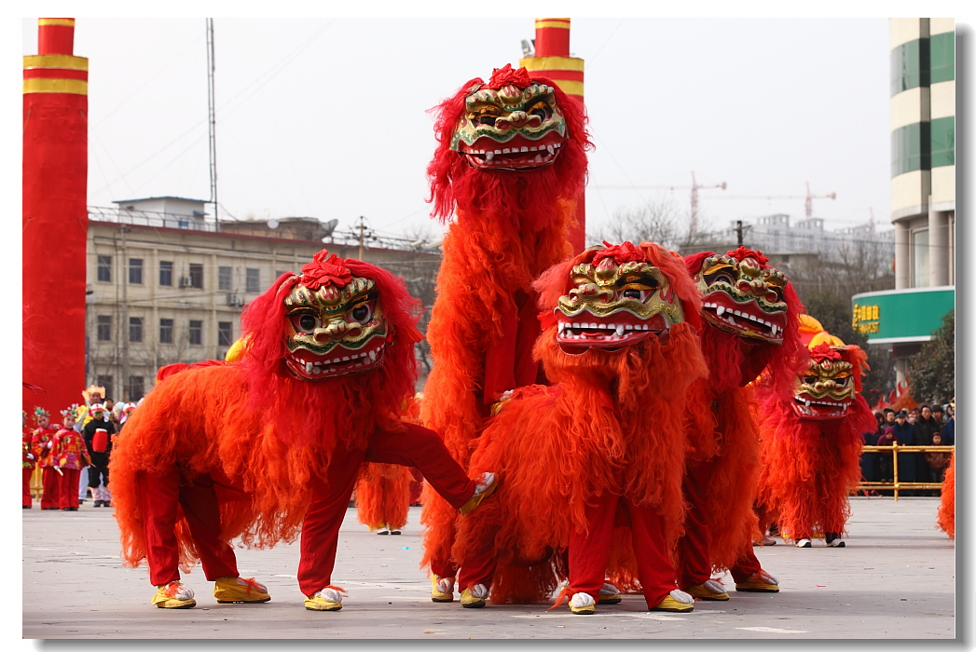
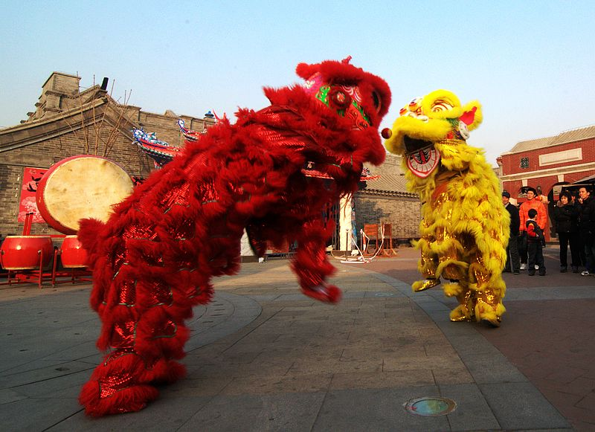
The Lion Dance

Slide 28
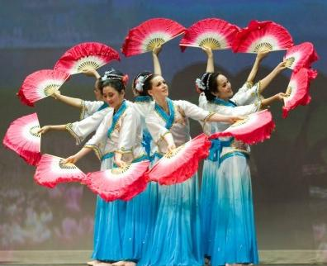
The Fan Dance
The origins of the fan dance are rooted in the Han Dynasty, which dates to around 200 AD .

Slide 29
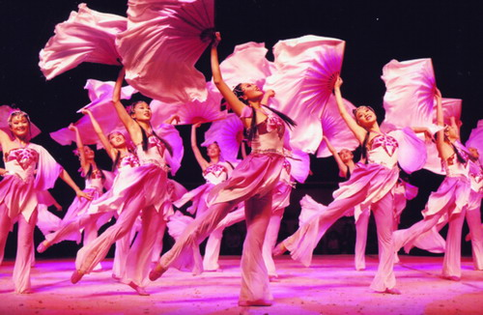
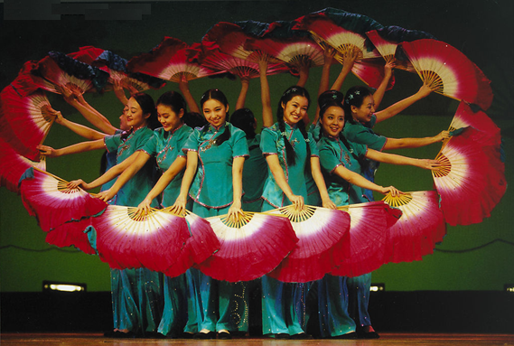
The Fan Dance

Slide 30
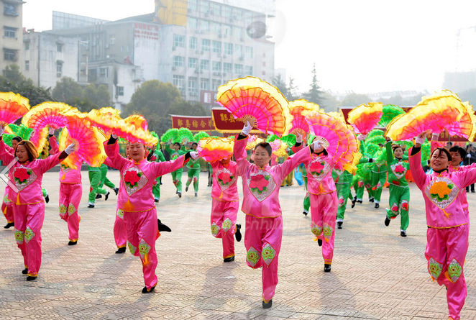
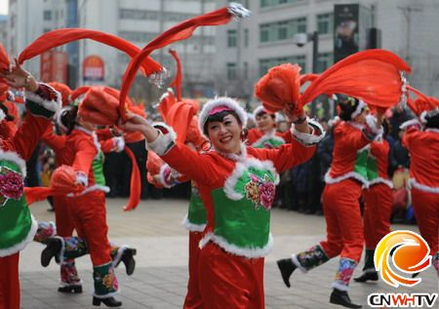
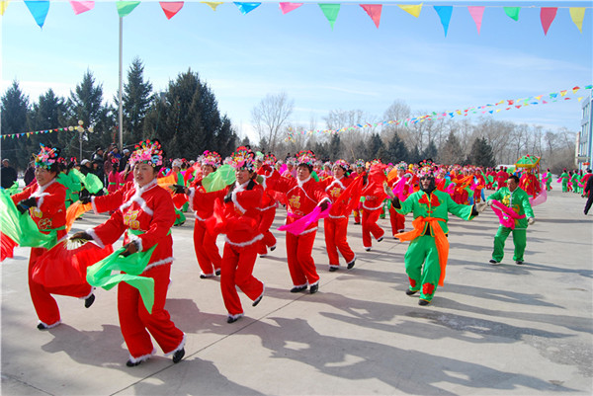
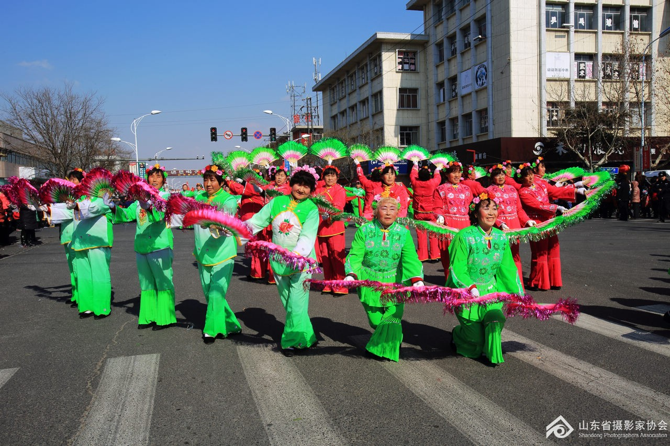
Yangge

Slide 31
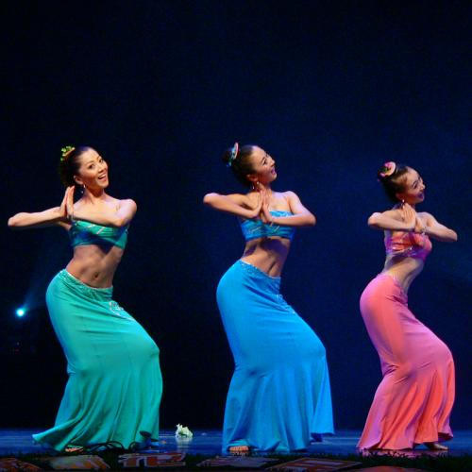
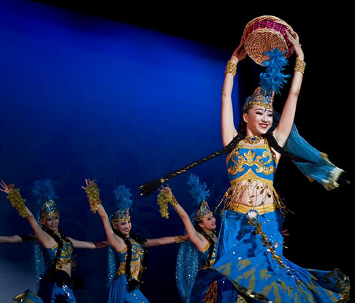
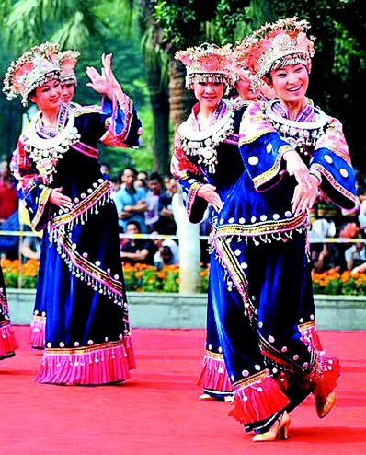
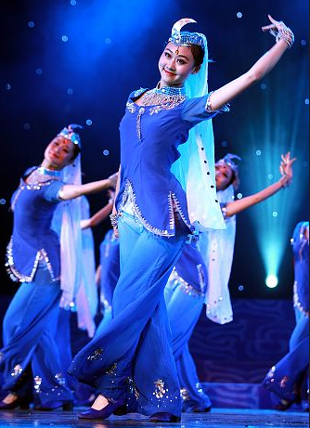
Ethnic Minority Folk Dance

Slide 33
With the development of the times, people are no longer confined to singing and dancing, a narrative art gradually formed

Slide 34
Chinese Quyi

Slide 35
The definition of Chinese Quyi
Quyi, also know as folk art of rap, is a kind of rap art which performs by narrating stories. It's the synthesis of literature, music and performing.

Slide 36
Main Types of Quyi
Only by speaking
Only by singing
Speaking while singing
Speaking, singing with dancing

Slide 37
Cross Talk

Slide 38
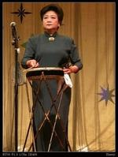
Story-telling in Beijing dialect
with drum accompaniment
京韵大鼓（Jing Yun Da Gu）

Slide 39
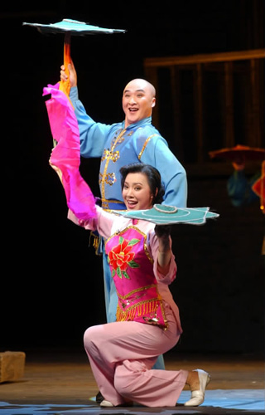
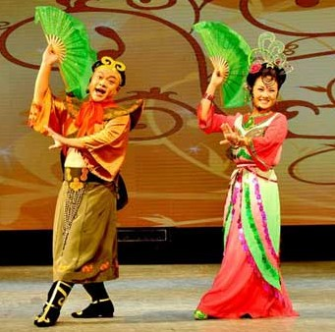
A Stage Scene of Errenzhuan

Slide 40
Introduction
A stage scene of Errenzhuan
Northeast Errenzhuan is a form of duet, also known as Bengbeng. It originated in Northeast China's Liaoning, Jilin and Heilongiiang provinces. It is a form of Quyi that involves storytelling, singing and dancing, between two performers. Bengbeng has a history of 200 years and its script is written in popular language that is easy to understand, humorous, and rich in local life style and flavor.

Slide 41
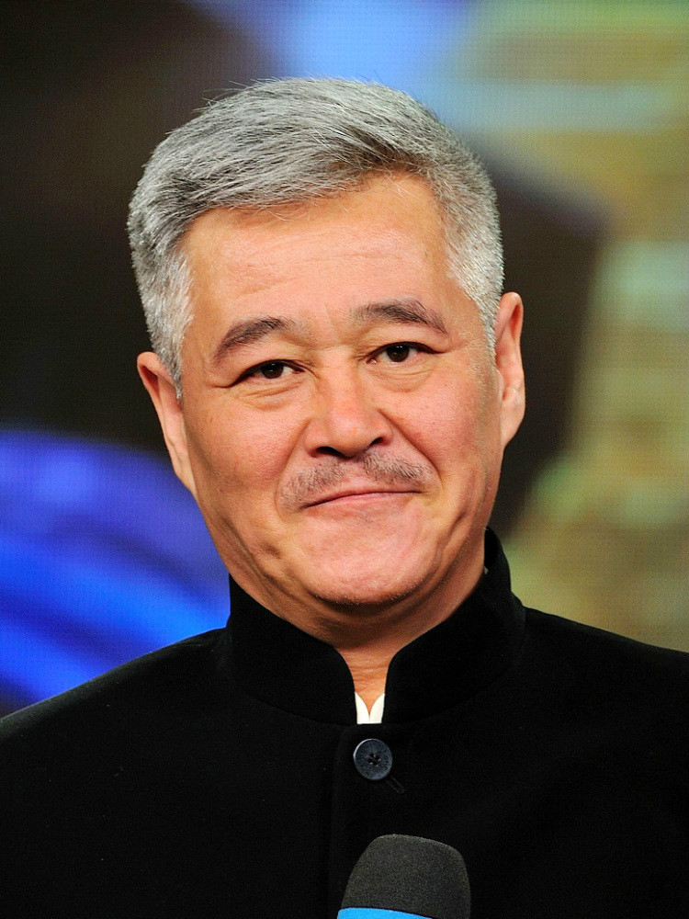
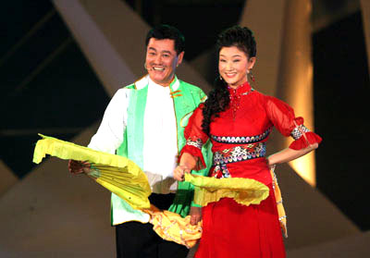
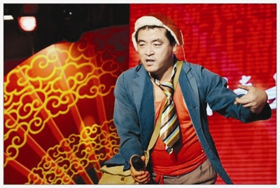
Famous actors
A stage scene of Errenzhuan
魏三 Weisan
Zhao Benshan
赵本山

Slide 42
Beijing opera

Slide 43
There are many kinds of opera, but Beijing Opera is the most representative.

Slide 44
Four basic skills
Singing 唱
Dialogue 念
Acting 做
Martial arts 打

Slide 45
Four male roles
Sheng (Male role，生)
Dan (Female role，旦)
Jing (Painted face male role，净)
Chou (Clown role，丑)

Slide 46
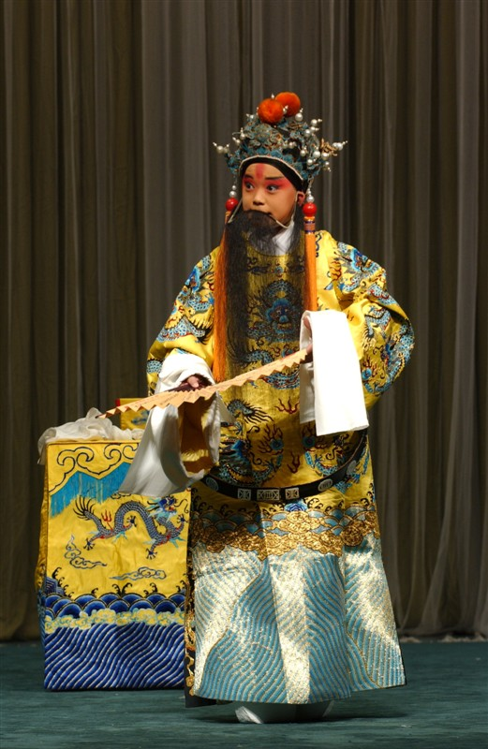
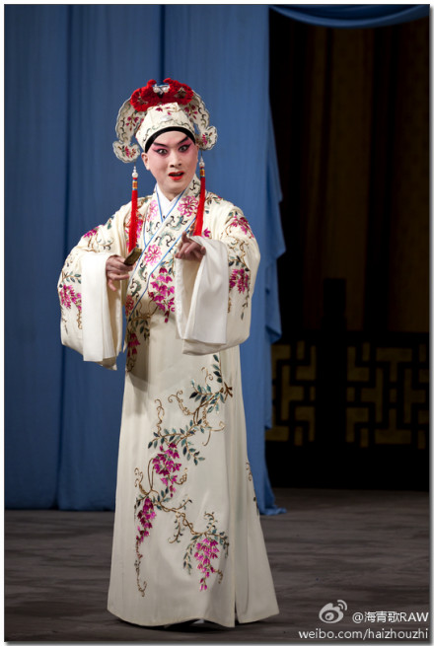
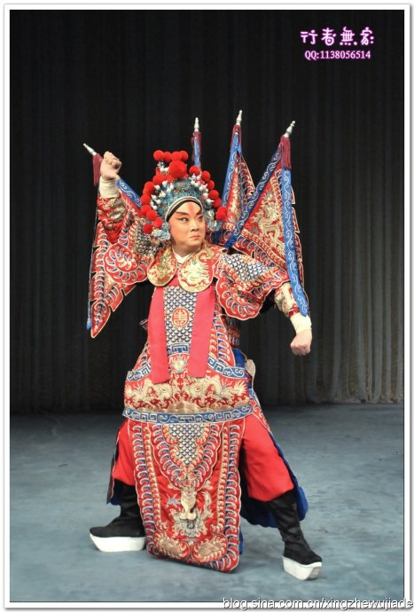
Sheng (Male role，生)
Sheng ,in Chinese may mean “strang”or “rare”,but the chief male role is a well known character.

Slide 47
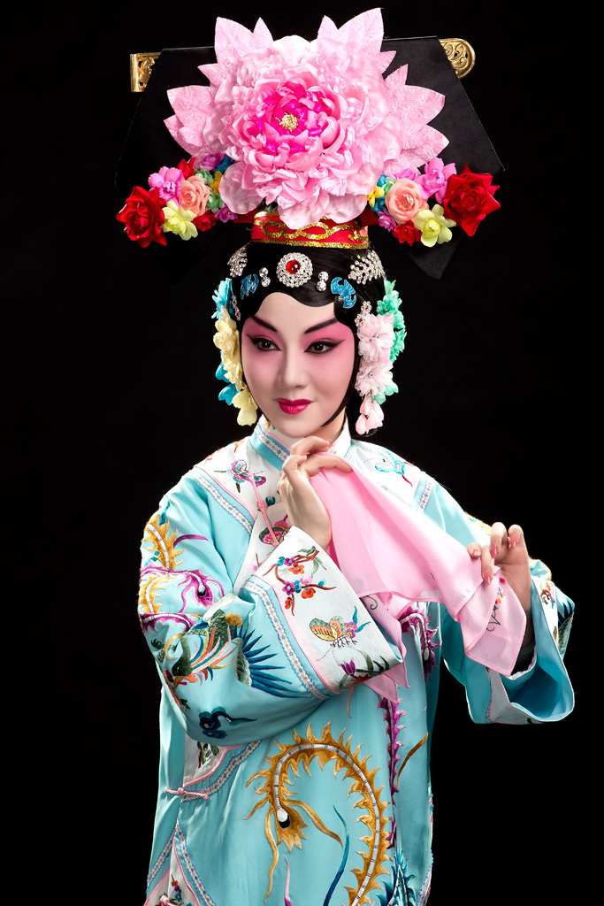
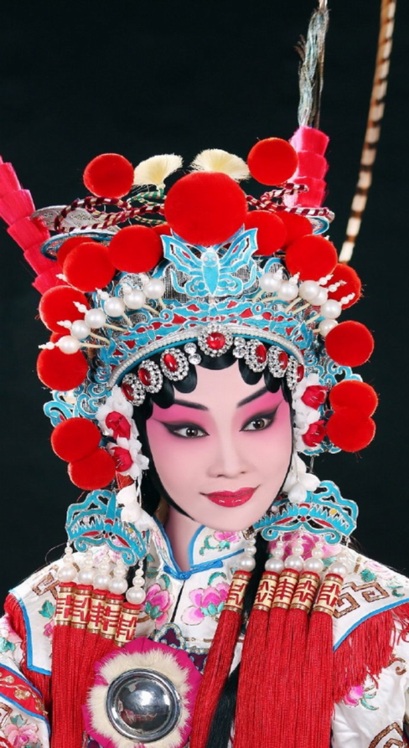
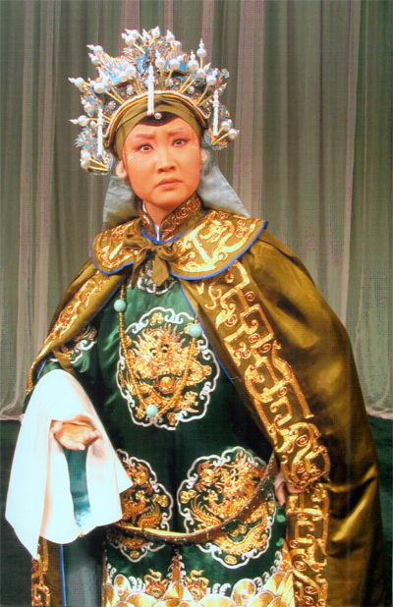
Dan (Female role，旦)
Dan,which means “morning”or “masculine”,is contrary to the feminine nature of the characters.

Slide 48
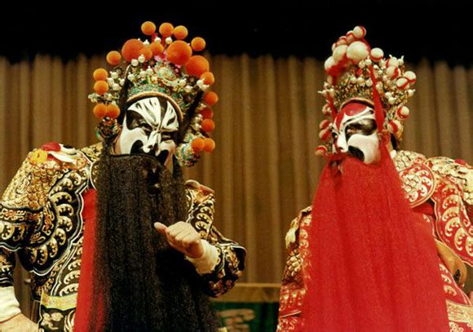
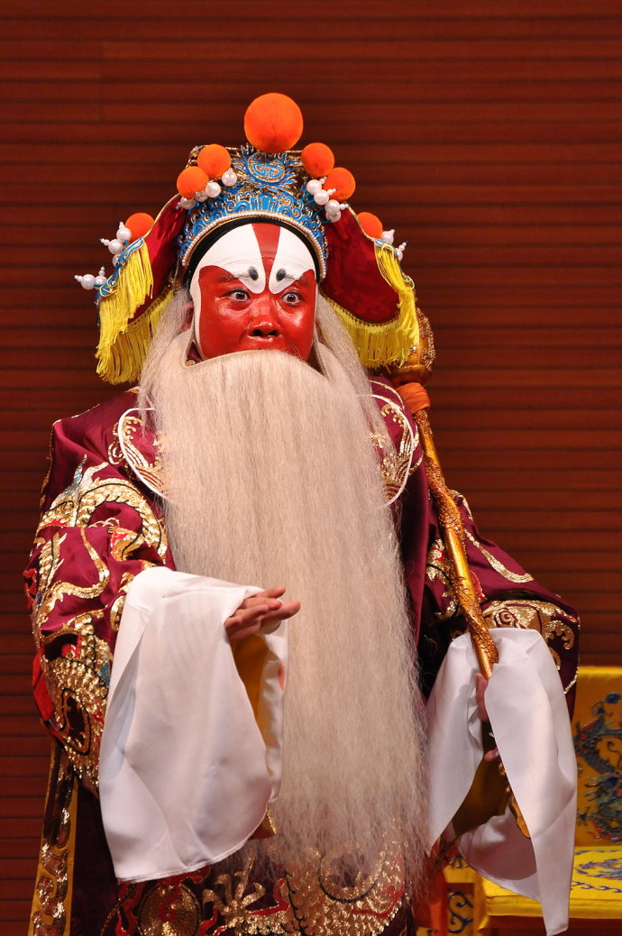
Jing (Painted face male role，净)
Jing,means “clean”,but in fact the paintings on their faces make the characters look unclean but colorful.

Slide 49
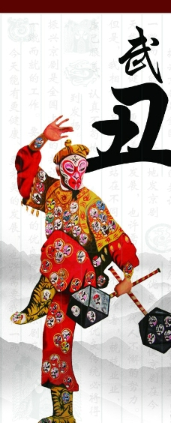
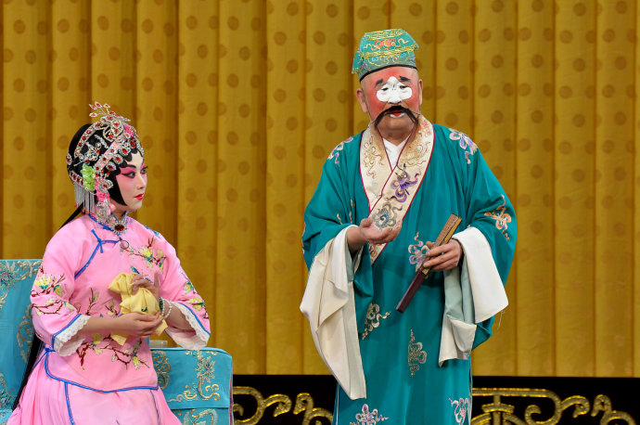
Chou (Clown role，丑)
The feature of chou characters are simliar with clown in western drama,they are usually quick and talkative.

Slide 50
Types of facial makeup

Slide 51
Beijing opera types of facial makeup in operas,is a special feature of a national cosmetic.As each historical figure or a certain type of person has an approximate spectral type,like sing,play music to the music,so called “types of facial makeup in operas”.On the types of facial makeup in operas sources,the general view is from mask.

Slide 52
Color of types facial makeup in opera
Red faces have positive meanings,symbolizing loyal,brave,faithful and wise men.such as Guan Yu.

Slide 53
Black, usually have neutral meanings,symbolizing just brave,criticized integrity and ever reckless,however,they can also represent uprightness.

Slide 54
Yellow, tapes of facial makeup in operas symbolize vicious brutality.

Slide 55
Blue or green have neutral meanings that symbolize the hero of the bush,with the former also hinting at strength and intrepidity.

Slide 56
White faces have negative meanings that symbolize treacherous,insidious and crafty men.

Slide 57
Purple is a positive color,which signifies wisdom and bravery.

Slide 58
The four famous artisits

Slide 59
There are many famous masters who are good at performing Beijing Opera.
Among them,the Four Famous Dans-Mei Lanfang,Cheng Yanqiu,Shang Xiaoyun and Xun Huisheng are the most well-known at home and abroad.

Slide 60
They are experts in performing the role of Dan and each has his own artist feature.
Their wonderful performances are still appreciated by many audiences.

Slide 61
Mei Lanfang（1894－1961）

Slide 62
Beijing opera contains the soul of Chinese national culture.Its unique charm inspires ethos of Chinese people.
There is no doubt that it is really the treasure of Chinese culture.

